Slide 1



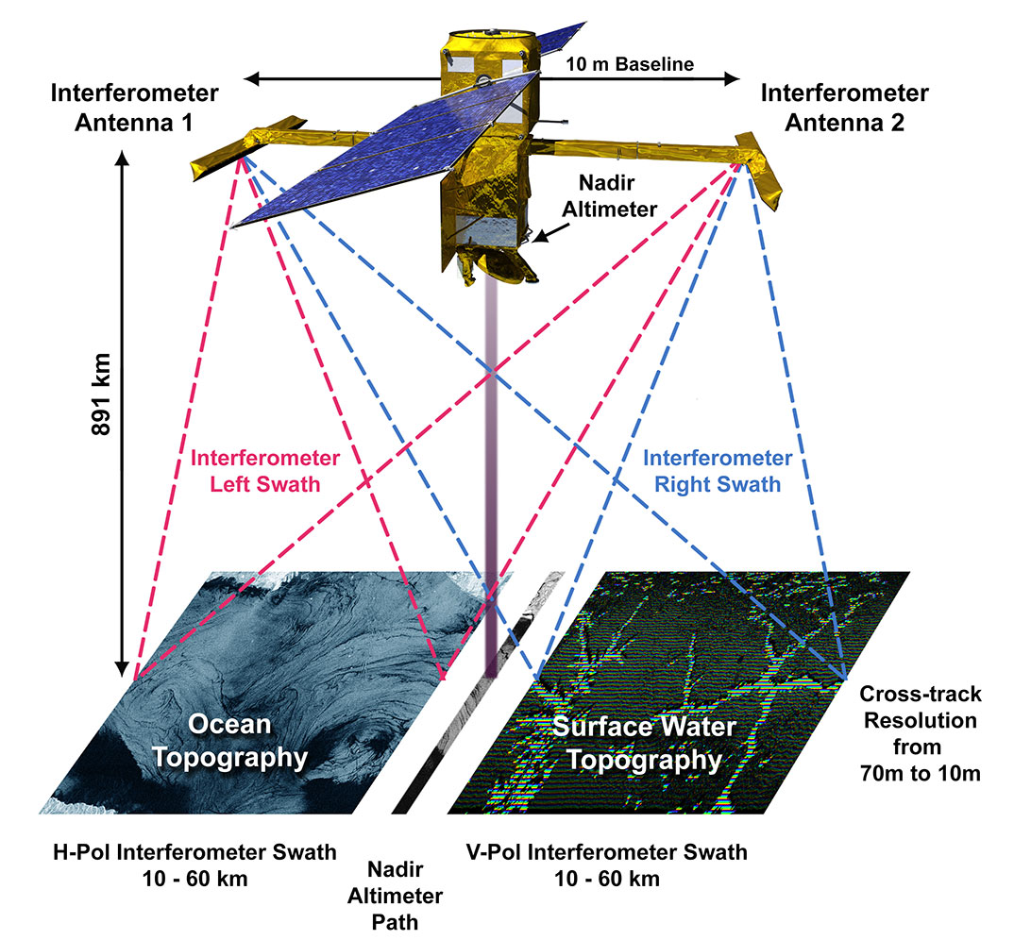
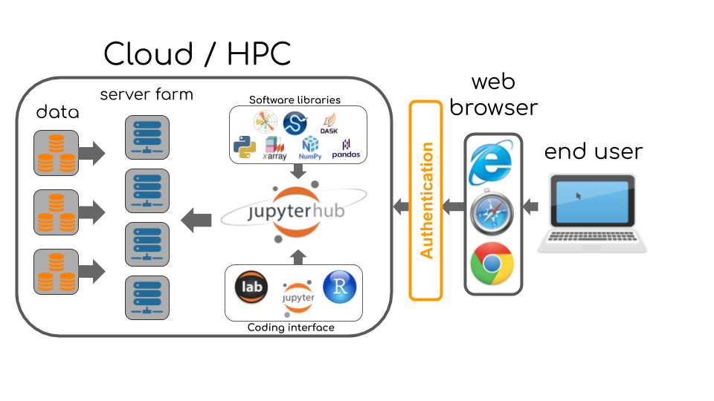
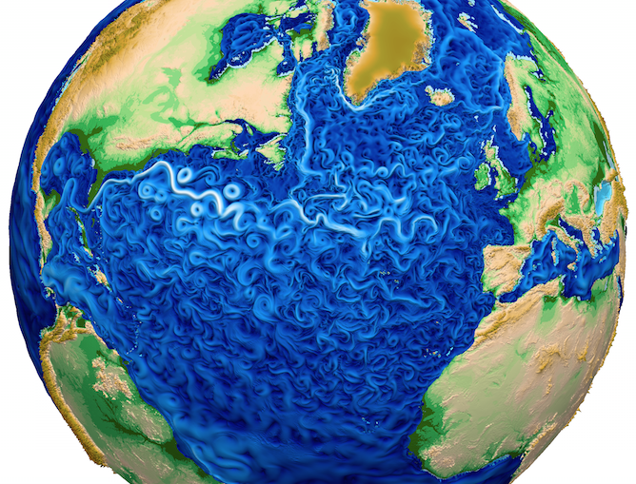
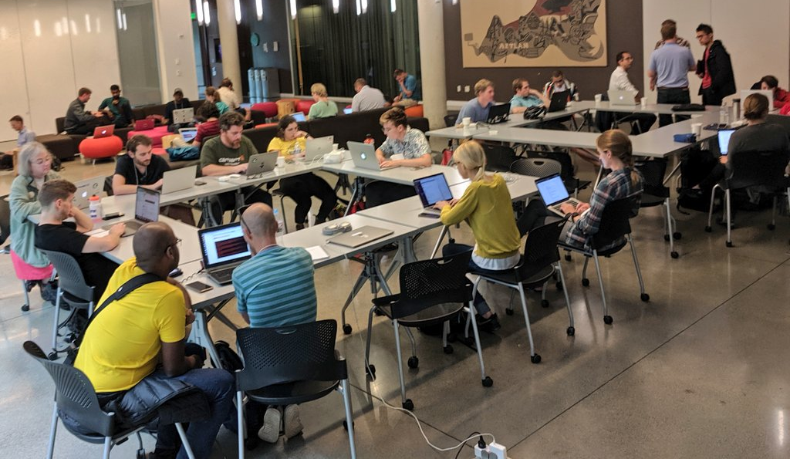



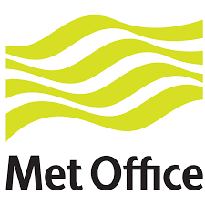



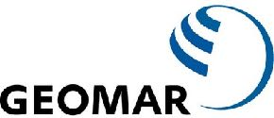
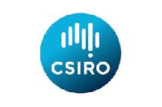



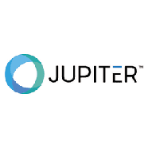




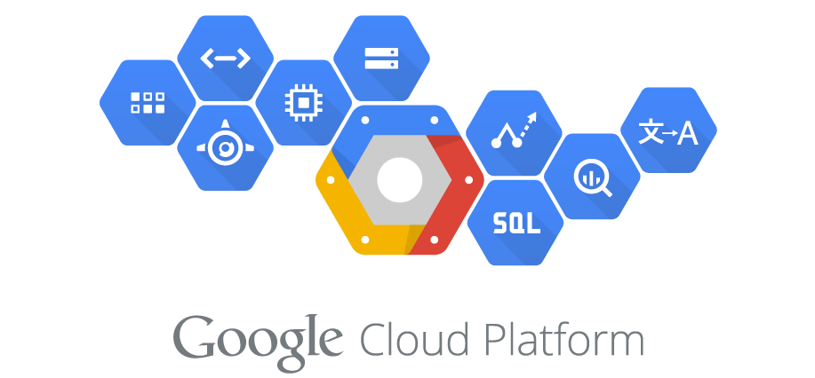
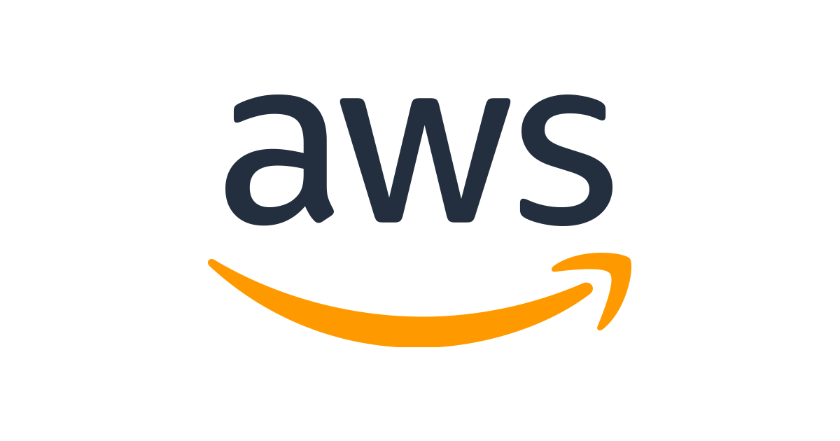
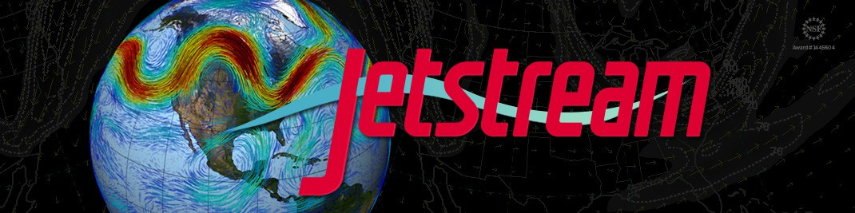

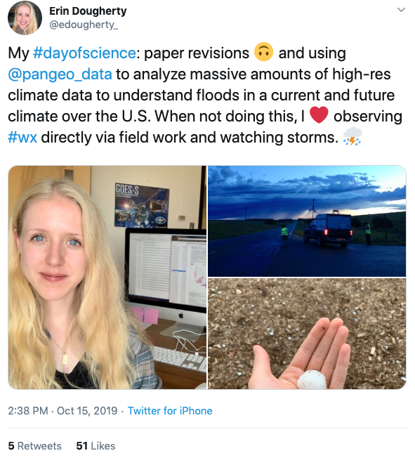


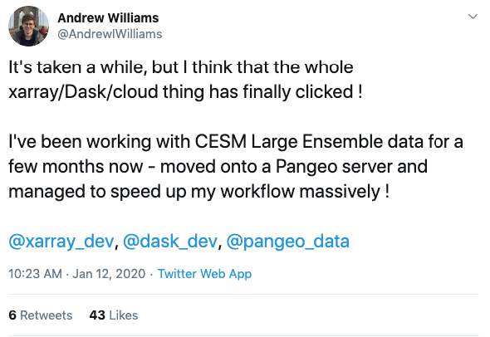
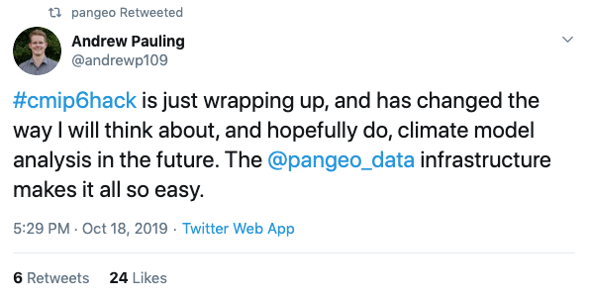
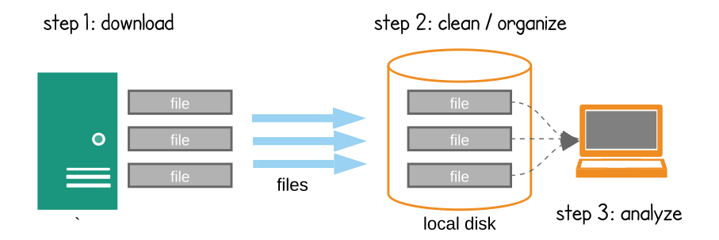
OceanCloud: Transforming Oceanography with a New Approach to Data and Computing
Ryan Abernathey (LDEO), Chelle Gentemann (Farallon Institute), Chiara Lepore (LDEO)
The cycle of progress in oceanography…
OceanCloud is a new vision for data infrastructure…
We have already built the foundation.
New Ideas / Hypotheses
New Observations
An illustration of how data, software, and computers come together on the cloud. An end user can access massive cloud computing resources through a one-click-to-compute computing environment running in a web browser tab, effectively putting a super-computer into any internet-connected device.
http://pangeo.io
Pangeo is an open-science community…
New Simulations
MPAS Ocean Model
NASA SWOT Satellite
Volume of NASA Earth Data
…building open-source big-data science infrastructure compatible with all major cloud platforms.
…is breaking down due to the size and complexity of data.
…with three pillars:
Analysis-ready data shared openly in the cloud
On-demand, scalable distributed processing
Interactive, data-proximate computing, available to anyone
https://earthdata.nasa.gov/eosdis/cloud-evolution
Status quo: The Download Model
Scientists ❤️ Pangeo!
Not scalable
Not reproducible
Barrier to collaboration
Limits creativity
Inefficient / duplicative
Limits inclusion and knowledge transfer
Anticipated Benefits
PB 😱
Faster science, more discoveries
Inherently reproducible
Allows seamless global collaboration
Unleashes creativity
Cost effective
Accessible to all
Connects with industry
Next steps to realize this vision:
Form a consortium (NOPP?) or science team of major ocean data providers and consumers to coordinate disparate efforts.
Fund development of federated cloud data library and computing infrastructure.
Provide access to all and watch the discoveries happen!
Data go under-utilized. Scientists are frustrated.
Let’s make the most of the amazing ocean data we already have!
👏👏👏

