Slide 1

GREAT GLOBAL FISH COUNT
Jesse H. Ausubel, Mark Y. Stoeckle
Program for the Human Environment, The Rockefeller University, New York, New York, USA
Information on species diversity & abundance from DNA in 1 liter of water
is comparable to information from 66 million liters trawled by a net.
Time for the Great Global Fish Count!
66M liters fills football field
above goal posts
1 liter
=
Acknowledgement: Monmouth-Rockefeller Marine Science & Policy Initiative

Slide 2
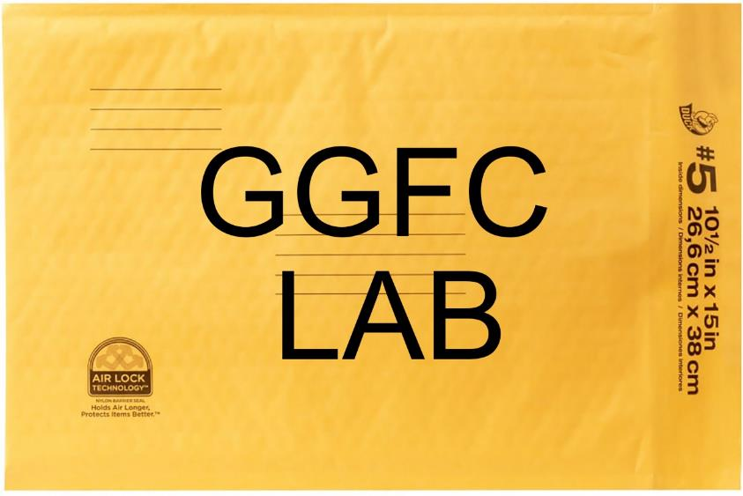
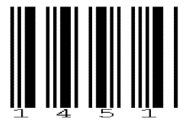
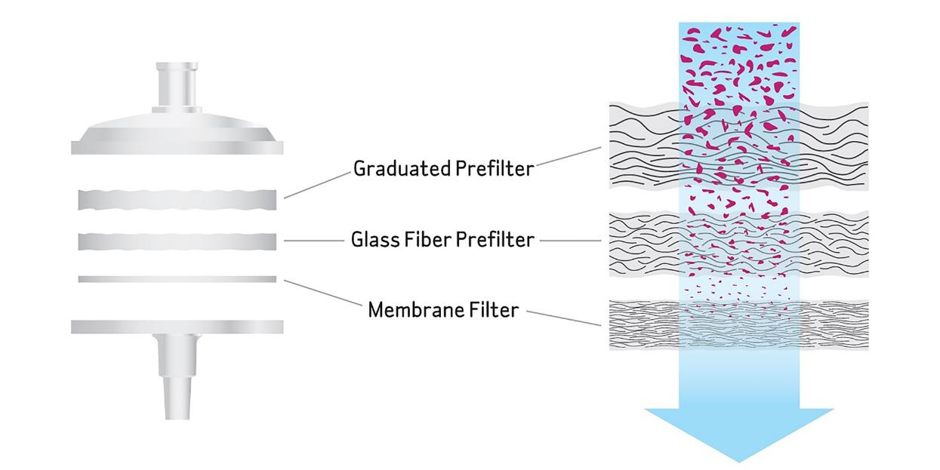

GREAT GLOBAL FISH COUNT
Jesse H. Ausubel, Mark Y. Stoeckle
Program for the Human Environment, The Rockefeller University, New York, New York, USA
The Idea
What’s new:
scale -
millions of samples
Collect water and metadata…filter water…save filter with sediment…email data to app…mail filter to lab

Slide 3
GREAT GLOBAL FISH COUNT
Jesse H. Ausubel, Mark Y. Stoeckle
Program for the Human Environment, The Rockefeller University, New York, New York, USA
The Process
2021: Form small team, raise funds for feasibility phase, draft decadal plan, find lead sponsor to
develop GGFC for approval in Berlin June ’22 as Project or Programme; gain partners
2022: Develop management, governance, brand; develop cost estimates ($100 m at $50 per sample?), make budget, win key funding commitments including in-kind
2023: set standards, protocols, web interface; pilot project; choose tech, order supplies;
2024: Great Global Fish Count (World Ocean Day), pool & analyze data, data into OBIS
2025: Publish findings, maps; hold science conference; global engagement
If successful so far: plan time series and more taxa
2026: Repeat GGFC, consider GGC for other vertebrates, molluscs, crustaceans…
2027, 2028, 2029…repeat, refine, expand…2030 full program evaluation
Partners: In US government, NOPP federal agencies; also state agencies
Nations with largest EEZs (France) and coastlines but all can participate
Suppliers of biotech goods and services; coastal enterprises; drone operators
International organizations: POGO, SCOR, SCAR, ICES, PICES, UN/FAO…
Aquariums and natural history museums; schools; members of environmental NGOs

Slide 4
GREAT GLOBAL FISH COUNT
Jesse H. Ausubel, Mark Y. Stoeckle
Program for the Human Environment, The Rockefeller University, New York, New York, USA
The Outcomes
Adoption of genomics in many organizations and programs
Cheaper, quicker, more reliable eDNA technologies
Useful info for fisheries and aquaculture, harbors, sanctuaries, coastal restoration, e.g., smarter
boundaries for protected areas and identification of new hot or trouble spots
Enhanced marine genomic reference libraries
Entrepreneurial companies and job creation providing eDNA services
Trained people, informed and inspired citizens
Surprises
Easy-to-measure most forms of progress
Can benefit people of all ages, everywhere
No collection of organisms or stress on animals

Slide 5
GREAT GLOBAL FISH COUNT
Jesse H. Ausubel, Mark Y. Stoeckle
Program for the Human Environment, The Rockefeller University, New York, New York, USA
The Ocean Decade: Time for the Great Global Fish Count!!
Concept Paper https://phe.rockefeller.edu/wp-content/uploads/2021/01/GFFC-V2.pdf
Thanks

