Slide 1

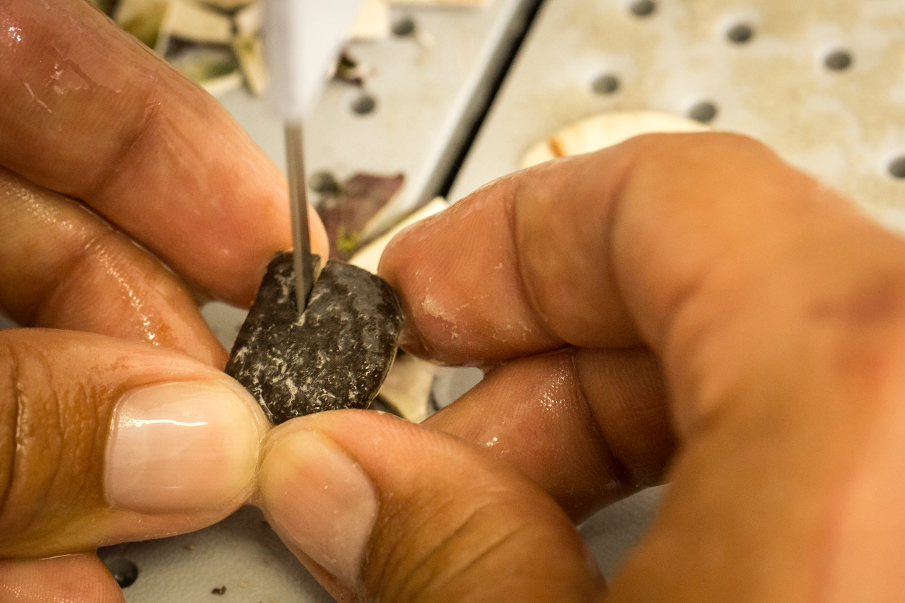
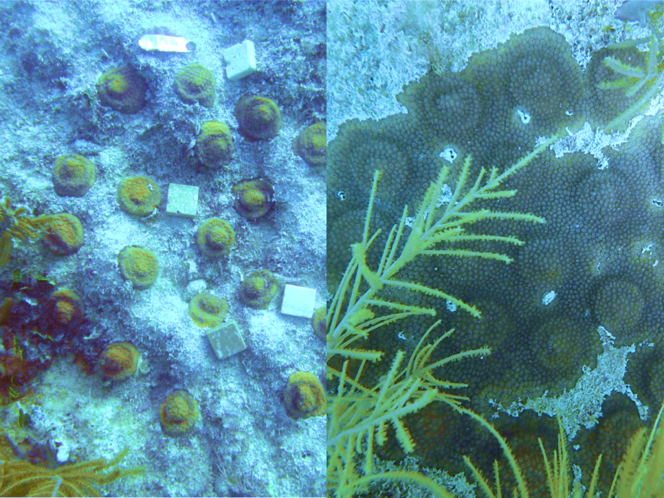
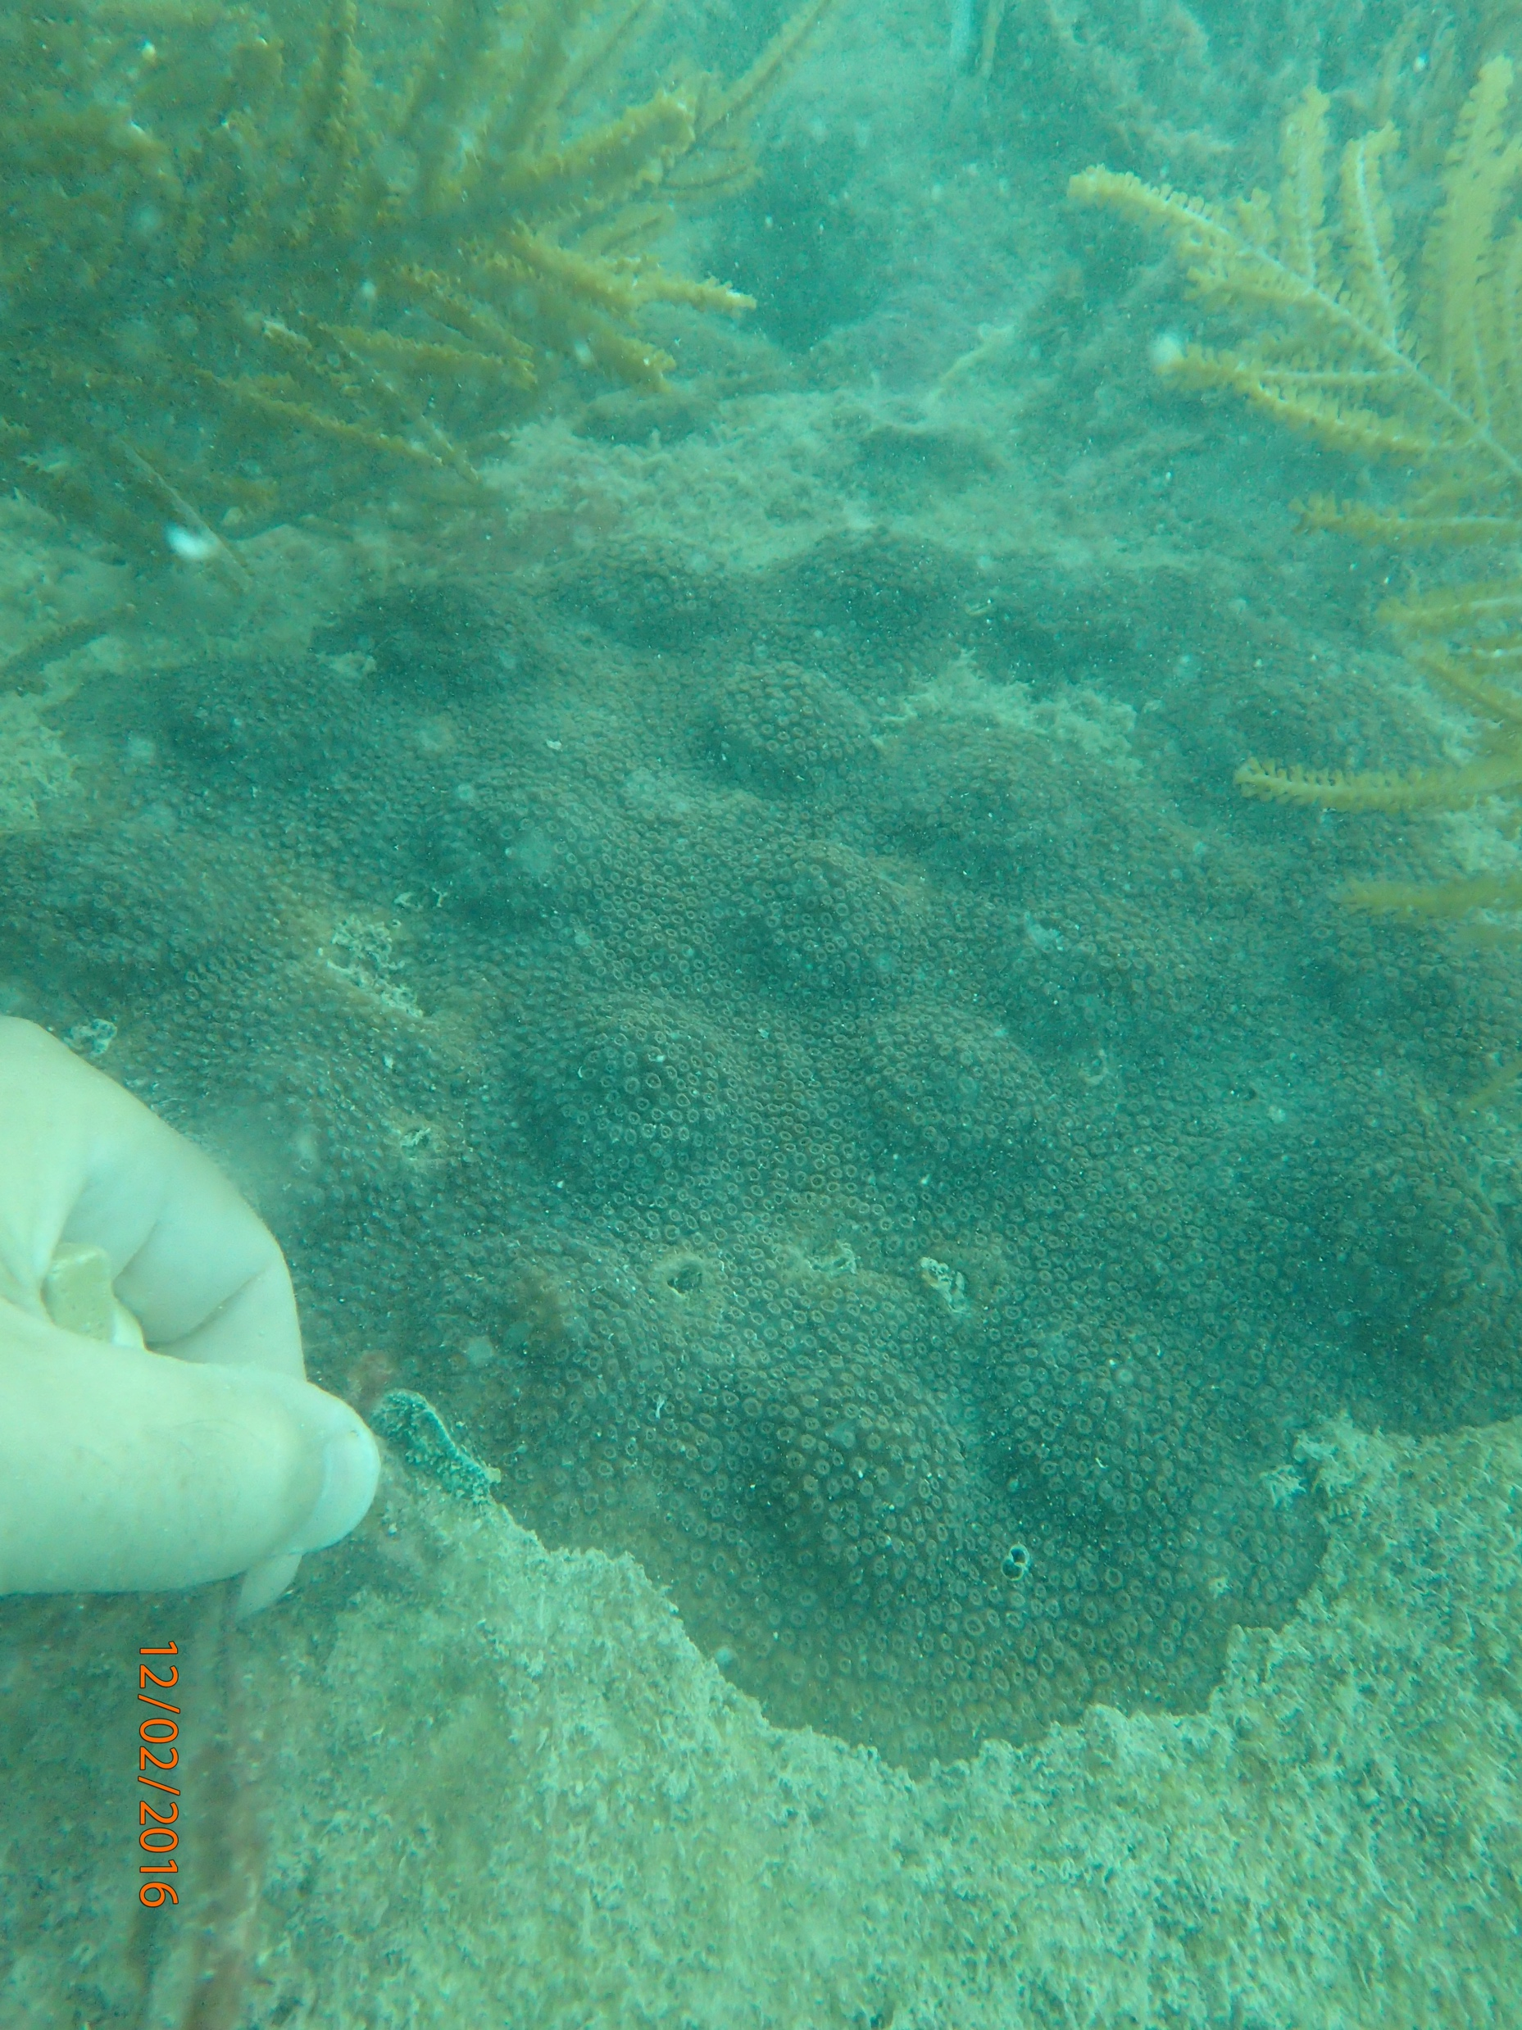
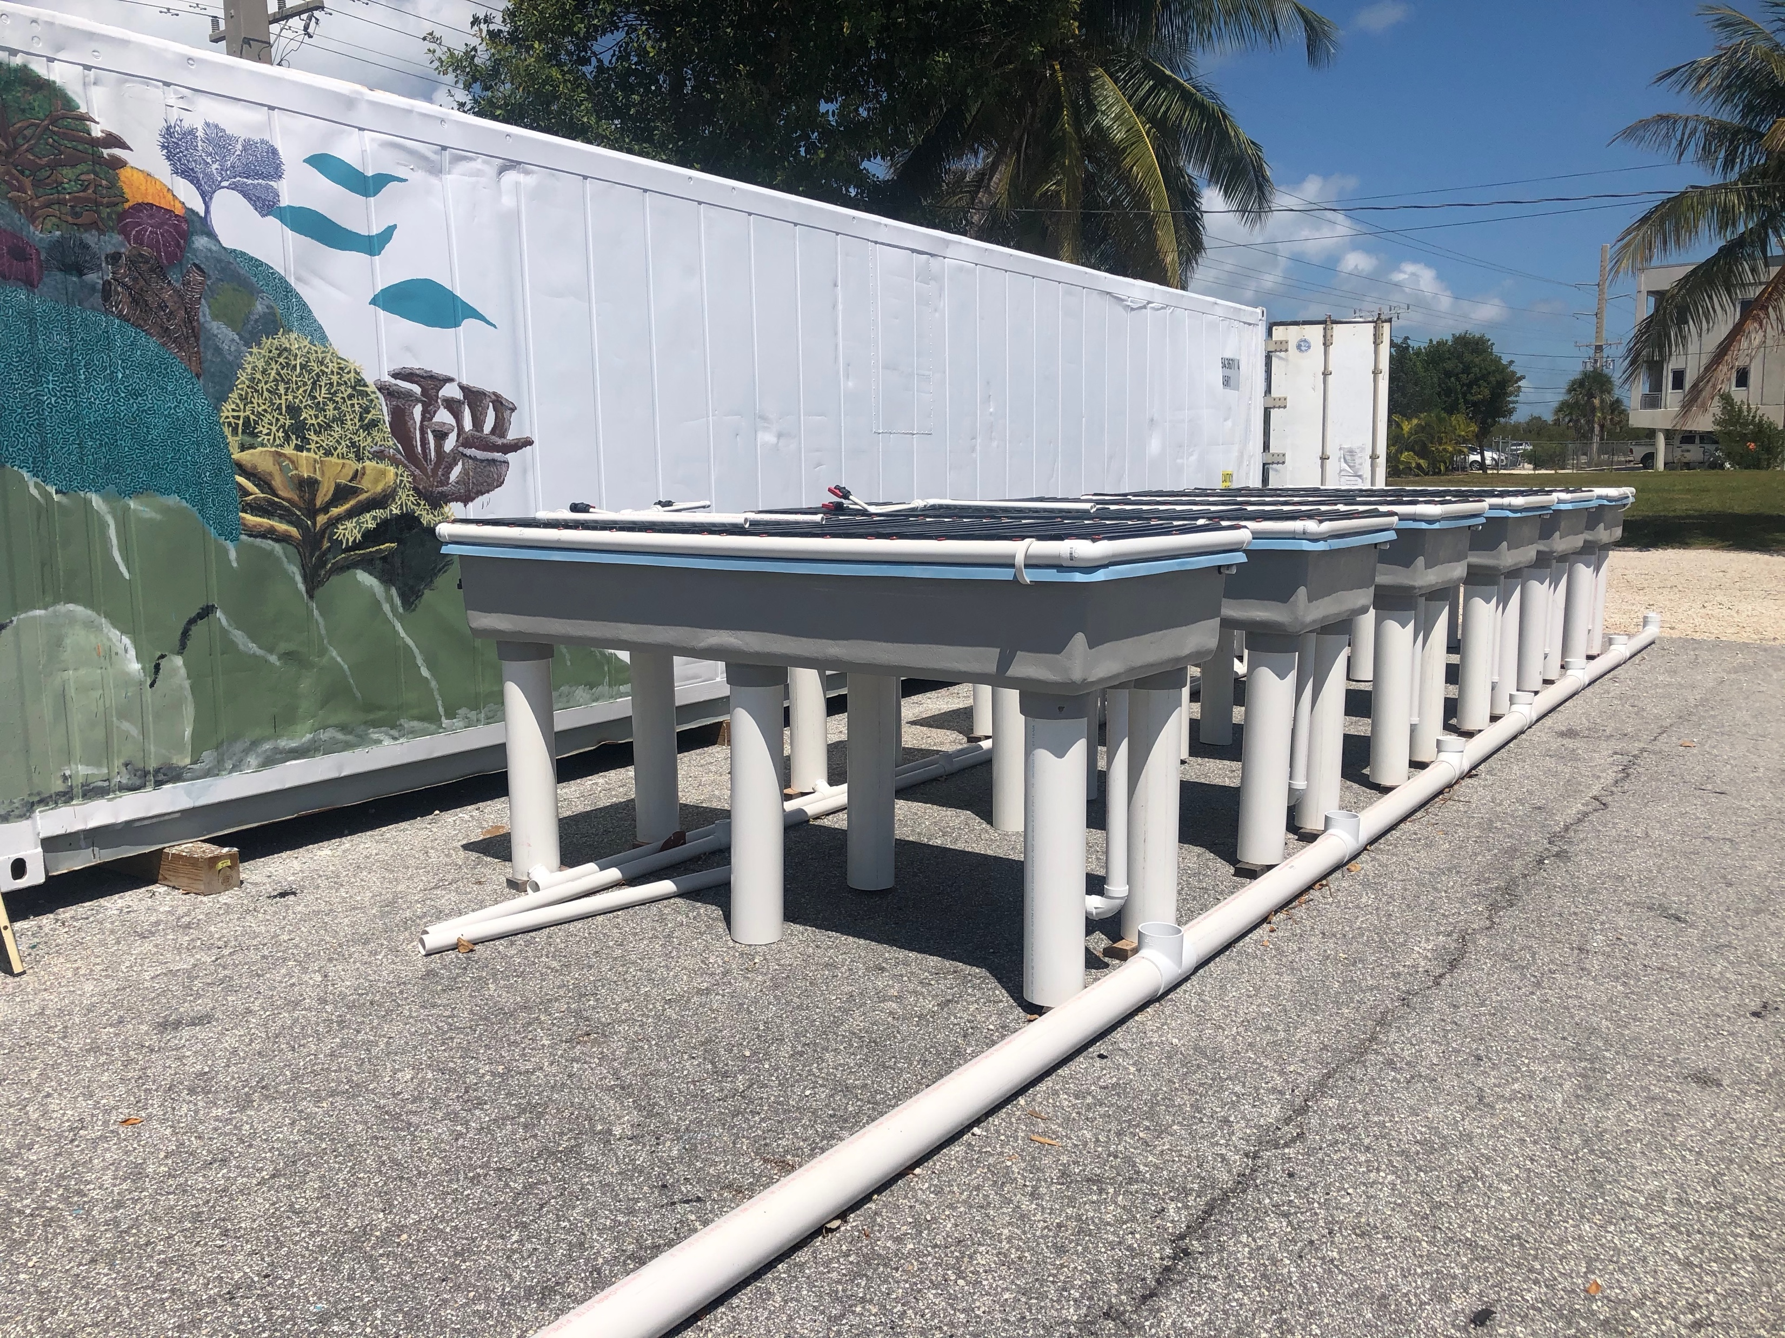
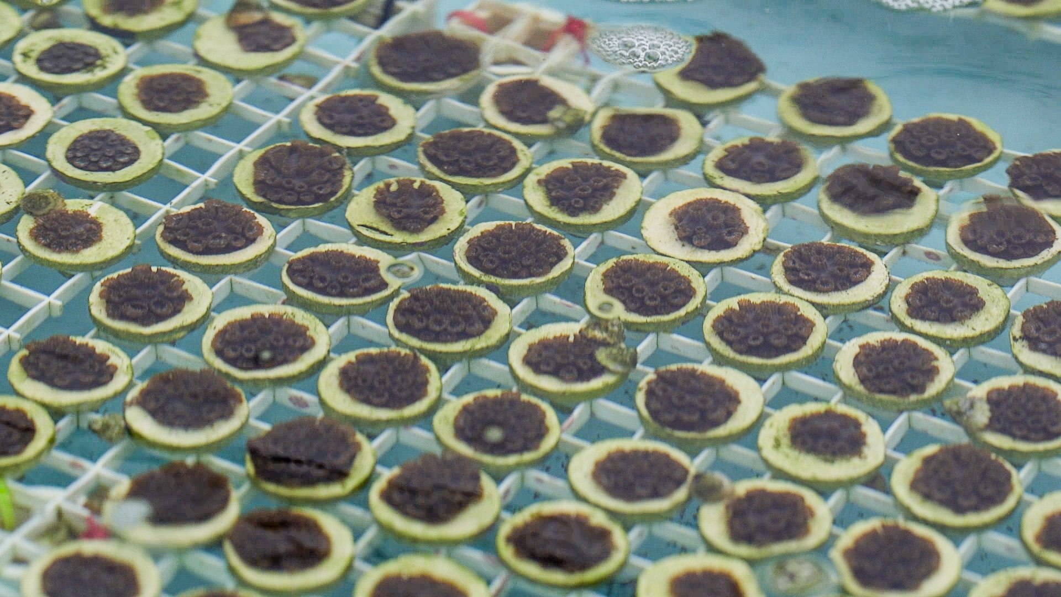

Plant a Million Corals
Dr. David E. Vaughan
Plant a Million Corals Foundation
Vision and Impact
Science and Technology
The global coral reef crisis requires scalable solutions for
communities of varied economies.
Micro-fragmentation and coral re-skinning can grow resilient corals up to 40x their natural rate and produce reproductive size corals on dead corals
The Plant a Million Corals Foundation, using their transportable Coral Restoration Units (CRUs), can provide affordable access immediate operations of coral restoration technology.
This will empower communities across the globe by affordably engineered nursery facilities and allow reef restoration at scale.
Opportunities
Introduction
Microfragmentation
2014
2016
2020
Thousands of Coral for planting
Technology Transfer + Training with multiple
Transportable Coral Restoration Units (CRU)
Producing reproductive size massive coral heads by re-skinning

Slide 2
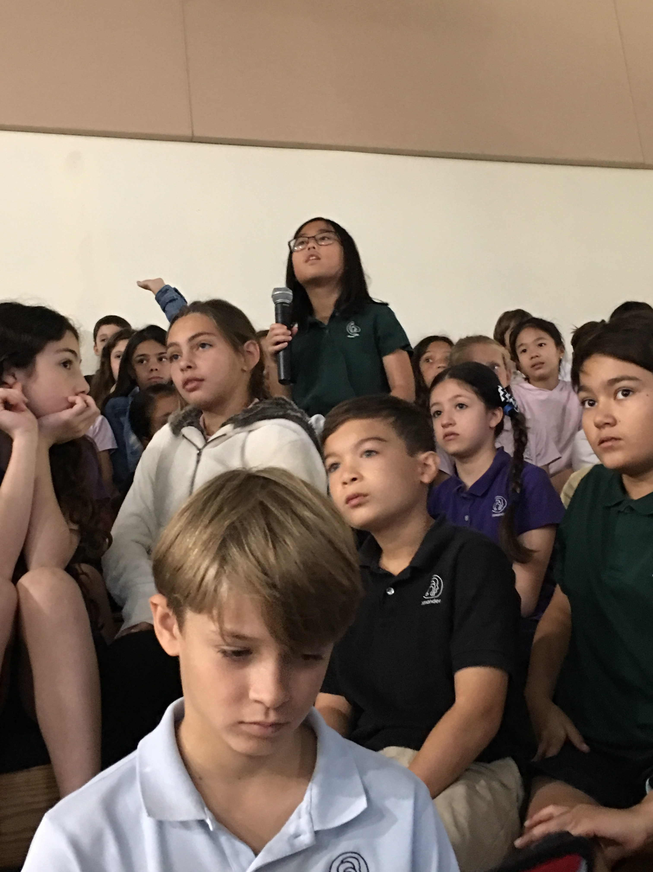
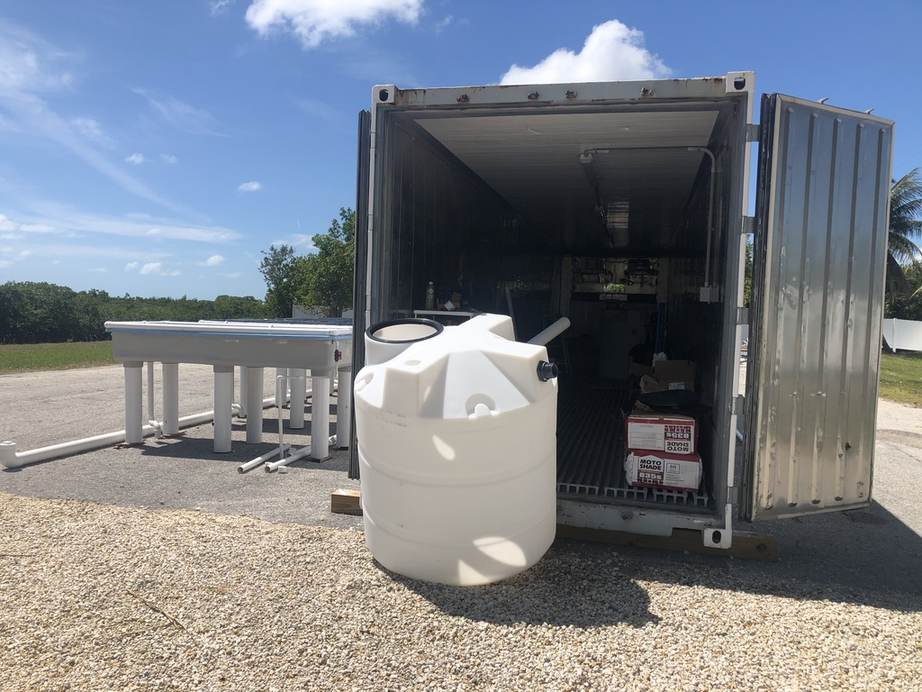
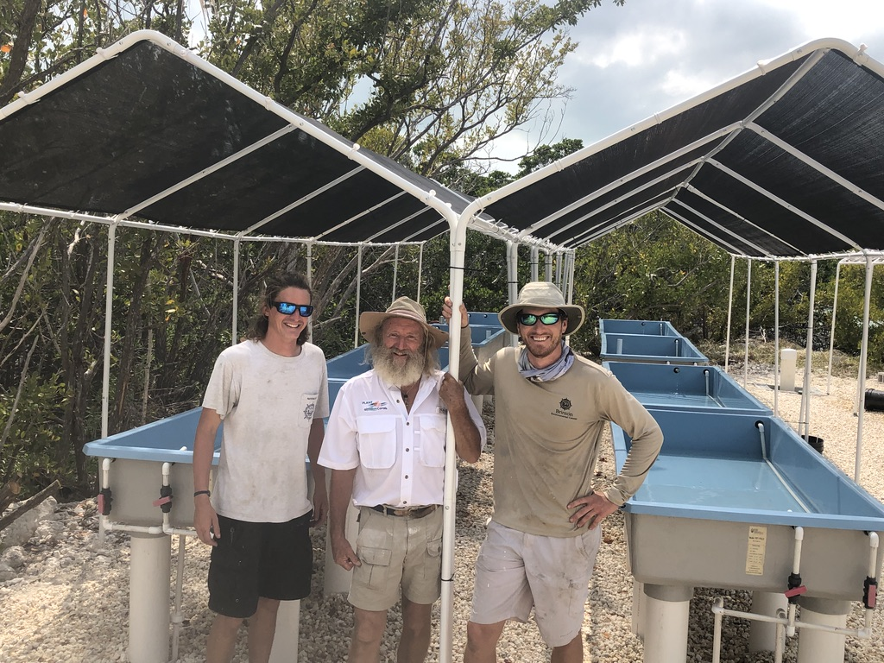
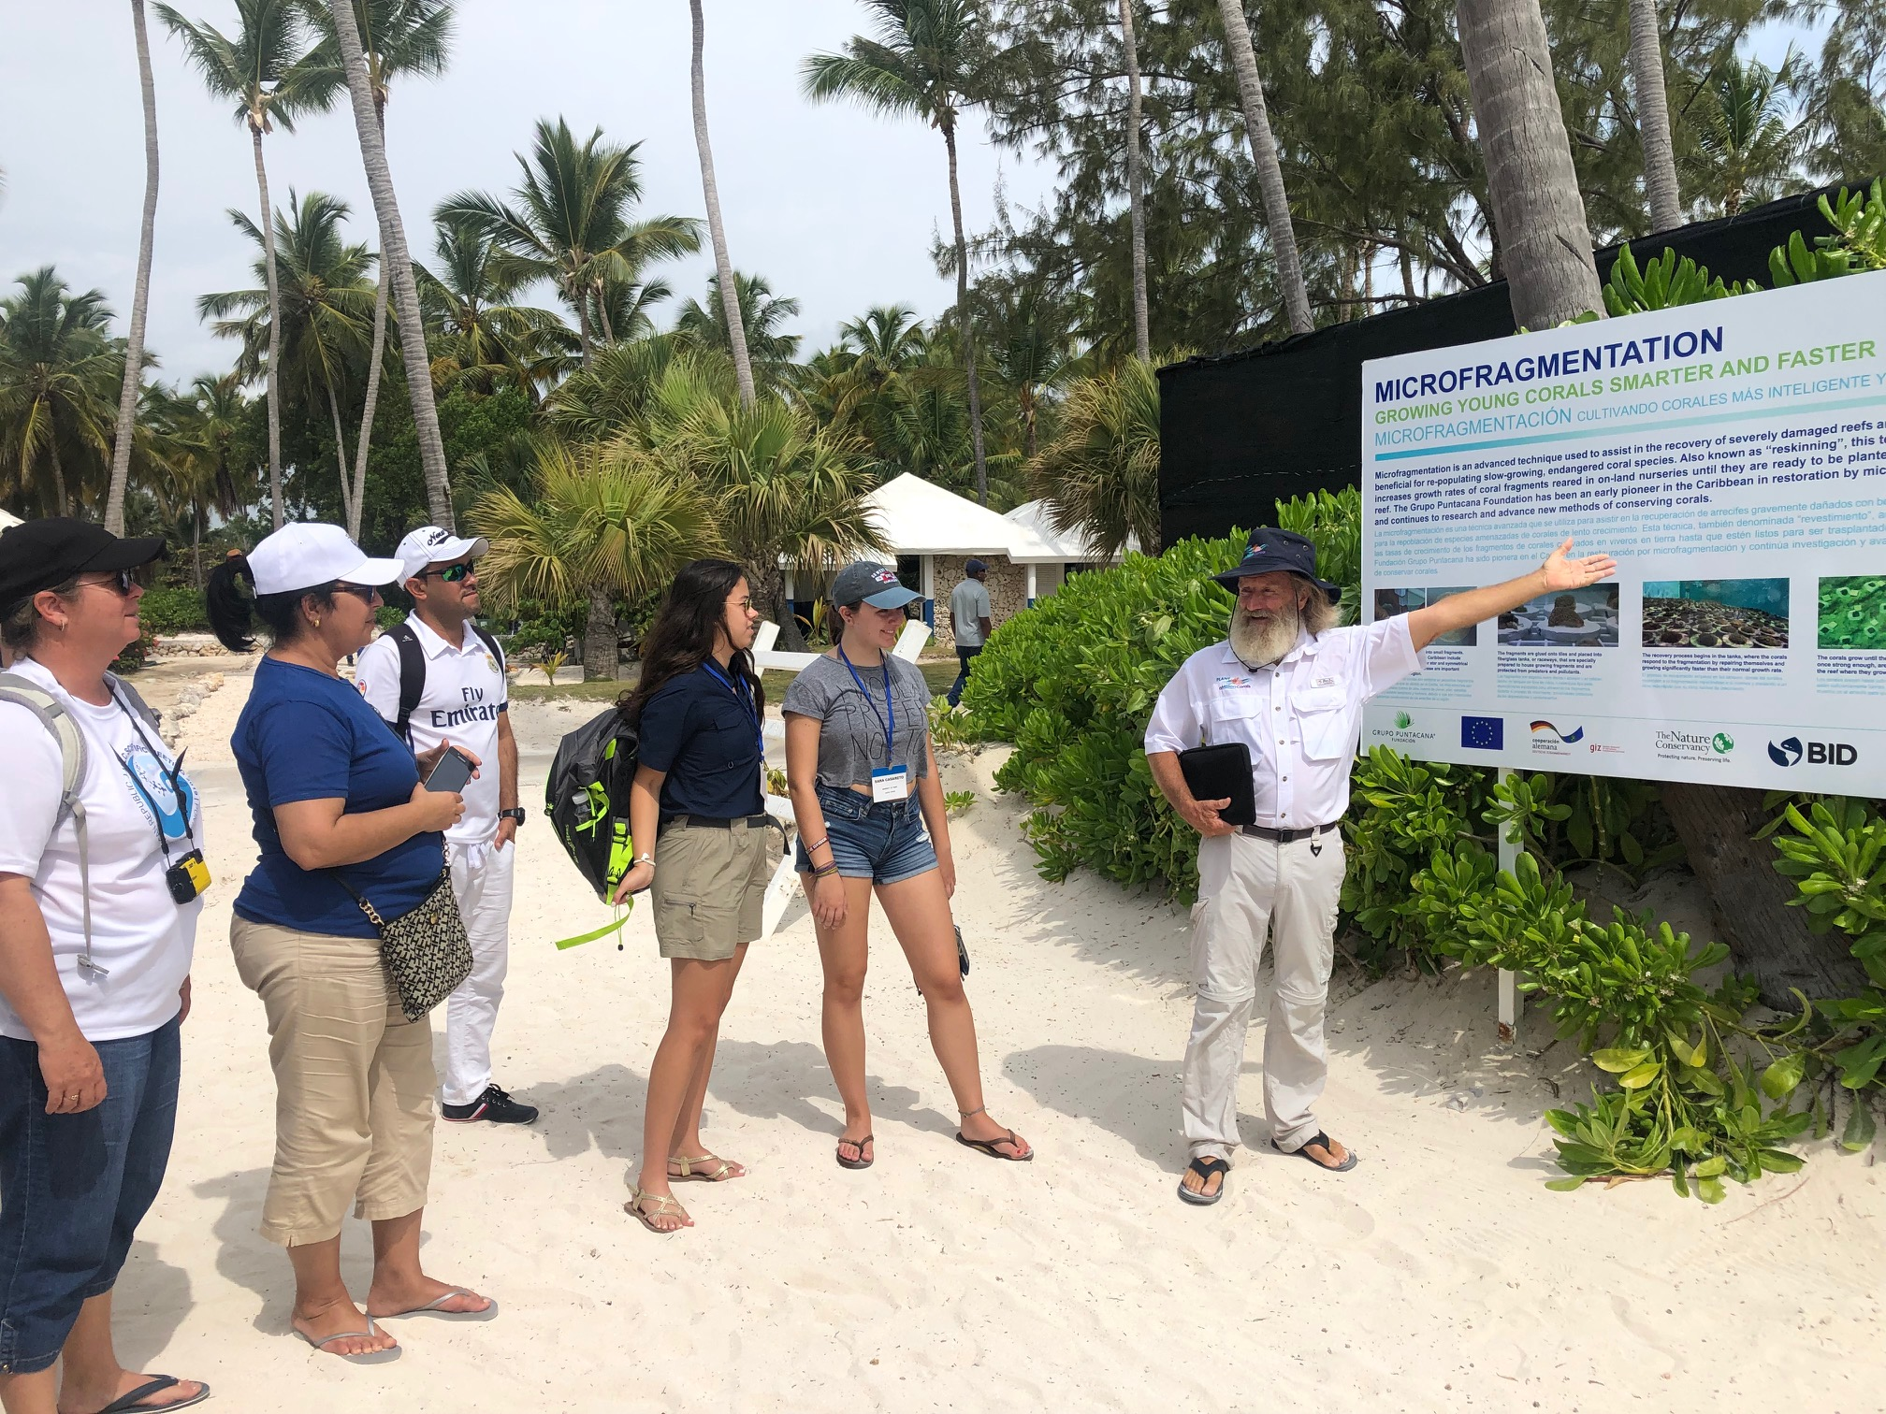
Plant a Million Corals
Dr. David E. Vaughan
Plant a Million Corals Foundation
Introduction
Make coral restoration accessible to all
To significantly accelerate coral restoration efforts through
  Education
  Training
  Technology Transfer with working culture nurseries
Exponential impact on fisheries and ocean economies
Science and Technology
Vision and Impact
Opportunities
Operational hands on training
Transportable Coral Restoration Unit
Community and organizational workshops

Slide 3
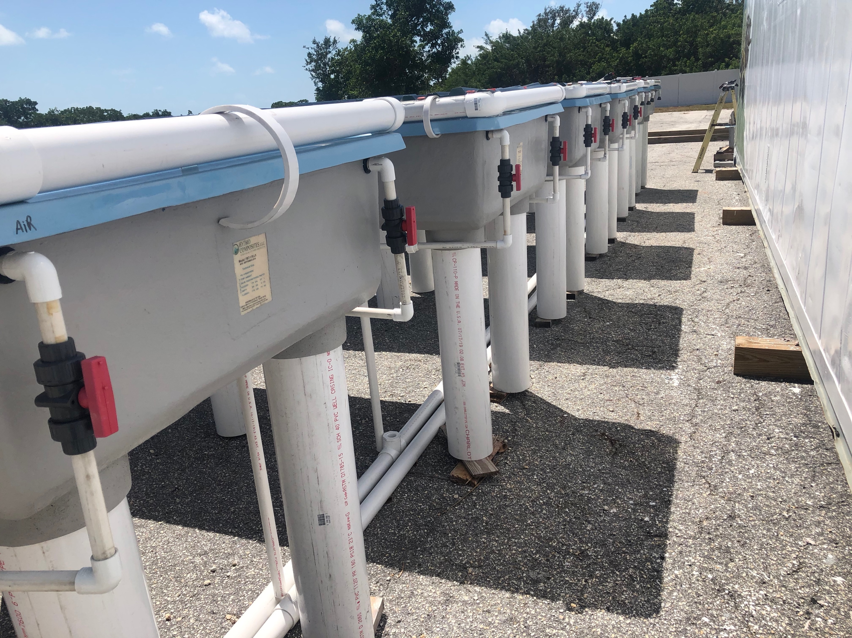
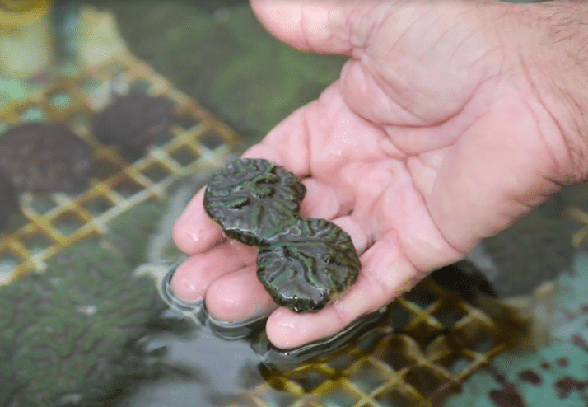
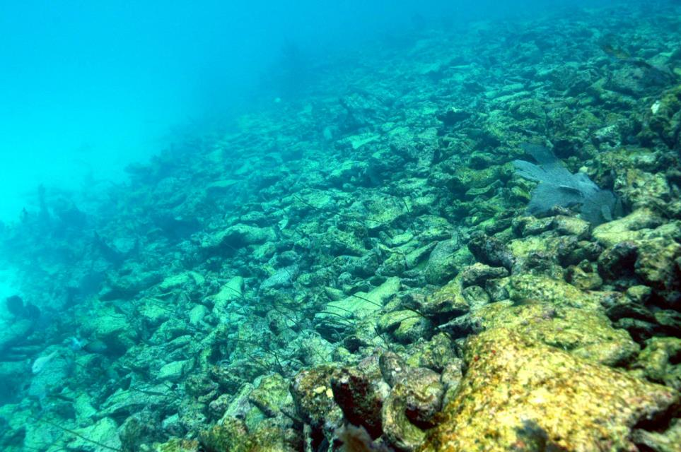
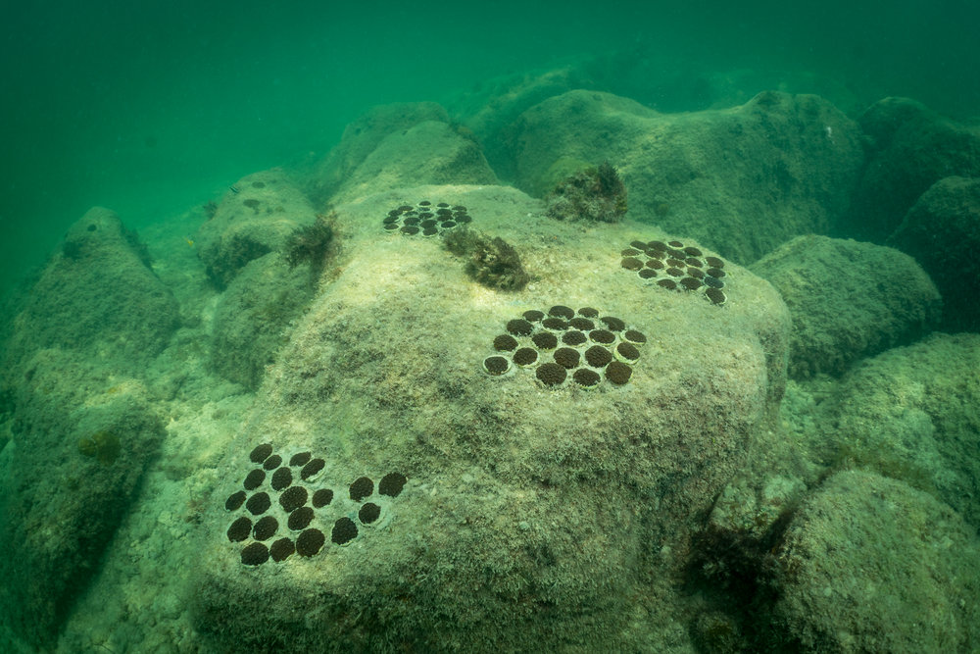
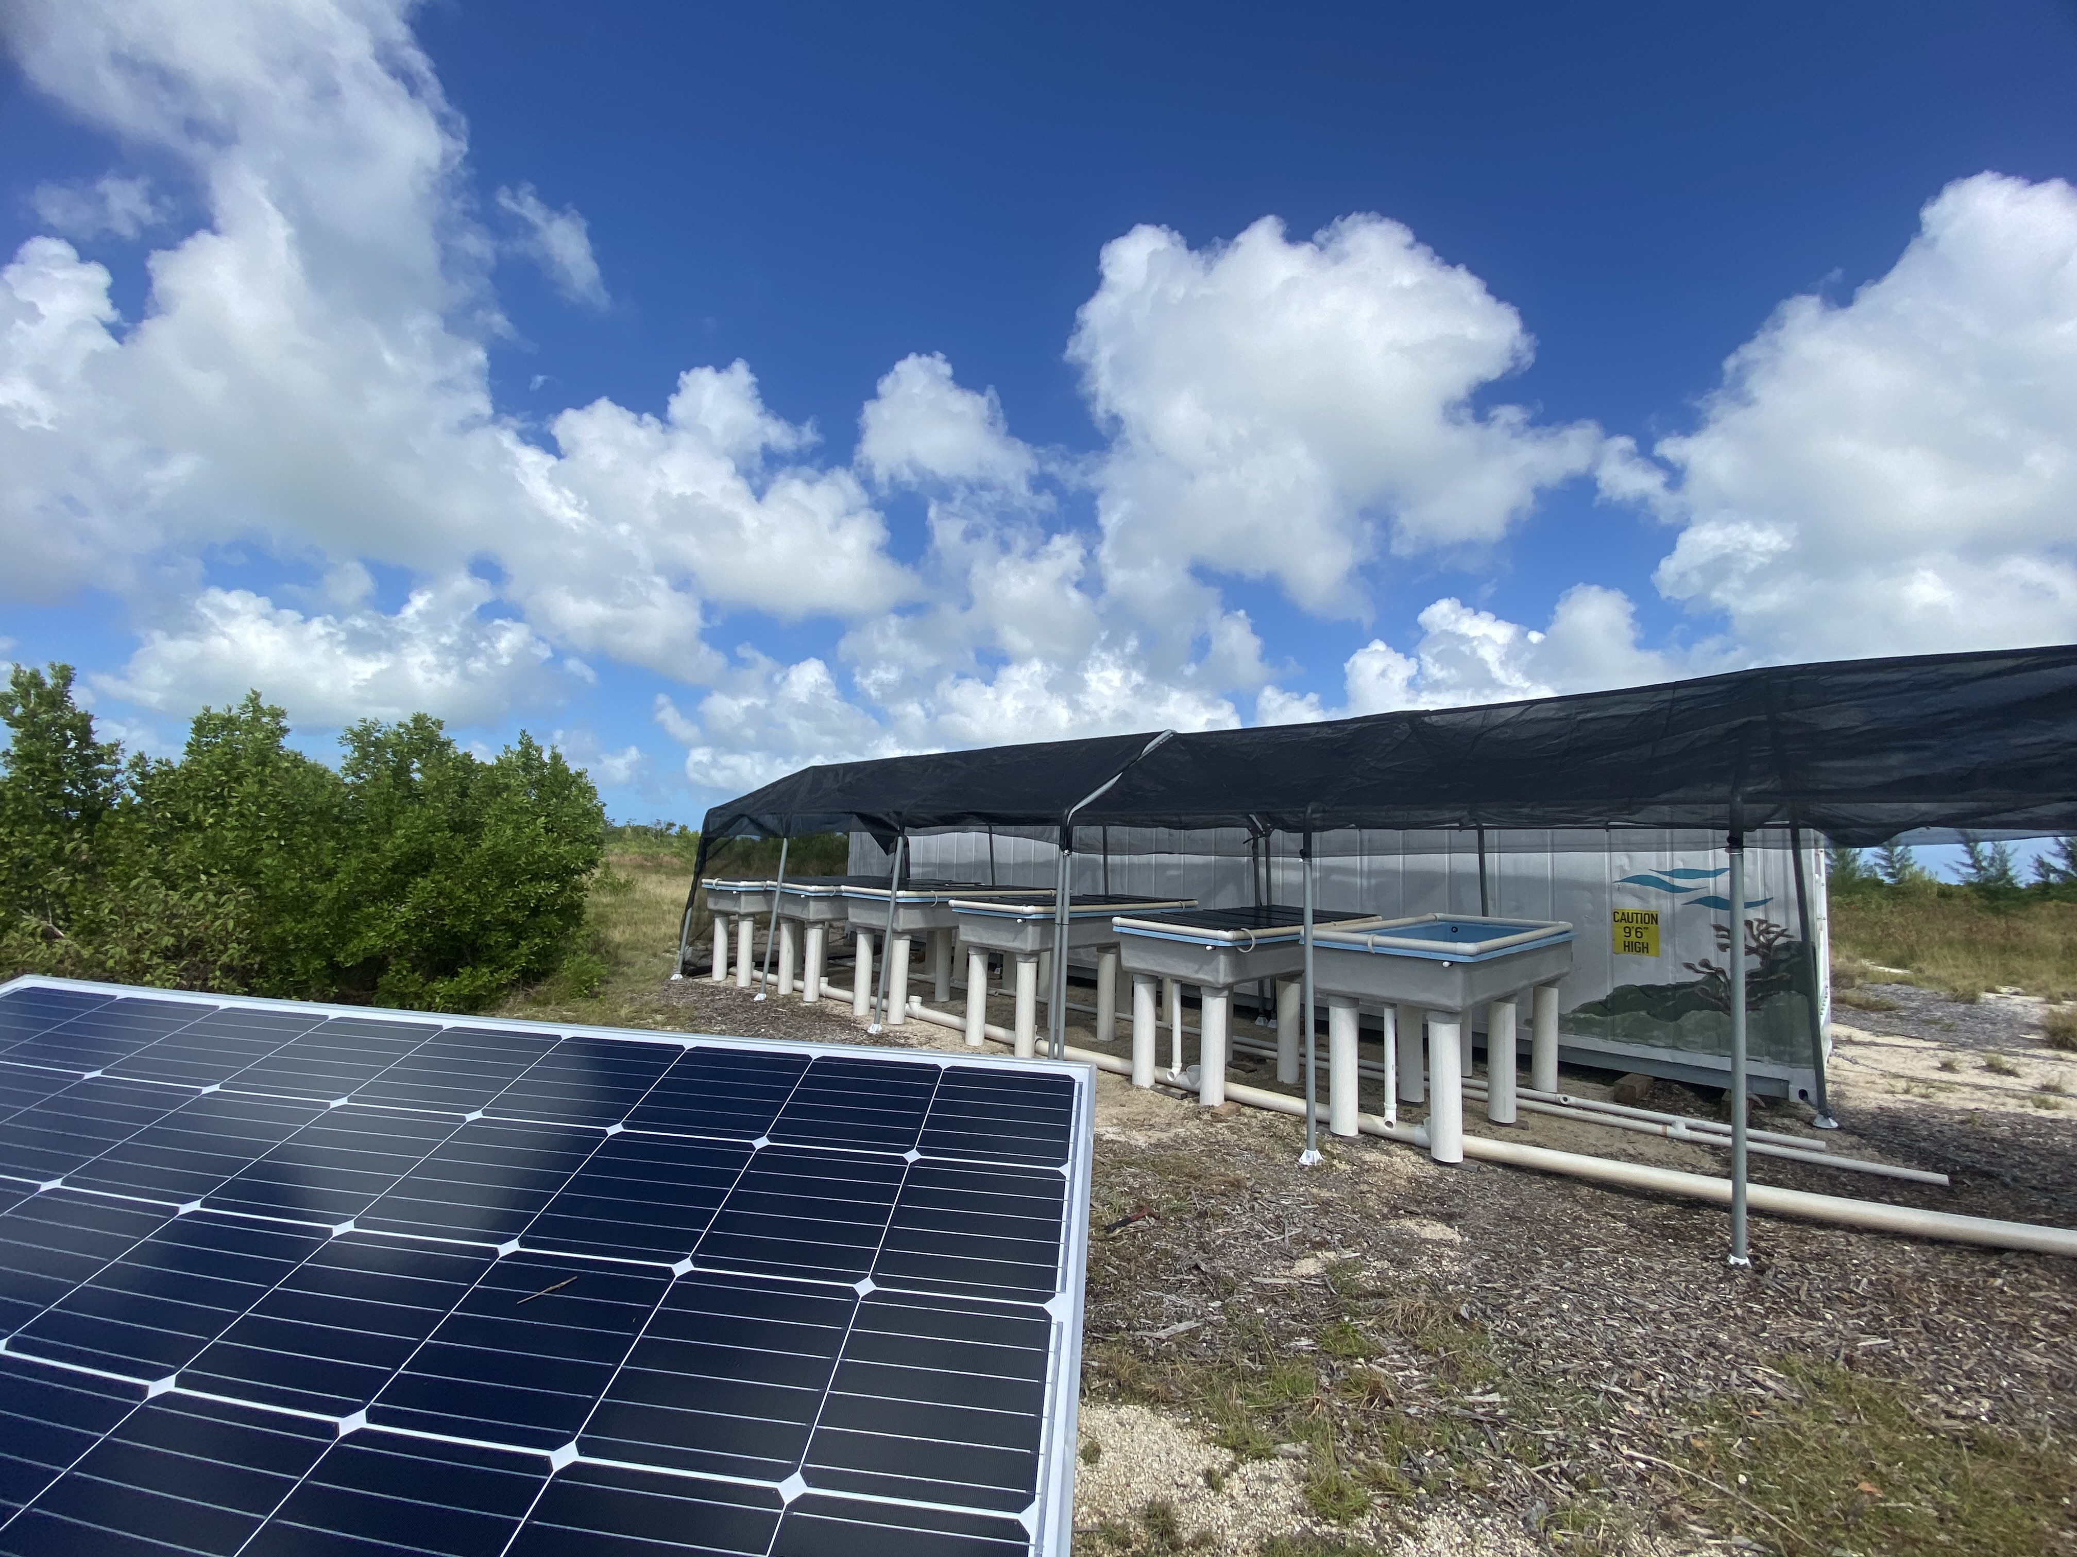
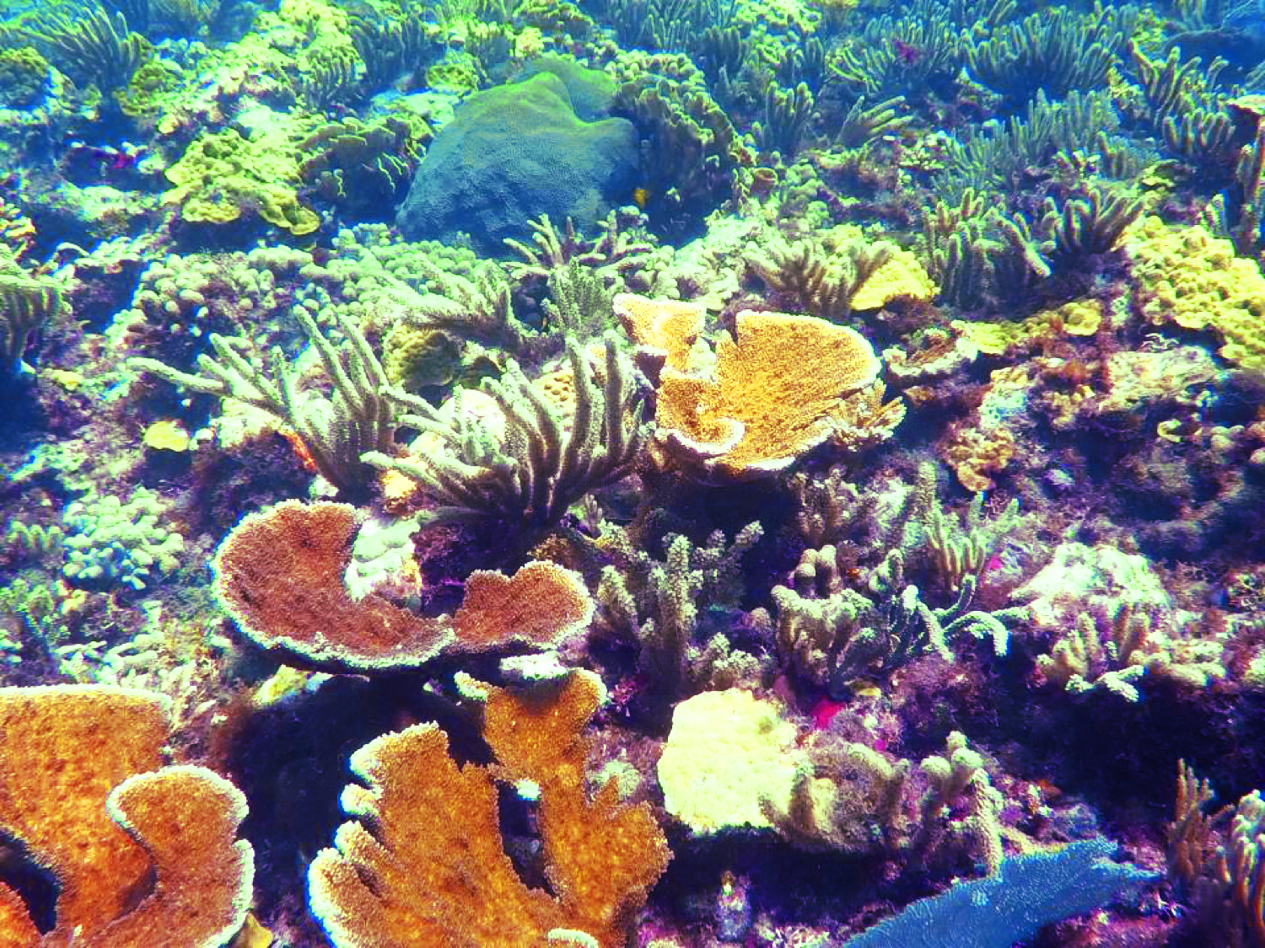
Plant a Million Corals
Dr. David E. Vaughan
Plant a Million Corals Foundation
Introduction
Vision and Impact
Science and Implemented Technology
Opportunities
Science and Technology
We have demonstrated that dead coral rubble can be restored into living reefs.
Active coral restoration engages new technology in a cost-effective way.
Before
Low cost working culture systems have been engineered
After
The first CRU with prototype solar powered well has been developed.

Slide 4
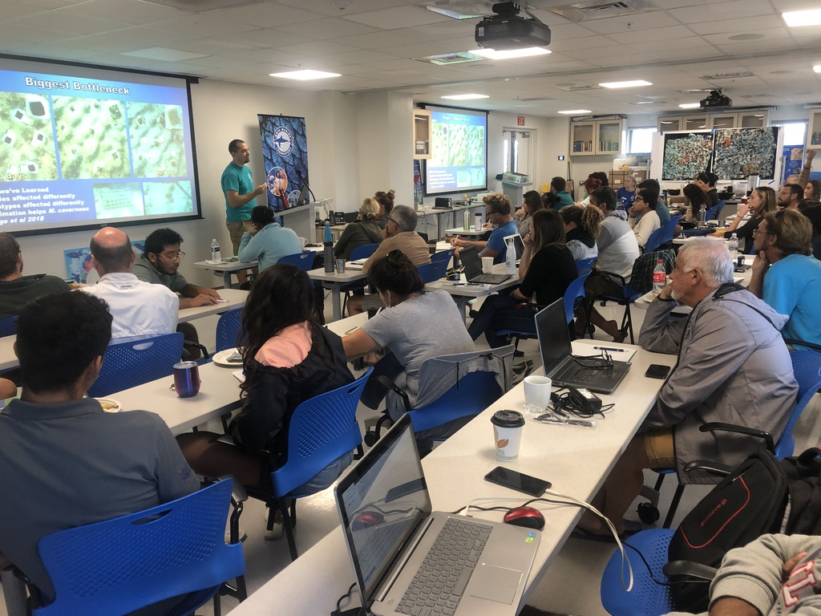
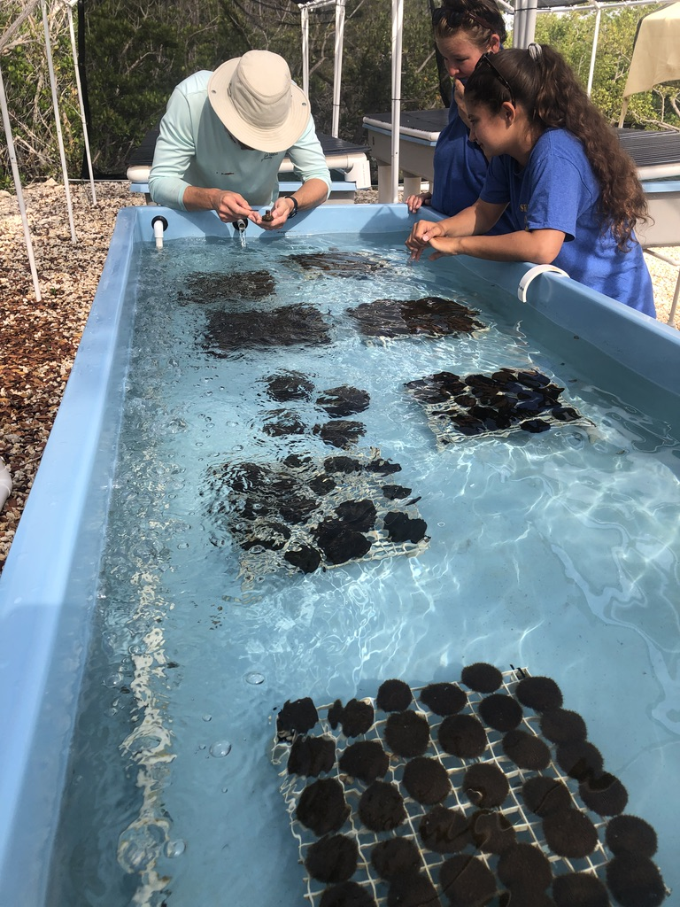
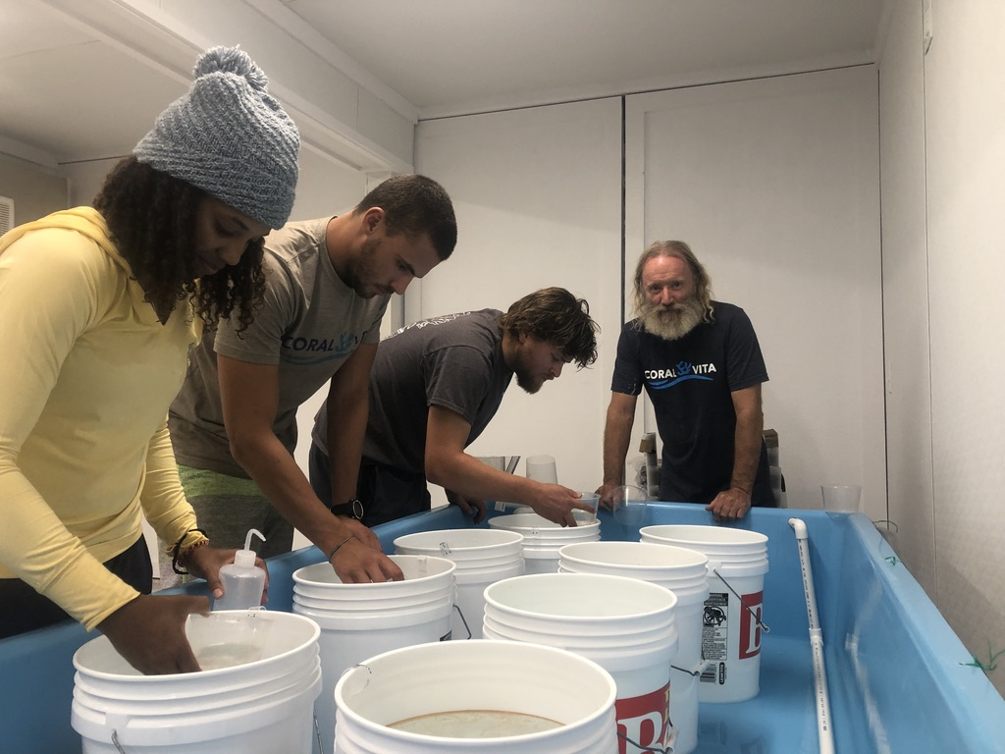
Plant a Million Corals
Dr. David E. Vaughan
Plant a Million Corals Foundation
Vision and Impact
International participation and collaboration
Develop the next generation of ocean scientists
Increase global capacity for affordable & scalable coral restoration
Economic benefits of coral restoration for fisheries & shoreline protection
Science and Technology
Introduction
Opportunities
Experiential learning
Education and technology transfer at the local community level
Encourage community support for sustainable reefs

