Slide 1

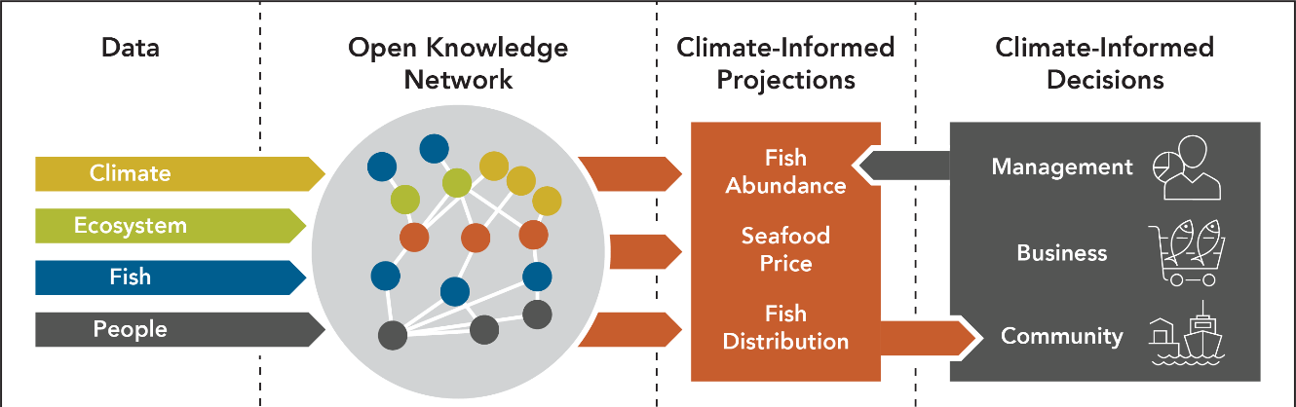
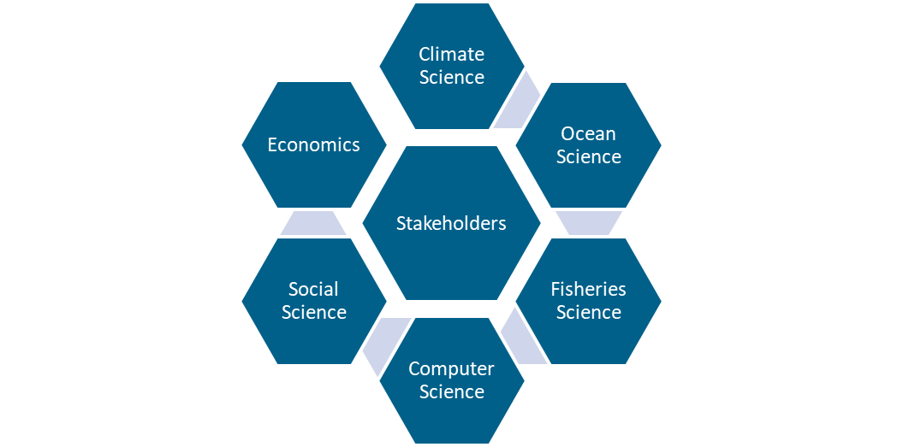

Forward-looking Decision Making in Fisheries in the Face of Climate Change
Lisa Kerr¹, Andrew Pershing², Katherine Mills¹, Kanae Tokunaga¹, Vincent Saba³, Jon Hare³, Carla Gomes⁴,Enrique Curchitser⁴, John Wiedenmann⁴, Malin Pinsky⁴, Kevin St. Martin⁴
¹Gulf of Maine Research Institute, ²Climate Central, ³NOAA NEFSC, ⁴Cornell University, ⁵Rutgers University
Ocean Challenge
Conceptual Model
Fisheries are a key sector in the U.S. economy and integral to the nation’s food security and social fabric of coastal communities. The future of fisheries is threatened by the rapid climate-driven changes underway in the ocean ecosystem, and the limited use of climate data in decision-making is exacerbating the challenges facing the fishing industry.
Data
Integration of ocean, data, and computer science
Climate-Informed Projections
Climate-Informed Decisions
Approach
Bringing together a transdisciplinary team to transform the use of data, capacity for predictive modeling, and the effectiveness of fisheries decision making. This team will work closely with stakeholders to design products that address key questions and help them make forward-looking, climate-informed decisions.
Anticipated Impact
This research will provide tools to support the ecological sustainability and economic viability of U.S. fisheries and help achieve climate-ready fisheries.
Integrated research - including transformative computer science approaches - to improve ocean decision making.
Concept development supported by the
NSF Convergence Accelerator Program

