Slide 1

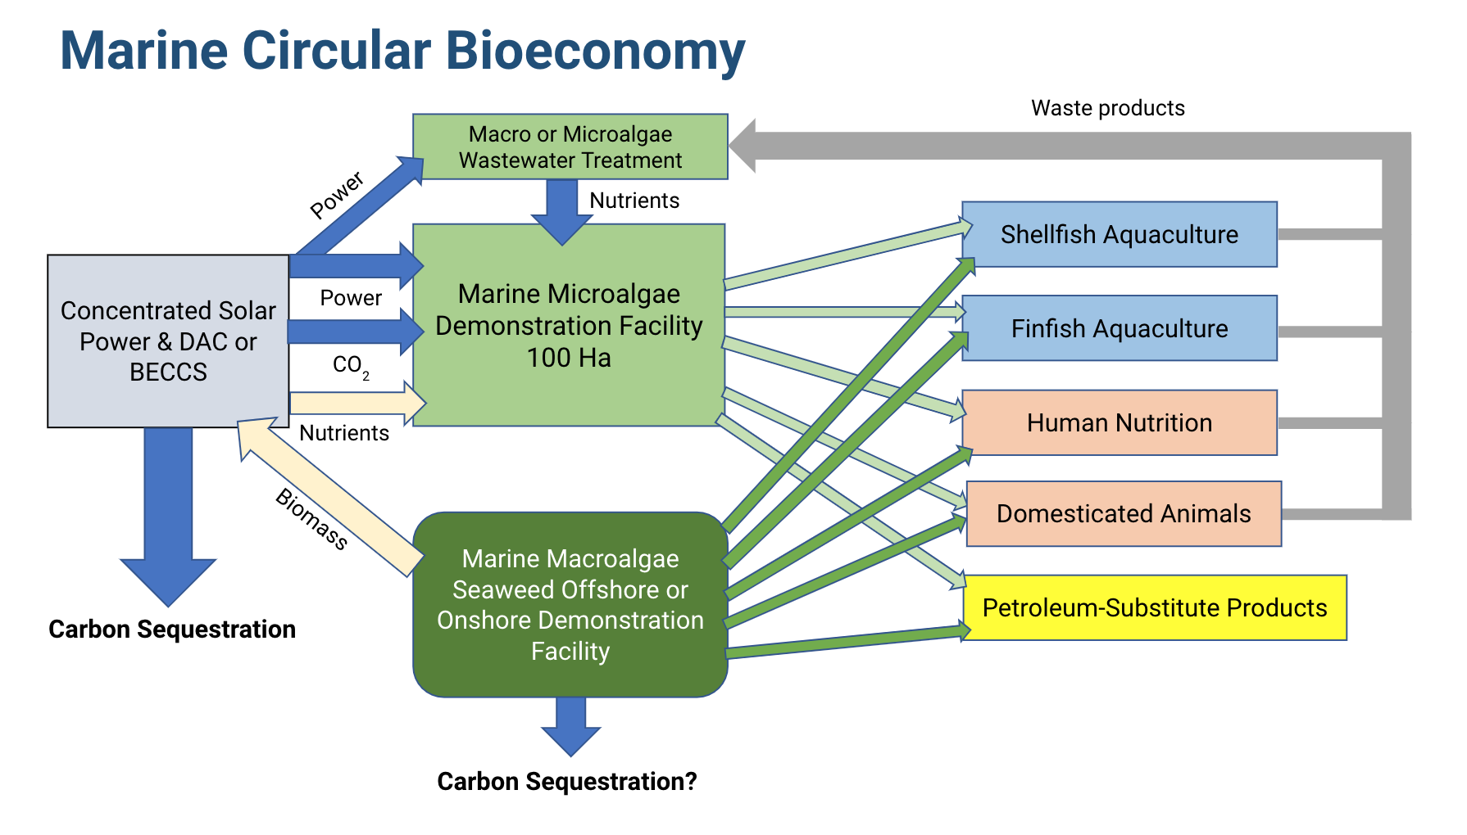


Feeding 10 Billion: Contributions from a Marine Circular Bioeconomy
Celina Scott-Buechler^{1,2}, Arjun Hausner¹, Charles Greene^{1,2}
¹ Cornell University, Department of Earth & Atmospheric Sciences; ² Ocean Visions
Food systems present critical challenges to achieving planetary stability.
Food systems produce up to 37% of total anthropogenic GHG emissions.
Meeting 2050 food demand is expected to require between1.5 and 7.3 million km² of agricultural expansion. Cropland currently covers 11 million km², and already poses acute threats to biodiversity and climate stability.
Oceans are already overexploited; a marine circular bioeconomy can help.
In 2018, capture fisheries yielded 96.4 million tonnes. Only 65.8% of fish stocks are harvested at biologically sustainable levels.
Algal aquaculture has nearly tripled since 2000. Although it represents a small share of total aquaculture, it shows great potential to increase.
With microalgae and macroalgae at its foundation, the marine circular bioeconomy will leverage marine aquaculture to sustainably intensify global food production. Nutrient recycling in algae-based wastewater treatment will close the circle in production processes, leading to the co-production of more environmentally favorable, algae-based energy products and materials. Sustainability benefits will include reductions in greenhouse gas emissions, freshwater use, arable land demand, eutrophication, and biodiversity loss.
Notes:
Single sided poster!

Slide 2
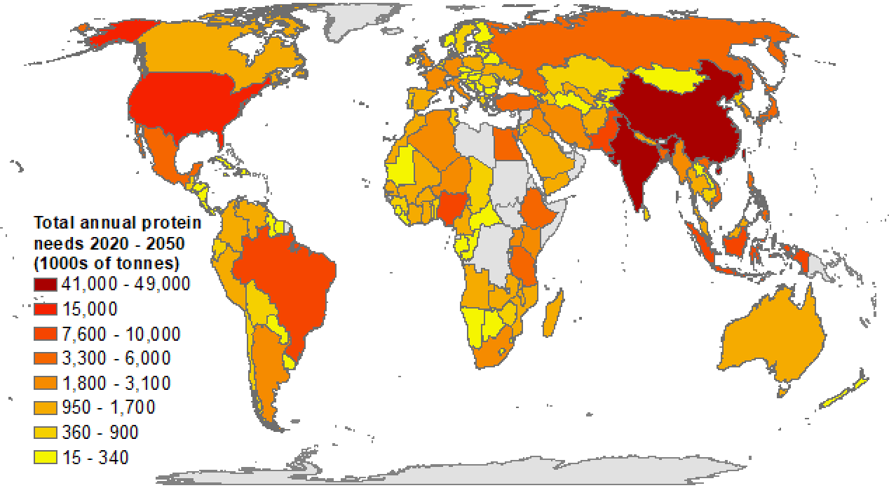
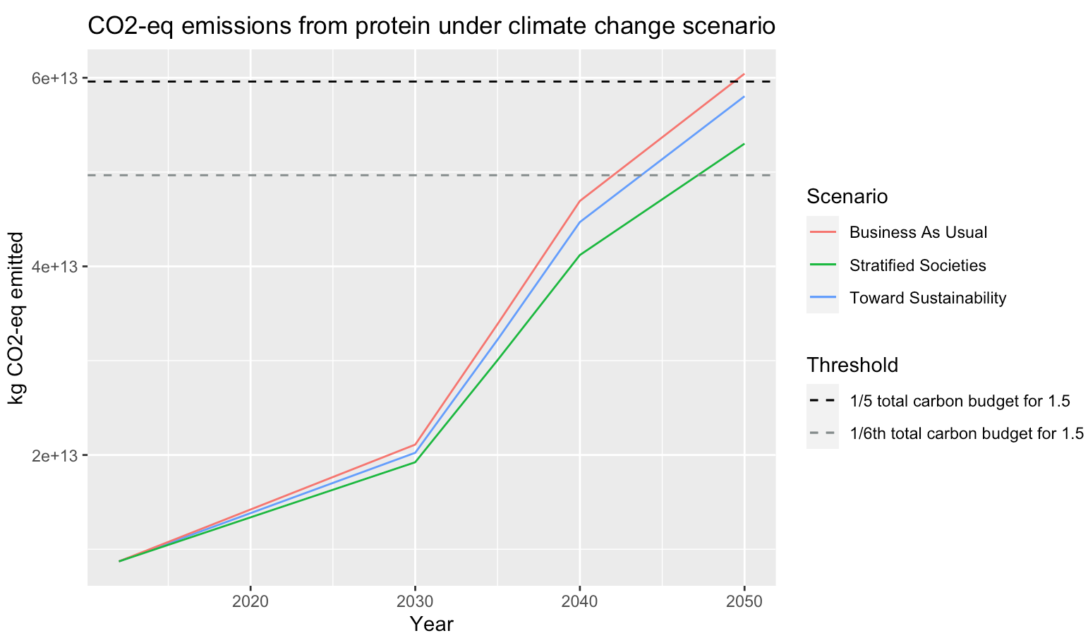
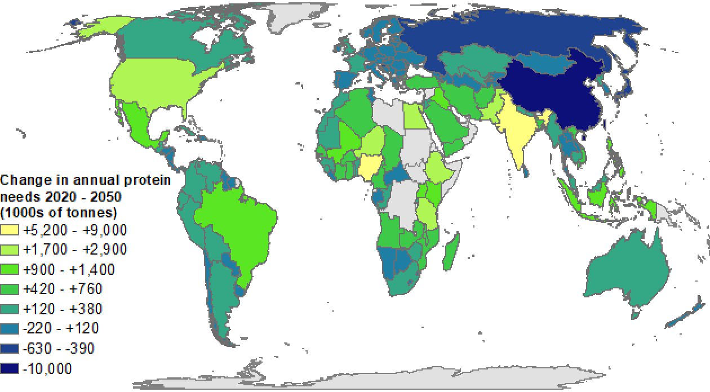
Feeding 10 Billion: Contributions from a Marine Circular Bioeconomy
Celina Scott-Buechler^{1,2}, Arjun Hausner¹, Charles Greene^{1,2}
¹ Cornell University, Department of Earth & Atmospheric Sciences; ² Ocean Visions
Mapping changes in protein consumption and corresponding impacts on cumulative CO₂ emissions
Cumulative CO₂-eq emissions from protein production under climate change scenario
60
1/5th remaining carbon budget for 1.5C international climate goal
Total annual protein needs in 2050 (1000s of tonnes)
1/6th remaining carbon budget for 1.5C international climate goal
Scenarios
40
Cumulative Gt CO₂-eq emissions
20
Relying on present production methods to meet future protein needs could put global climate targets out of reach…
Notes:
Single sided poster!

Slide 3
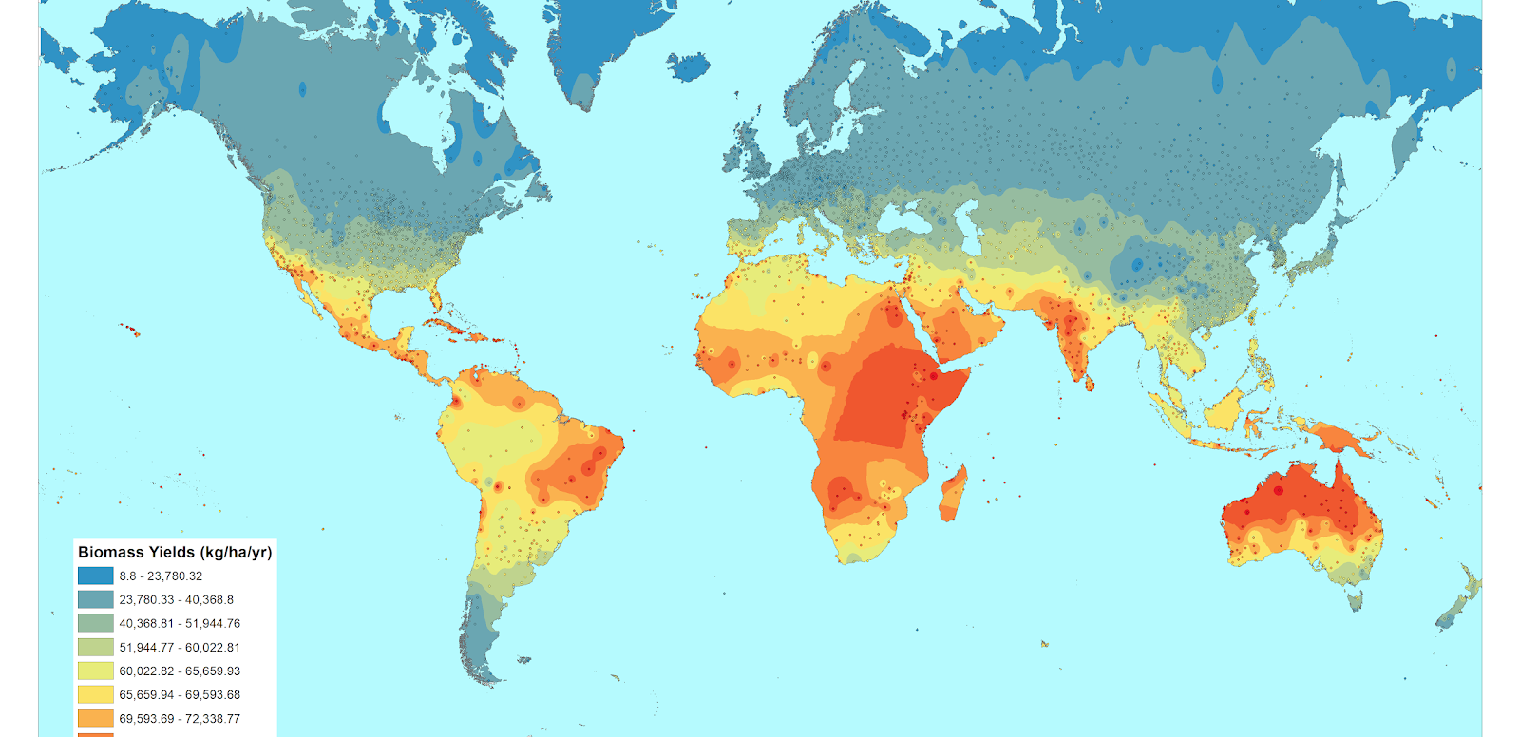
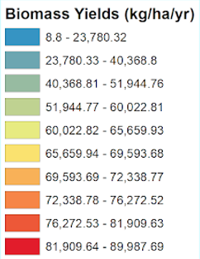
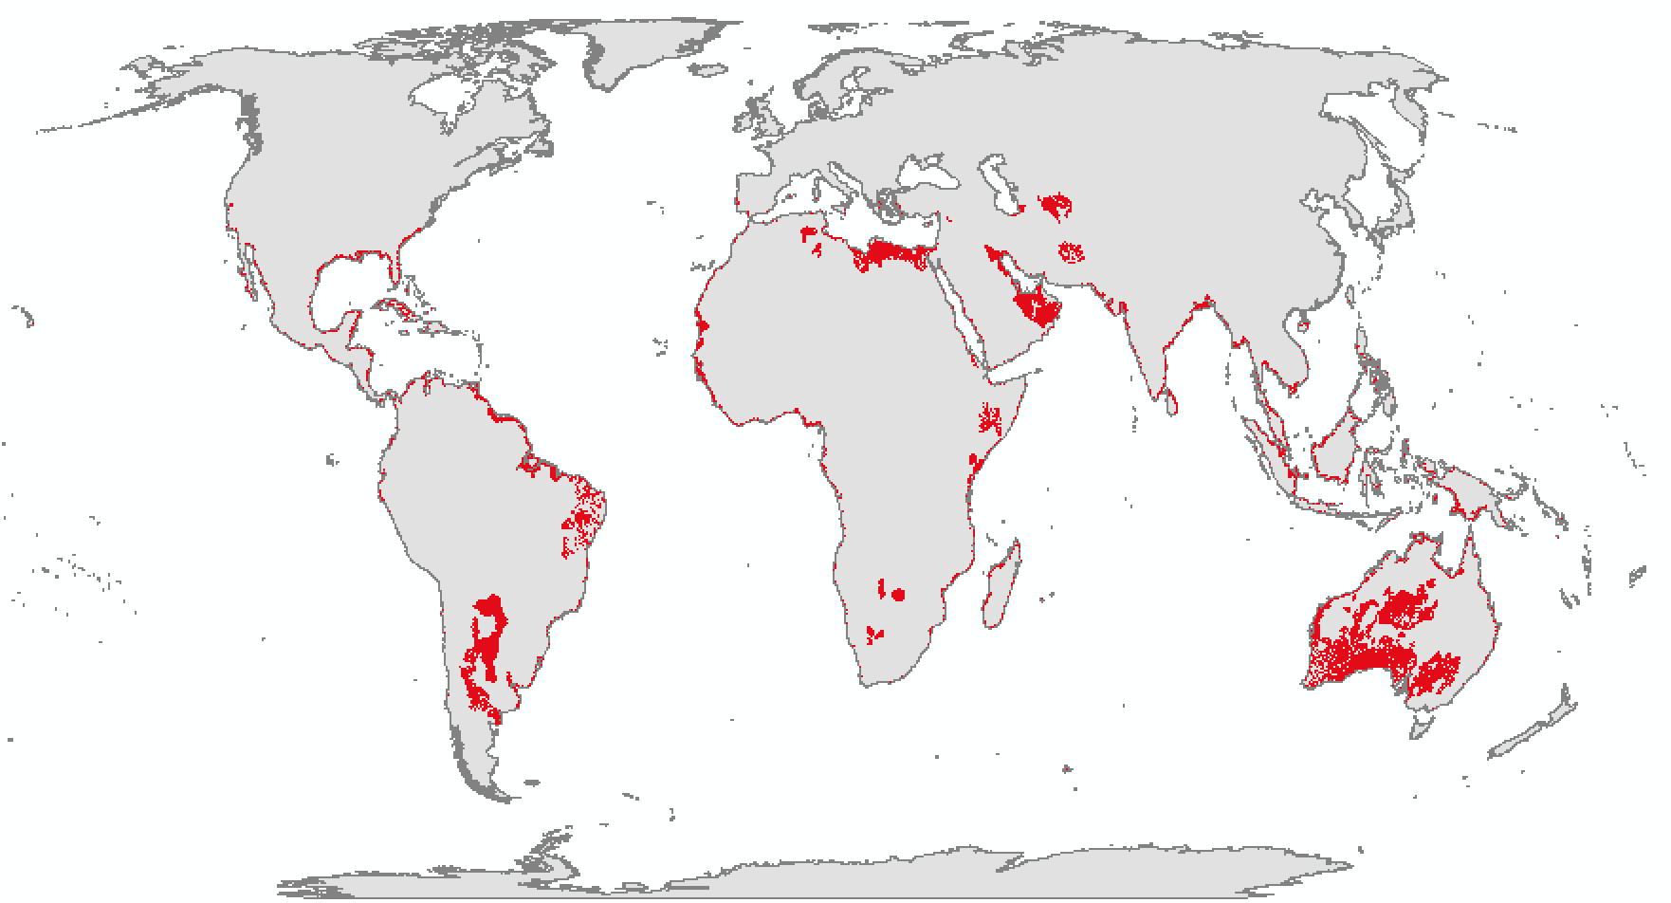
Feeding 10 Billion: Contributions from a Marine Circular Bioeconomy
Celina Scott-Buechler^{1,2}, Arjun Hausner¹, Charles Greene^{1,2}
¹ Cornell University, Department of Earth & Atmospheric Sciences; ² Ocean Visions
Mapping marine microalgae production potential
Global Viability
Land area in 75th percentile geophysical suitability: 9.46 million km²
Annual biomass production potential in 75th percentile suitability: 58.85 billion tonnes of protein per year. Percent of total 2050 protein consumption: 2,1763.16%
Ocean Visions Marine Circular Bioeconomy Task Force
Comprised of academics, industry representatives, NGO advocates, and federal program managers.
Primary objective: Explore the potential of marine aquaculture for sustainably intensifying global food production system.
Secondary objectives: 1) Consider the role of marine aquaculture in the coastal circular bioeconomy; 2) Map potential for nutrient, wastewater, and other material cycling in sustainable seafood production; 3) Highlight opportunities for co-producing biofuels and materials.
References
¹ IPCC. (2019). Climate Change and Land: an IPCC special report on climate change, desertification, land degradation, sustainable land management, food security, and greenhouse gas fluxes in terrestrial ecosystems. Geneva.
² Zabel, F., Delzeit, R., Schneider, J. M., Seppelt, R., Mauser, W., & Václavík, T. (2019). Global impacts of future cropland expansion and intensification on agricultural markets and biodiversity. Nature communications, 10(1), 1-10.
³ FAO. (2020). The State of World Fisheries and Aquaculture 2020: Sustainability in action. Rome.
Notes:
Single sided poster!

