Slide 1

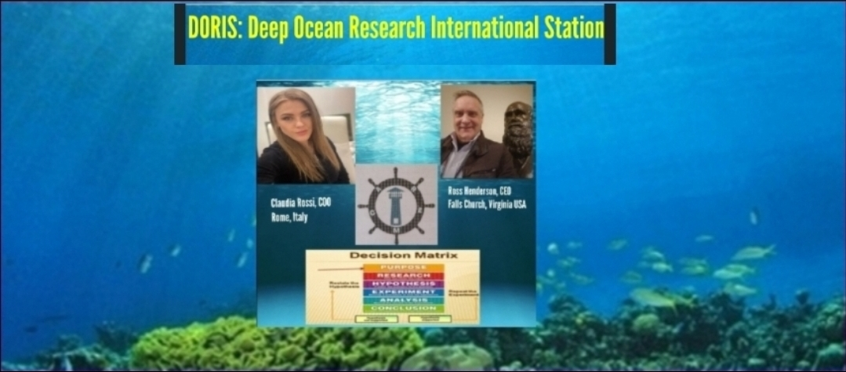
Abstract:
Logo
Title:
Author(s):
Affiliations:
Figures & Graphs:
Slide/poster size is 40.97x23.04 (16:9 aspect ratio)
Minimum font: 28pt (this may seem large, but at this poster size it’s not)
Recommended font Types: Calibri, Arial, Times New Roman
This is only a template. All content may be modified, except for slide dimensions
If you are creating your e-poster on a PC, please make sure to save your formulas as an image and embed it into your presentation or they will change on our Macs.
Include and image or a graph for visual appeal. If you have more than one, they will be viewable in the center when this section is selected.
Don’t exceed past this point.
ABSTRACT
DORIS will map the Ocean’s dynamic currents and patterns of marine life migration in a systematic manner using multispectral sensors deployed aboard the station, and with extra-vehicular arrays of edge-computing devices, Distributed Acoustic Sensing (DAS) arrays, and Uncrewed Underwater Vehicles (UUV). The research will encompass many areas of basic ocean science research to examine less-understood forms of life. Examples will include extremophiles, which thrive under high pressure and temperature near undersea hydrothermal vents, and other ocean floor-dwelling organisms that survive by chemosynthesis. Understanding chemosynthesis more precisely will spur applied marine biology research, with the potential for using naturally occurring marine organisms to ingest and mitigate man-made ocean pollutants.
Introduction:
Results:
Keep it short and sweet.
More explanation and images/graphs/videos will be viewable in the center when this section is selected.
Around 3-4 bullet points.
Keep it short and sweet.
More explanation and images/graphs/videos will be viewable in the center when this section is selected.
Around 3-4 bullet points.
Methods:
Step-by-step explanation
More explanation and images/graphs/videos will be viewable in the center when this section is selected.
As many bullet points as needed, but keep it around 5-6 (fit within this side of the page.
Don’t exceed past this point.
Conclusions:
Keep it short and sweet.
More explanation and images/graphs/videos will be viewable in the center when this section is selected.
Around 3-4 bullet points.
References:
Font for this can be relatively small (around 18pt).
Can give a general thanks or contact information.
The larger reference list can be viewable in the middle with the section is selected.
Click Section Headings to View Additional Content

Slide 2


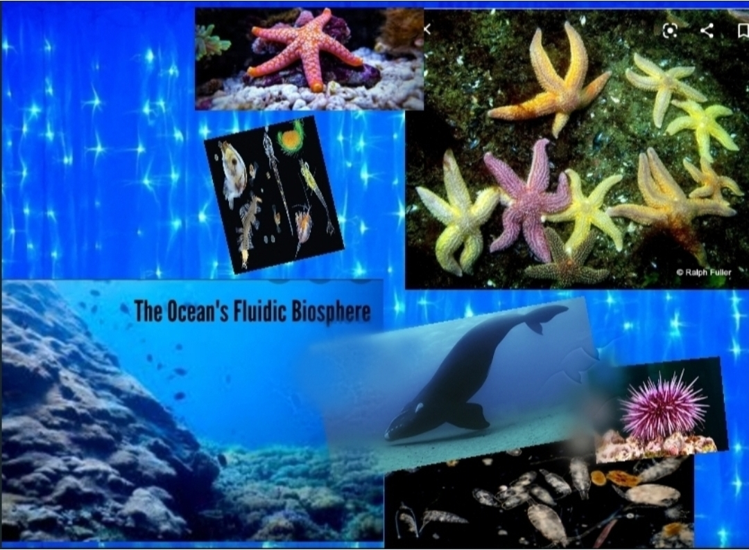
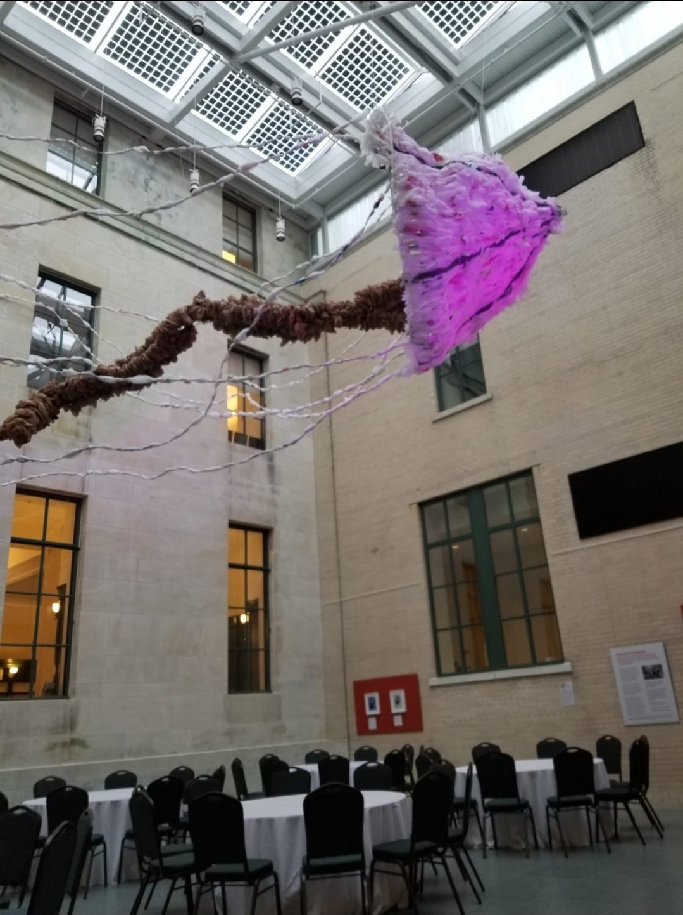
Title:
Author(s):
Affiliations:
Abstract:
Logo
Title:
Author(s):
Affiliations:
Figures & Graphs:
Slide/poster size is 40.97x23.04 (16:9 aspect ratio)
Minimum font: 28pt (this may seem large, but at this poster size it’s not)
Recommended font Types: Calibri, Arial, Times New Roman
This is only a template. All content may be modified, except for slide dimensions
If you are creating your e-poster on a PC, please make sure to save your formulas as an image and embed it into your presentation or they will change on our Macs.
Include and image or a graph for visual appeal. If you have more than one, they will be viewable in the center when this section is selected.
Don’t exceed past this point.
Introduction:
Near-term objectives with clearly quantifiable metrics will be established to monitor progress towards:
1) Ocean health and resilience;
2) protection of ocean ecosystems and marine life diversity;
3) data collection and development of evidence-based simulations to inform decision-making processes and to implement policies for responsible Ocean stewardship;
4) contingency planning and disaster recovery strategies for ocean-scale seismic events and other global disruptions, i.e., the “unknown unknowns.”
Results:
Keep it short and sweet.
More explanation and images/graphs/videos will be viewable in the center when this section is selected.
Around 3-4 bullet points.
Keep it short and sweet.
More explanation and images/graphs/videos will be viewable in the center when this section is selected.
Around 3-4 bullet points.
Methods:
Step-by-step explanation
More explanation and images/graphs/videos will be viewable in the center when this section is selected.
As many bullet points as needed, but keep it around 5-6 (fit within this side of the page.
Don’t exceed past this point.
Conclusions:
Keep it short and sweet.
More explanation and images/graphs/videos will be viewable in the center when this section is selected.
Around 3-4 bullet points.
References:
Font for this can be relatively small (around 18pt).
Can give a general thanks or contact information.
The larger reference list can be viewable in the middle with the section is selected.
Click Section Headings to View Additional Content

Slide 3
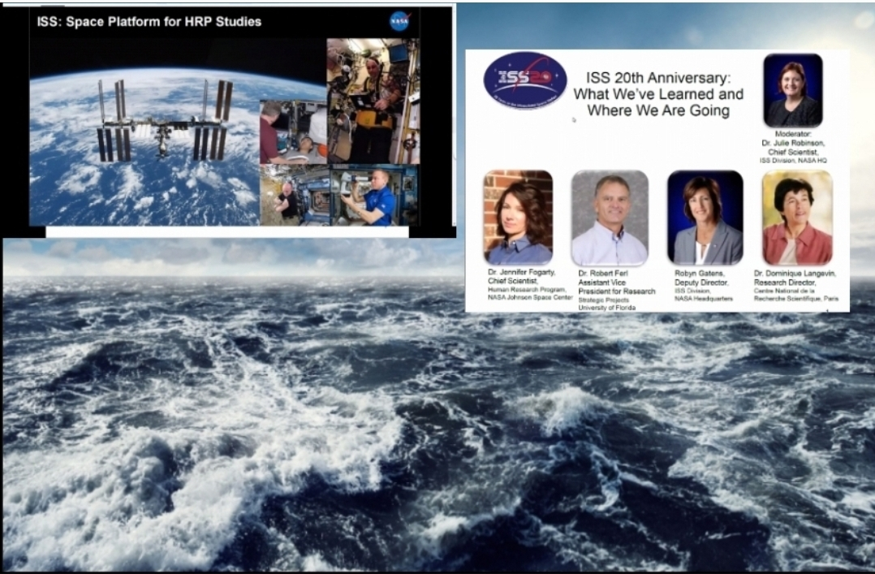
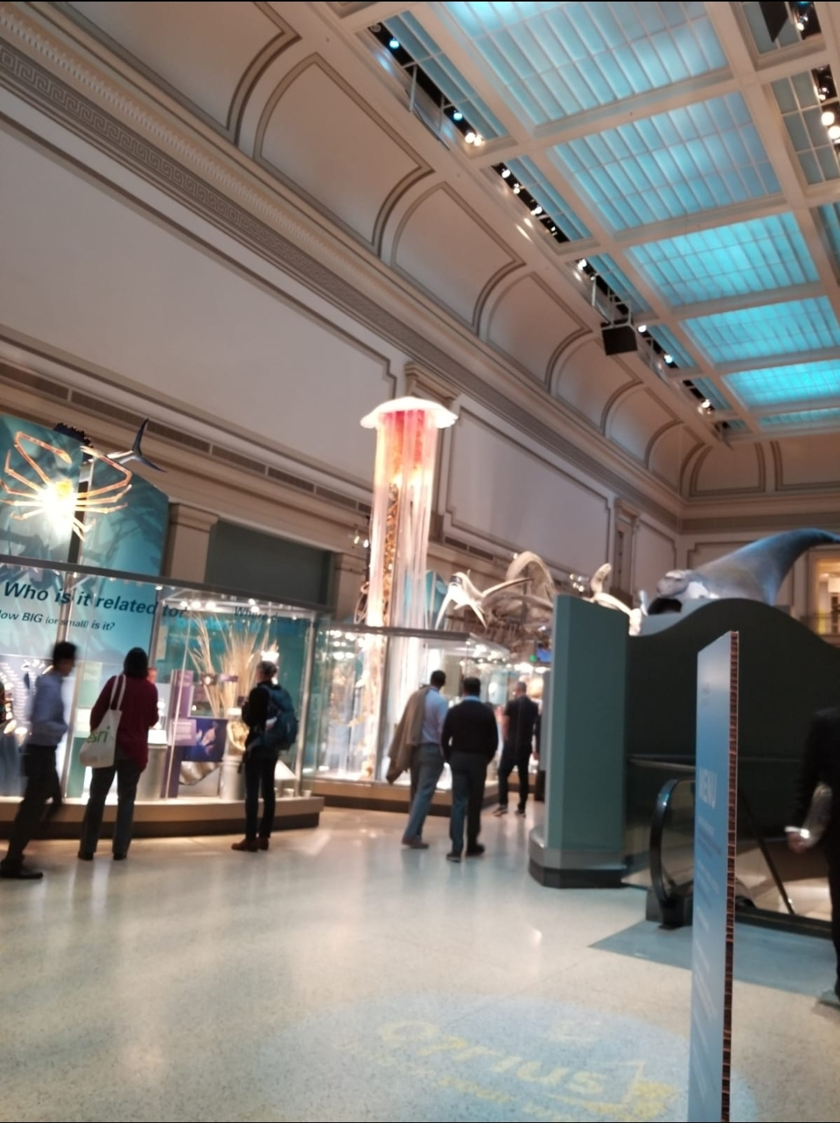
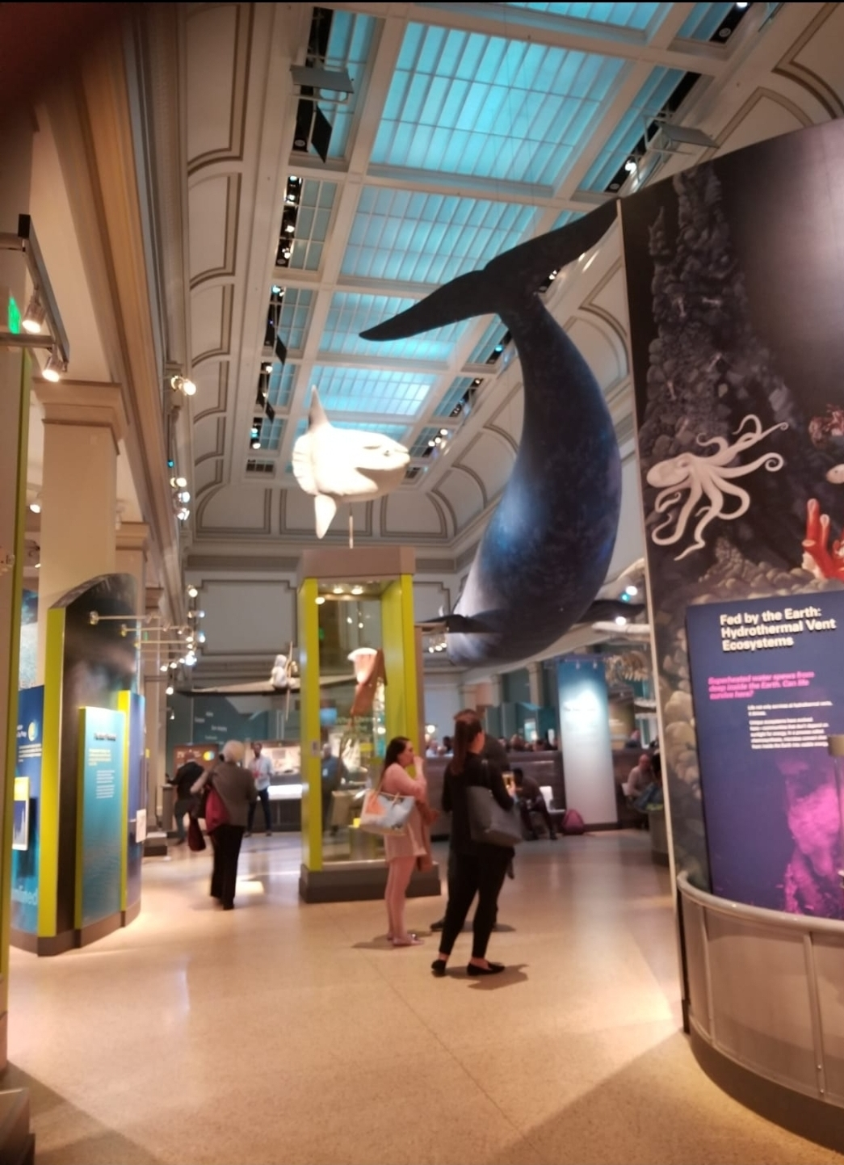
Abstract:
Logo
Title:
Author(s):
Affiliations:
Figures & Graphs:
Slide/poster size is 40.97x23.04 (16:9 aspect ratio)
Minimum font: 28pt (this may seem large, but at this poster size it’s not)
Recommended font Types: Calibri, Arial, Times New Roman
This is only a template. All content may be modified, except for slide dimensions
If you are creating your e-poster on a PC, please make sure to save your formulas as an image and embed it into your presentation or they will change on our Macs.
Include and image or a graph for visual appeal. If you have more than one, they will be viewable in the center when this section is selected.
Don’t exceed past this point.
METHODS
Like the ISS, DORIS will be an international enterprise. It is proposed that DORIS be a multi-national endeavor, with opportunities for all UN member nations, regardless of their seafaring history or access to coastlines. DORIS should offer a low barrier to participation, emulating the guidelines established by the R/V Falkor, an oceanographic research vessel operated by the Schmidt Ocean Institute in Germany, where post-secondary school students are encouraged to participate. It is expected that the benefits of regenerating the Ocean’s health and establishing Blue Economy opportunities will outweigh the costs of participation in the DORIS mission.
Introduction:
Results:
Keep it short and sweet.
More explanation and images/graphs/videos will be viewable in the center when this section is selected.
Around 3-4 bullet points.
Keep it short and sweet.
More explanation and images/graphs/videos will be viewable in the center when this section is selected.
Around 3-4 bullet points.
Methods:
Step-by-step explanation
More explanation and images/graphs/videos will be viewable in the center when this section is selected.
As many bullet points as needed, but keep it around 5-6 (fit within this side of the page.
Don’t exceed past this point.
Conclusions:
Keep it short and sweet.
More explanation and images/graphs/videos will be viewable in the center when this section is selected.
Around 3-4 bullet points.
References:
Font for this can be relatively small (around 18pt).
Can give a general thanks or contact information.
The larger reference list can be viewable in the middle with the section is selected.
Click Section Headings to View Additional Content

Slide 4
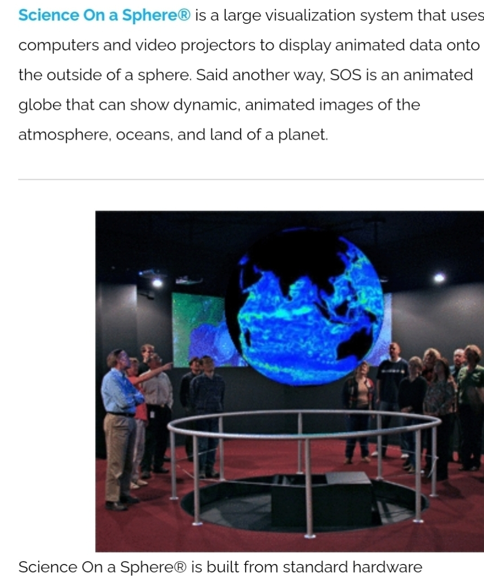
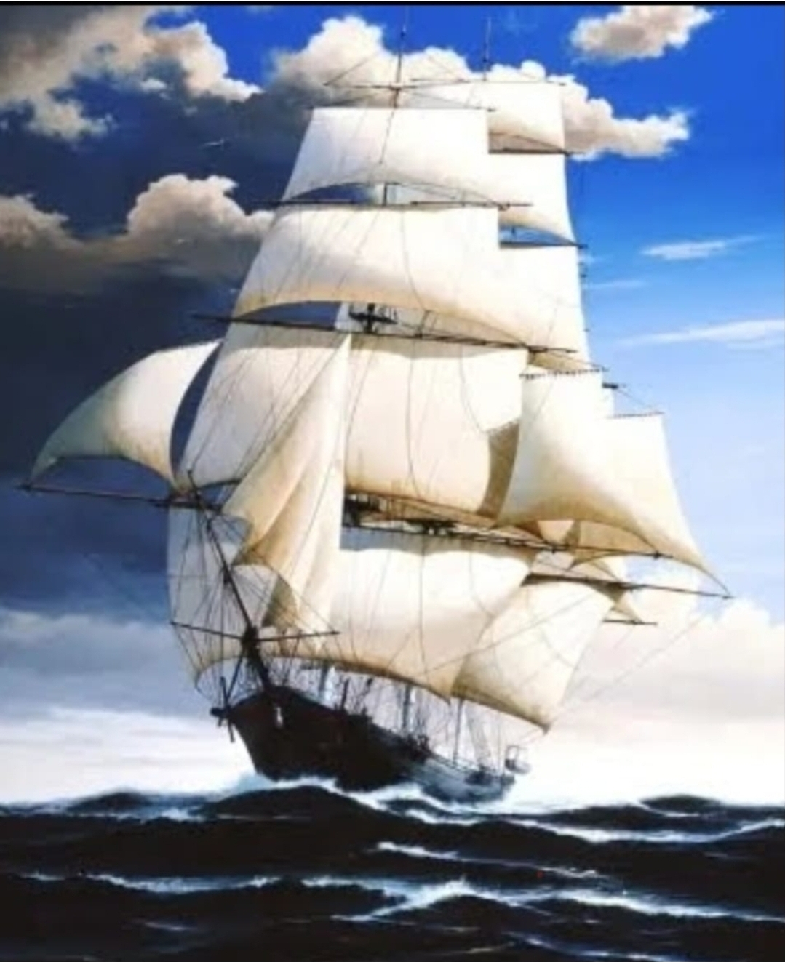
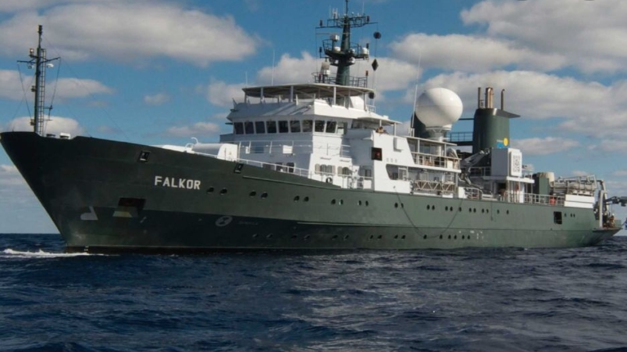
Abstract:
Logo
Title:
Author(s):
Affiliations:
Figures & Graphs:
Slide/poster size is 40.97x23.04 (16:9 aspect ratio)
Minimum font: 28pt (this may seem large, but at this poster size it’s not)
Recommended font Types: Calibri, Arial, Times New Roman
This is only a template. All content may be modified, except for slide dimensions
If you are creating your e-poster on a PC, please make sure to save your formulas as an image and embed it into your presentation or they will change on our Macs.
Include and image or a graph for visual appeal. If you have more than one, they will be viewable in the center when this section is selected.
Don’t exceed past this point.
FIGURES & GRAPHS
The U.S. component of DORIS will be patterned after NASEM’s Gulf Research Program, whose members represent federal, state, and local agencies, universities, private industries, NGOs and non-profit organizations, philanthropic foundations, and regional conservancies. The scope of the DORIS program will include the entirety of the Earth’s international waters. A strategic plan will be developed to ensure that the decadal-spanning goals to develop, translate, and apply marine science and oceanographic engineering can be achieved, and medical knowledge from deep ocean sources can be enhanced.
Introduction:
Results:
Keep it short and sweet.
More explanation and images/graphs/videos will be viewable in the center when this section is selected.
Around 3-4 bullet points.
Keep it short and sweet.
More explanation and images/graphs/videos will be viewable in the center when this section is selected.
Around 3-4 bullet points.
Methods:
Step-by-step explanation
More explanation and images/graphs/videos will be viewable in the center when this section is selected.
As many bullet points as needed, but keep it around 5-6 (fit within this side of the page.
Don’t exceed past this point.
Conclusions:
Keep it short and sweet.
More explanation and images/graphs/videos will be viewable in the center when this section is selected.
Around 3-4 bullet points.
References:
Font for this can be relatively small (around 18pt).
Can give a general thanks or contact information.
The larger reference list can be viewable in the middle with the section is selected.
Click Section Headings to View Additional Content

Slide 5
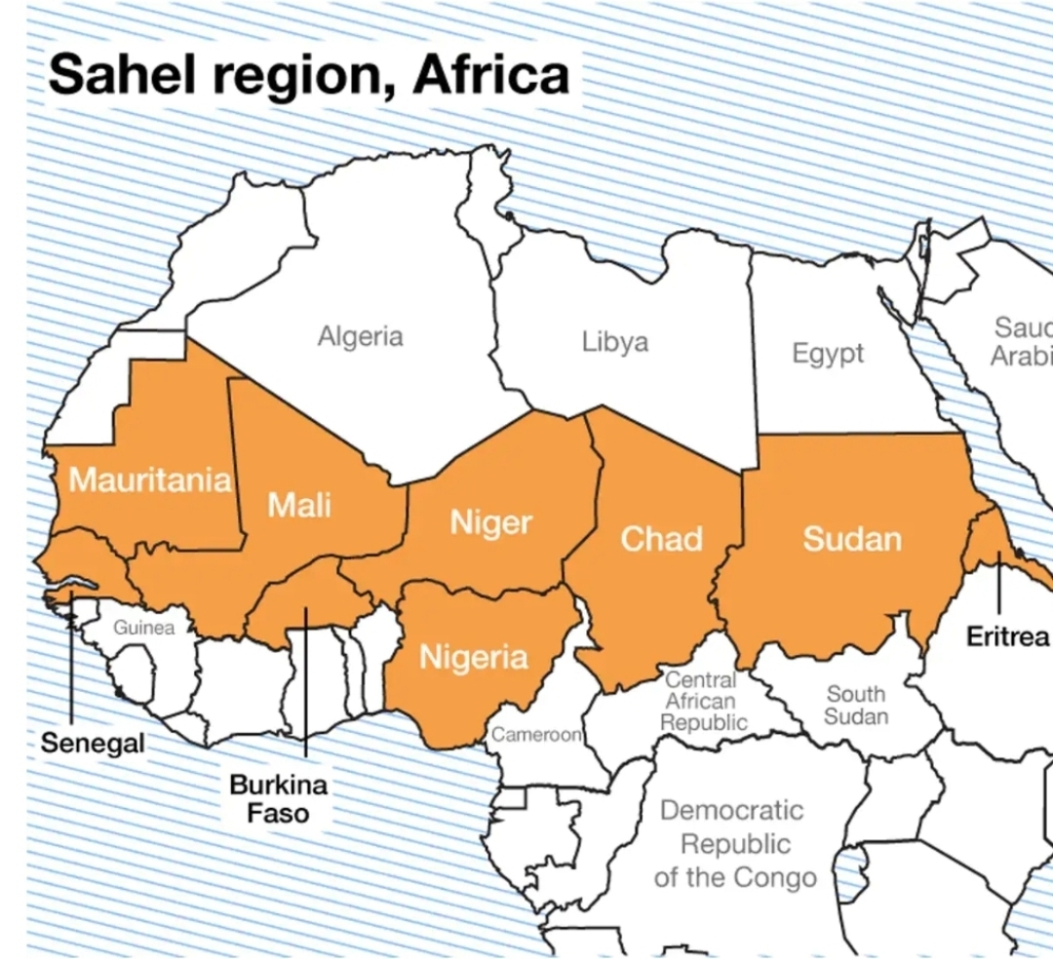


Abstract:
Logo
Title:
Author(s):
Affiliations:
Figures & Graphs:
Slide/poster size is 40.97x23.04 (16:9 aspect ratio)
Minimum font: 28pt (this may seem large, but at this poster size it’s not)
Recommended font Types: Calibri, Arial, Times New Roman
This is only a template. All content may be modified, except for slide dimensions
If you are creating your e-poster on a PC, please make sure to save your formulas as an image and embed it into your presentation or they will change on our Macs.
Include and image or a graph for visual appeal. If you have more than one, they will be viewable in the center when this section is selected.
Don’t exceed past this point.
RESULTS
DORIS will also identify, monitor and map sustainable fishing zones. Catch limits will be determined to ensure an adequate food supply for provisioning Earth’s growing population, while maintaining a healthy fishing environment. Additionally, it is envisioned that DORIS will serve as an aquacultural research station to implement new methods of sustainable and salient aquacultural practices. DORIS will also be used to perform research for desalination processes, with the aim of providing fresh water to Earth’s regions afflicted by drought and inadequate or contaminated fresh water resources.
Introduction:
Results:
Keep it short and sweet.
More explanation and images/graphs/videos will be viewable in the center when this section is selected.
Around 3-4 bullet points.
Keep it short and sweet.
More explanation and images/graphs/videos will be viewable in the center when this section is selected.
Around 3-4 bullet points.
Methods:
Step-by-step explanation
More explanation and images/graphs/videos will be viewable in the center when this section is selected.
As many bullet points as needed, but keep it around 5-6 (fit within this side of the page.
Don’t exceed past this point.
Conclusions:
Keep it short and sweet.
More explanation and images/graphs/videos will be viewable in the center when this section is selected.
Around 3-4 bullet points.
References:
Font for this can be relatively small (around 18pt).
Can give a general thanks or contact information.
The larger reference list can be viewable in the middle with the section is selected.
Click Section Headings to View Additional Content

Slide 6
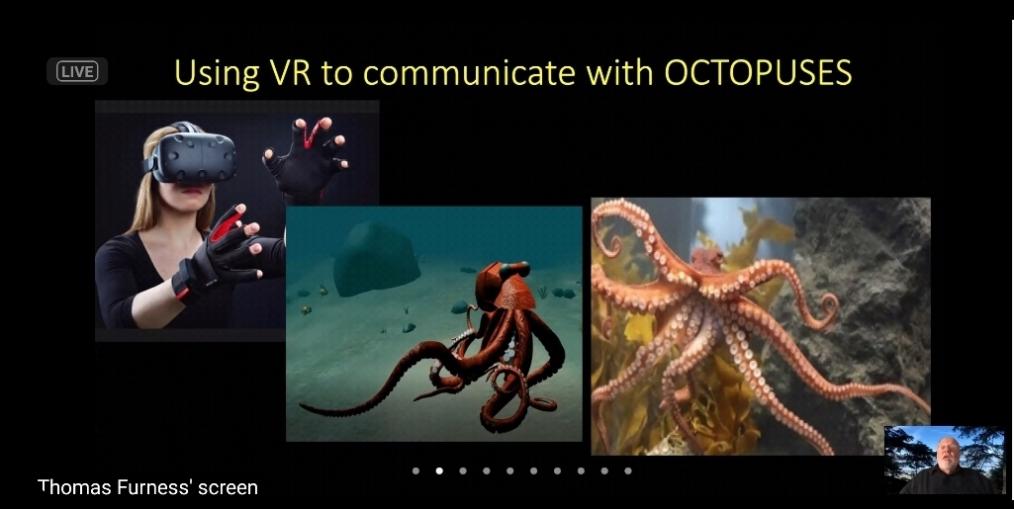

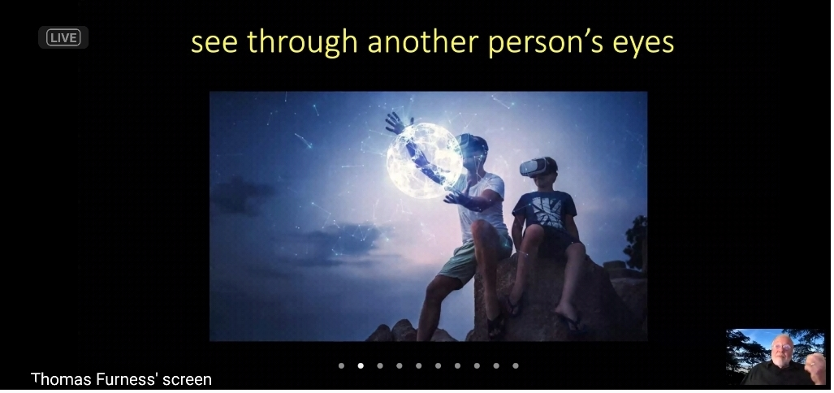
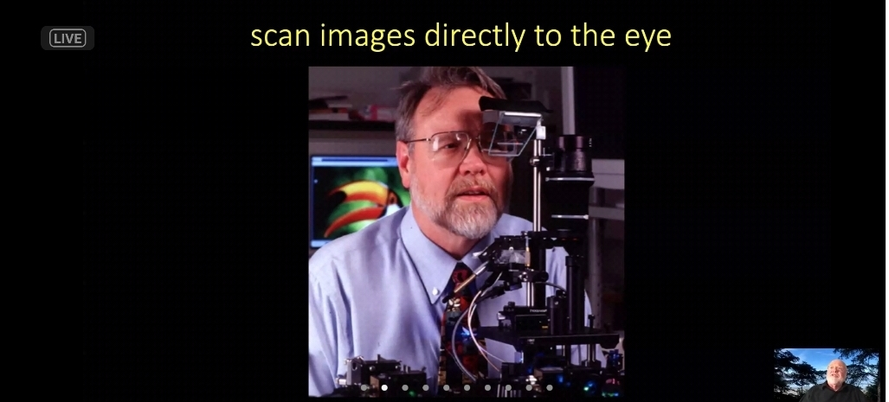
Abstract:
Logo
Title:
Author(s):
Affiliations:
Figures & Graphs:
Slide/poster size is 40.97x23.04 (16:9 aspect ratio)
Minimum font: 28pt (this may seem large, but at this poster size it’s not)
Recommended font Types: Calibri, Arial, Times New Roman
This is only a template. All content may be modified, except for slide dimensions
If you are creating your e-poster on a PC, please make sure to save your formulas as an image and embed it into your presentation or they will change on our Macs.
Include and image or a graph for visual appeal. If you have more than one, they will be viewable in the center when this section is selected.
Don’t exceed past this point.
CONCLUSIONS
Similar to NASA’s annual SpaceApps Challenge and hackathon, DORIS could be marketed to young aquanauts worldwide. The idea of undersea voyages of exploration is ancient, yet until this decade the resources, technological capabilities, and international resolve to undertake such exploratory missions for the entire Earth’s benefit have been few, with notable exceptions such as the Jacques Cousteau Calypso voyages. Like the ISS, DORIS would serve as a beacon to a new generation of ocean scientists, and could be a platform for harmonious international cooperation and valuable scientific discovery
Introduction:
Results:
Keep it short and sweet.
More explanation and images/graphs/videos will be viewable in the center when this section is selected.
Around 3-4 bullet points.
Keep it short and sweet.
More explanation and images/graphs/videos will be viewable in the center when this section is selected.
Around 3-4 bullet points.
Methods:
Step-by-step explanation
More explanation and images/graphs/videos will be viewable in the center when this section is selected.
As many bullet points as needed, but keep it around 5-6 (fit within this side of the page.
Don’t exceed past this point.
Conclusions:
Keep it short and sweet.
More explanation and images/graphs/videos will be viewable in the center when this section is selected.
Around 3-4 bullet points.
References:
Font for this can be relatively small (around 18pt).
Can give a general thanks or contact information.
The larger reference list can be viewable in the middle with the section is selected.
Click Section Headings to View Additional Content

