Slide 1

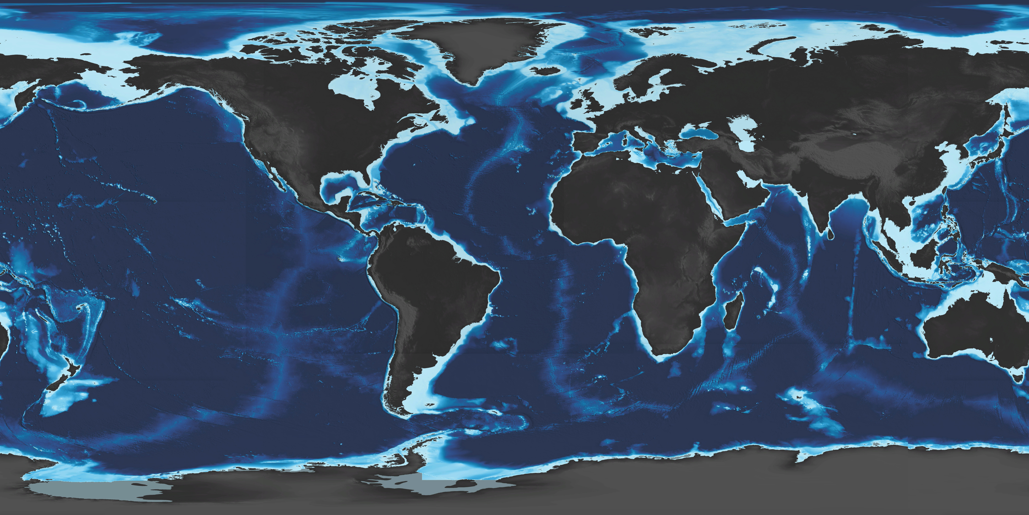
Interactive!
Click on any of these bubbles to jump to each section
Persistent Mobile Ocean Observing: Marine Vehicle Highways
Dana Manalang¹, William Wilcock¹, Kendra Daly²
¹University of Washington, ²University of South Florida
SCIENCE
TECH
Exponential decrease in cost per measurement
Exponential increase in AUV operations
Testable on smaller scales
CONCEPT
Marine Vehicle Highways (MVH):
Global infrastructure for Ocean and Planetary Health Monitoring by a fleet of marine vehicles compatible with standard interface
Observe difficult-to-predict transient events that drive ocean processes not accessible to fixed instrumentation
Opportunity for global partnerships and open to any vehicle developer
MVH route – arrays of service stations
Vehicle maintenance site

Slide 2
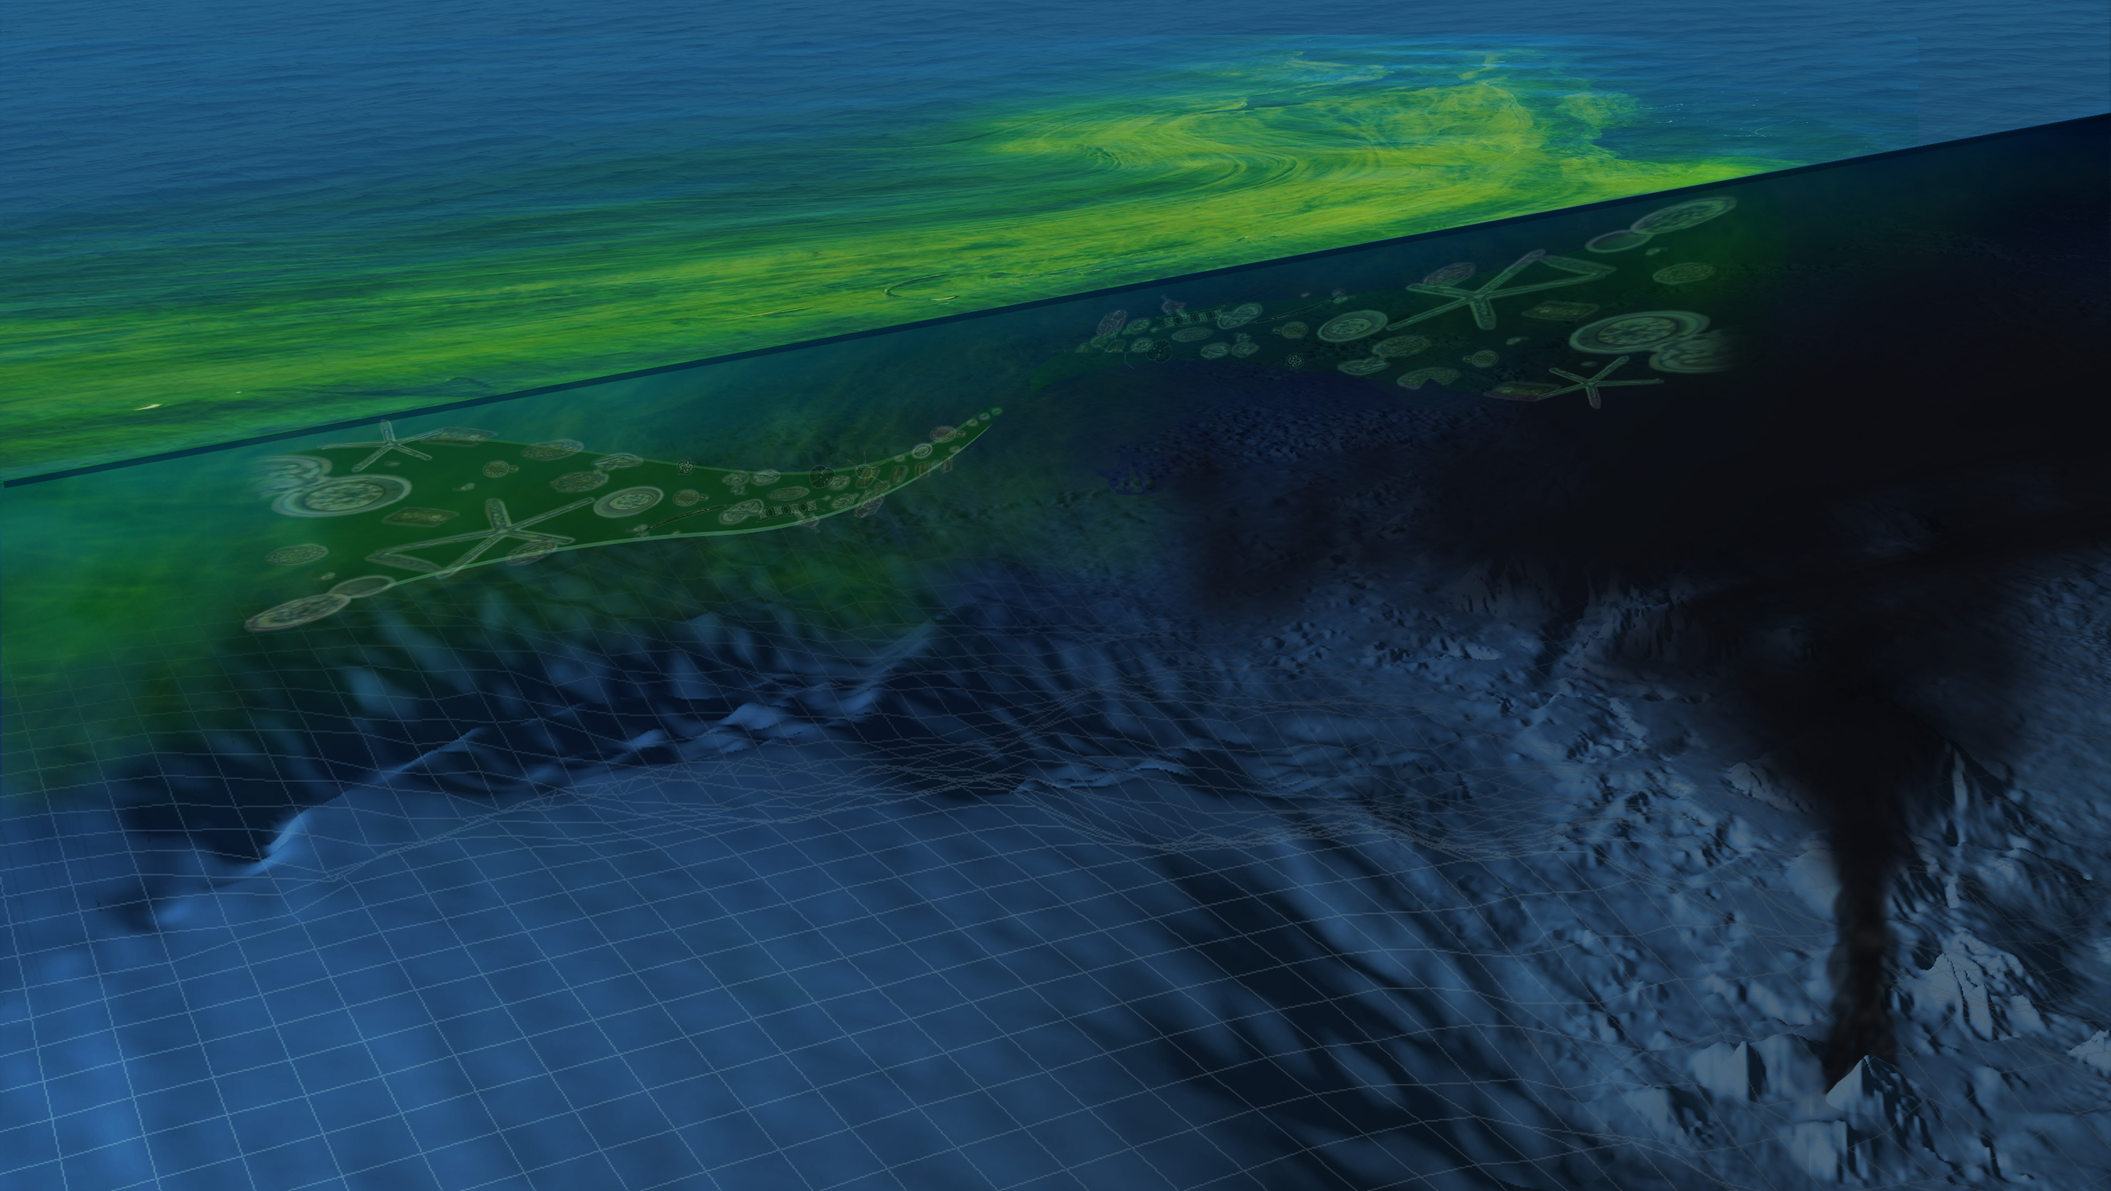
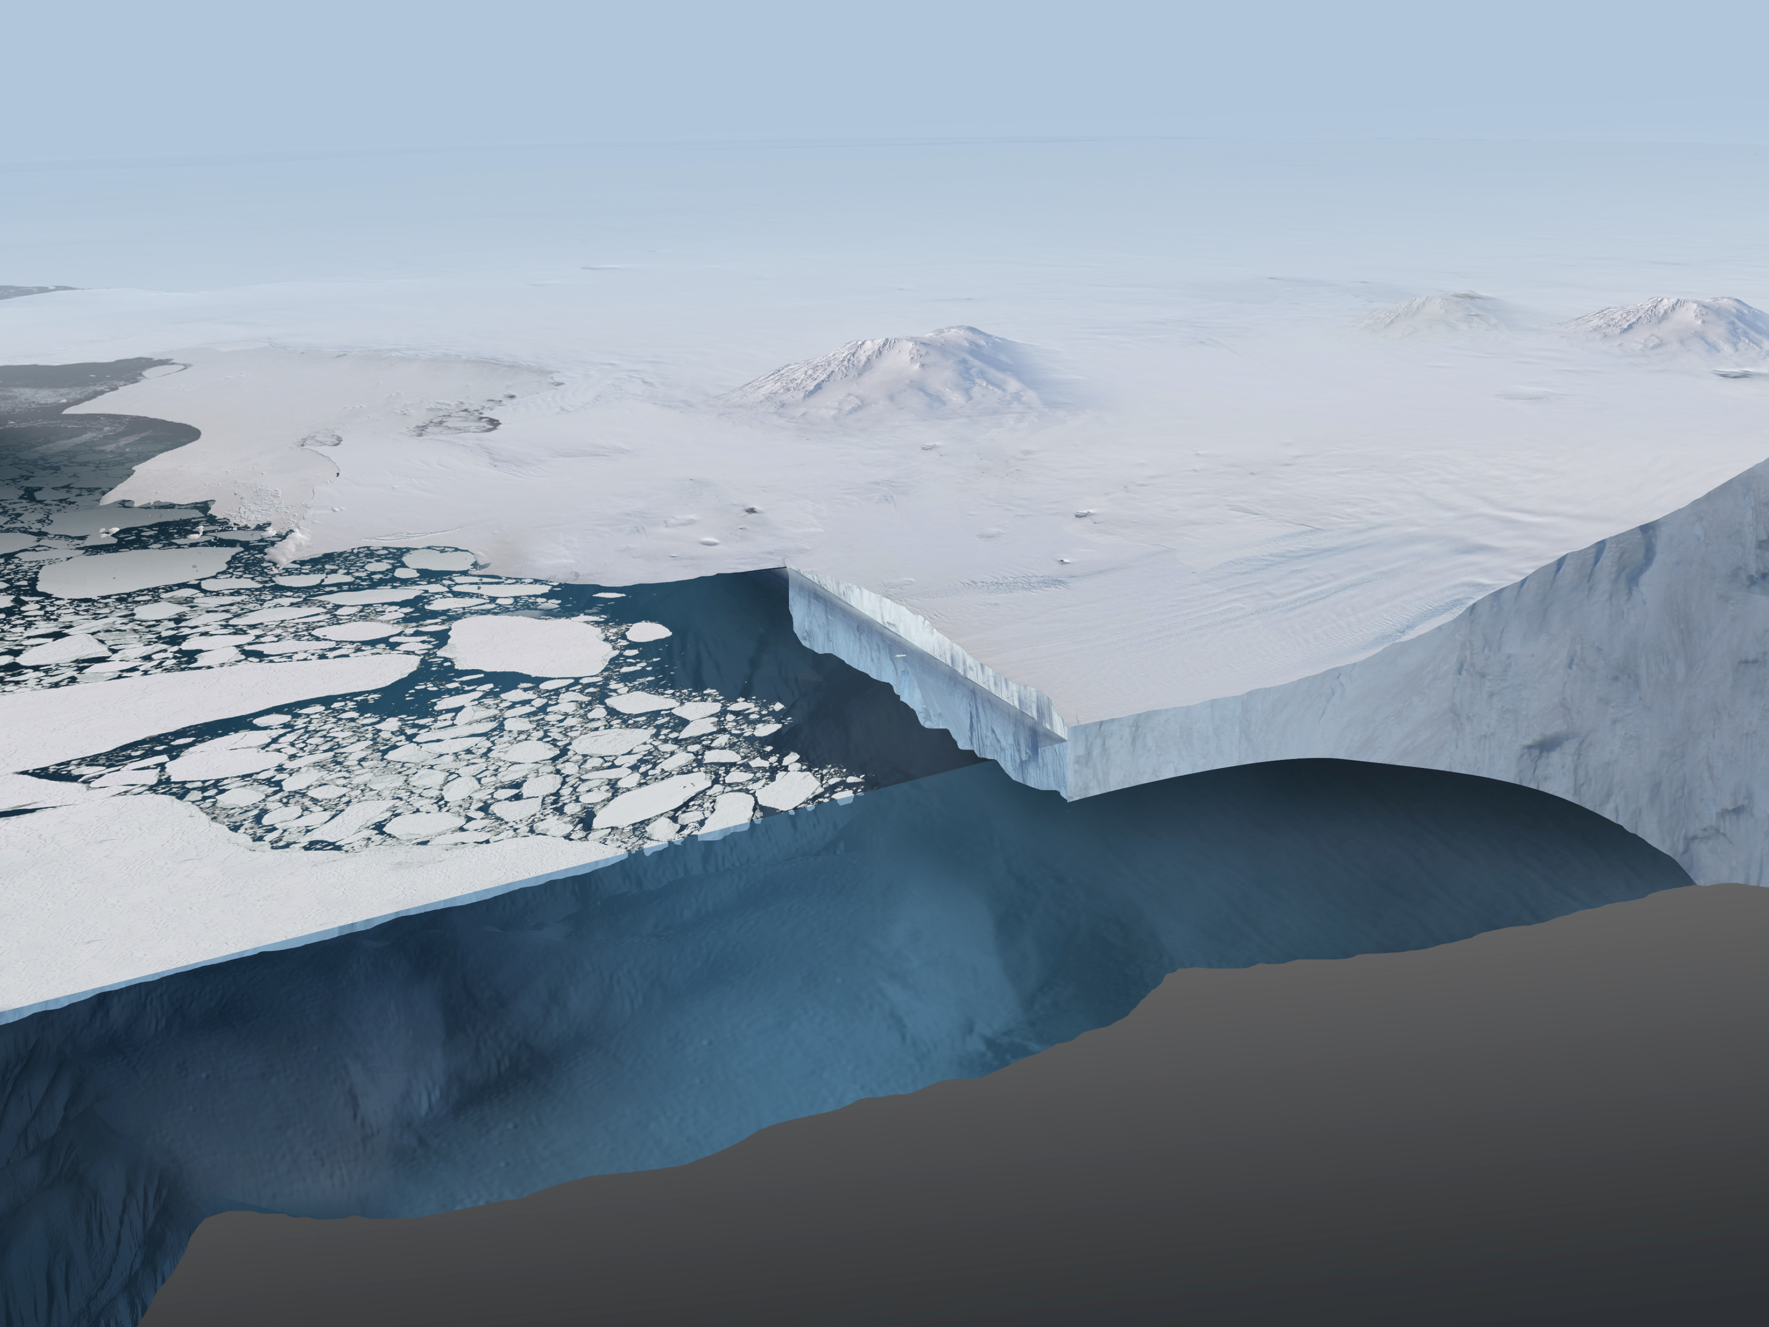
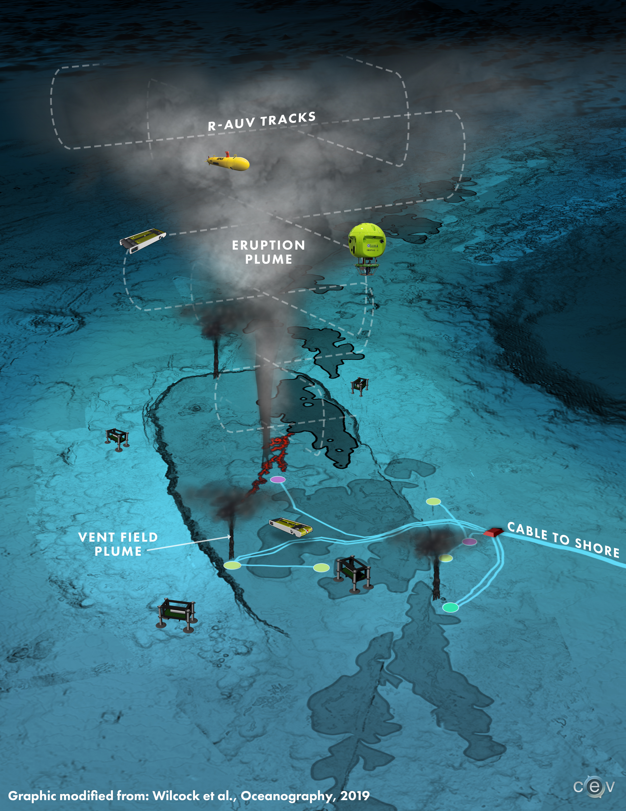
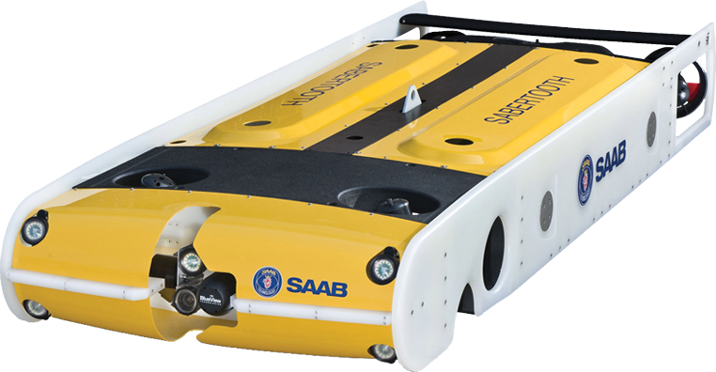
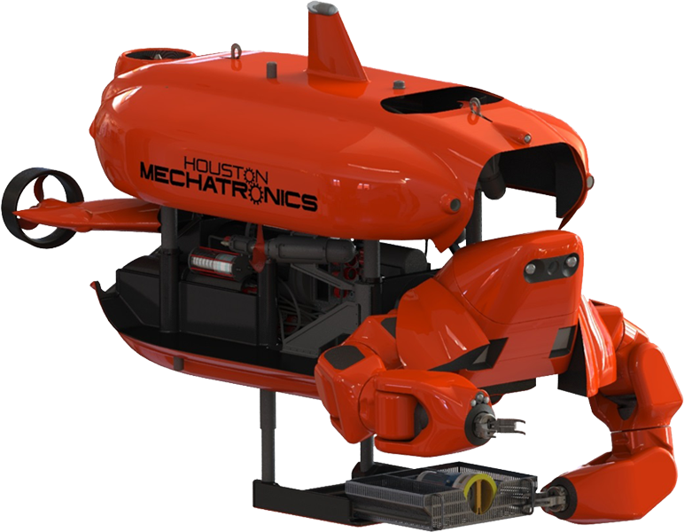
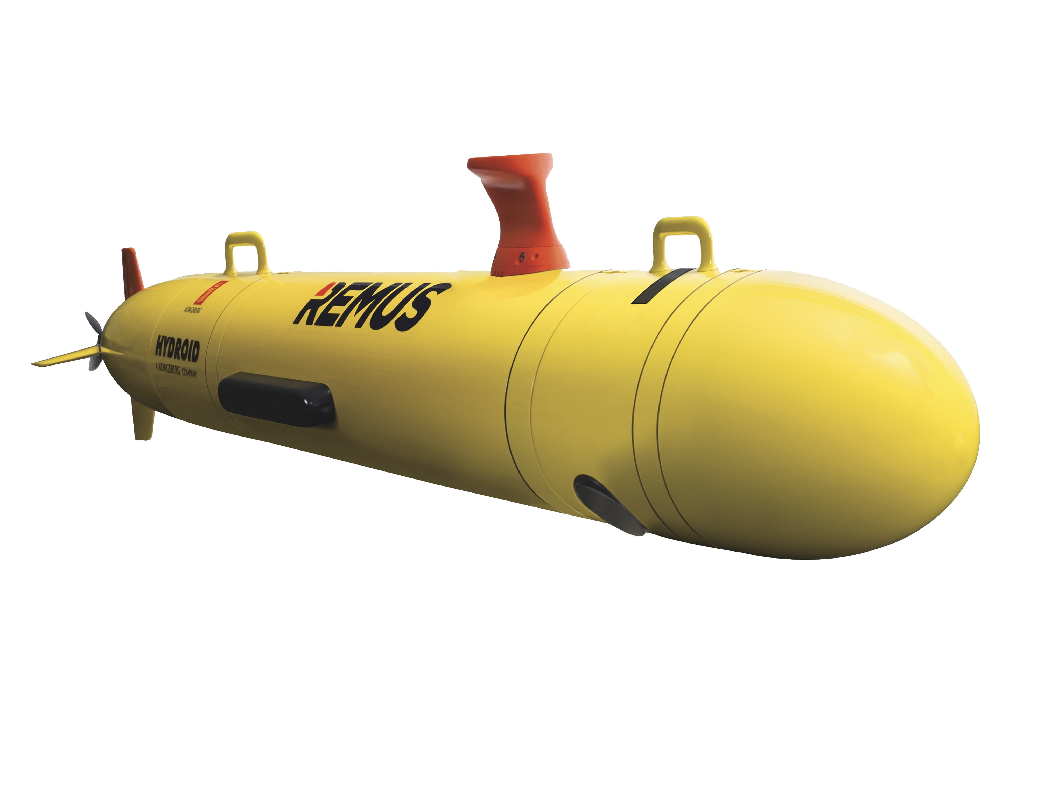
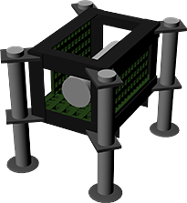
Interactive!
Click on any of these bubbles to jump to each section
Persistent Mobile Ocean Observing: Marine Vehicle Highways
Dana Manalang¹, William Wilcock¹, Kendra Daly²
¹University of Washington, ²University of South Florida
CONCEPT
TECH
Repeated sea-ice and ecosystem surveys are critical to understanding the rapidly changing Arctic.
SCIENCE
Repeated year-round surveys of coral reefs reveal critical indications of reef health.
Vehicles detecting meanders of the Gulf Stream near the continental shelf will advance understanding of effects on coastal circulation and shelf ecosystems.
Because vehicles can recharge and offload data along the route, they have increased payload capacity for mission-critical instruments like sonars, laser scanners, samplers, manipulators, high resolution camera systems, and E-DNA systems.
Submarine eruptive plumes are energetic and transient. AUVs will measure chemical content and collect samples for E-DNA analysis as the plume ascends within the water column.

Slide 3
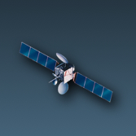
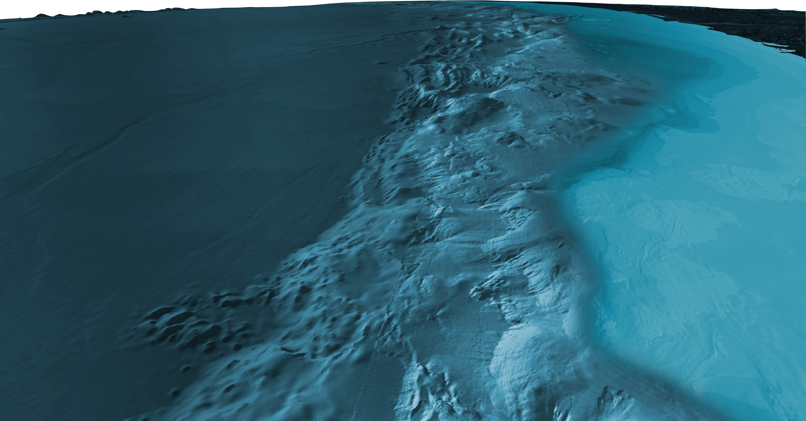
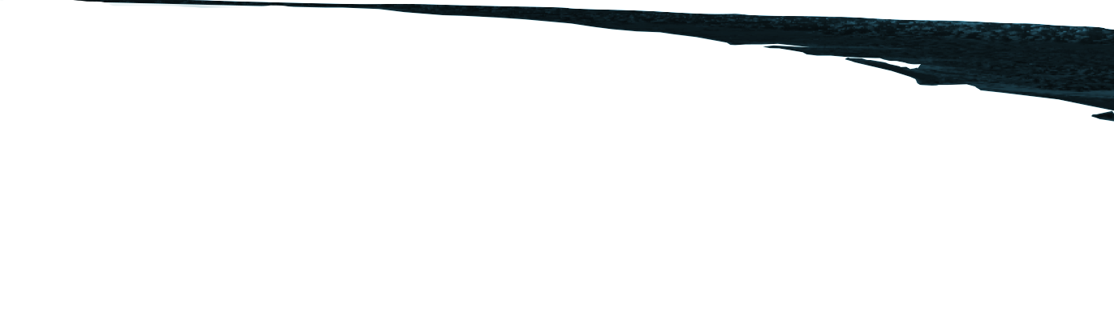
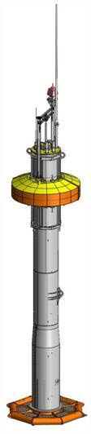
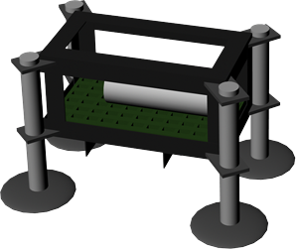
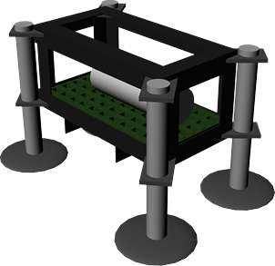
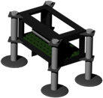
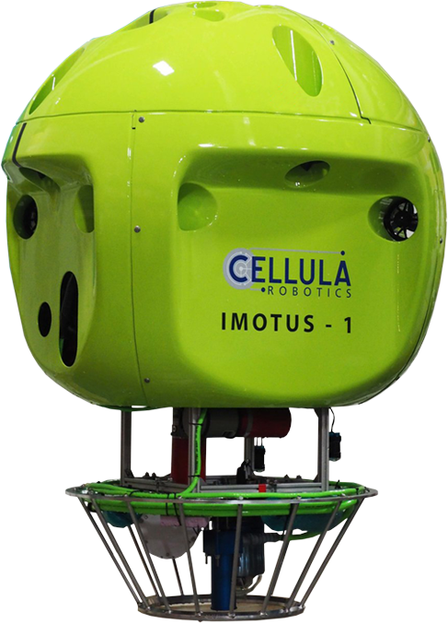
Interactive!
Click on any of these bubbles to jump to each section
Persistent Mobile Ocean Observing: Marine Vehicle Highways
Dana Manalang¹, William Wilcock¹, Kendra Daly²
¹University of Washington, ²University of South Florida
CONCEPT
SCIENCE
Service stations accept power and comms to shore from cabled infrastructure or energy harvesting platforms. Any vehicle with a compatible docking module can recharge, upload data, and receive re-tasking.
TECH
Vehicle service stations will provide a standard interface for wireless battery charging and communications. Vehicles are launched from coastal sites while shore-based operators monitor vehicle progress along programmed routes. Multiple vehicles can operate along MVH at any time.
Service Stations send periodic acoustic signals to aid inbound vehicle navigation.
Vehicles recover data and provide timing corrections to long term instrumentation without surface expressions.
Service Stations include integrated comms module – vehicle and station select appropriate comms channel for range, message length.
Some vehicles may remain resident at a service station, performing repeated missions in the same area to collect baseline data and loitering in a low power mode when other vehicles stop to recharge.
Vehicle recharges batteries and uploads data/health status using a real-time link to shore while docked.

Slide 4
Interactive!
Click on any of these bubbles to jump to each section
EPOSTERBOARDS TEMPLATE
Click here to add author(s)
Click here to add affiliations
Introduction
Methods
Results
Discussion

