Slide 1

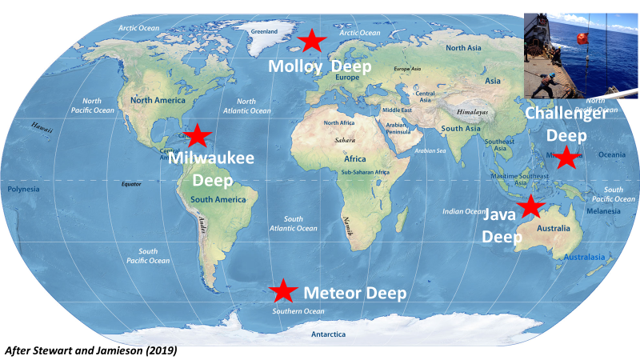

The Vision:
Measuring the pulse of Earth’s global ocean
The Ocean Sound & Marine Life Interagency Working Group
Partners & Connections
We will use unique, deep-ocean hydrophone sensors, pressure cases, moorings rated to 11,000 meters depth developed by NOAA-PMEL and several industry partners:
High-Tech Inc., Nautilus Marine, Deep-Sea Power & Light, RBR Inc.
This project will also connect multiple U.S. agencies and departments:
Navy, Army, Coast Guard, USGS, BOEM, NOAA, National Parks, National Science Foundation, and Department of State.
Researchers from several academic oceanographic institutions will be involved in the project:
WHOI, Scripps, Washington, and Oregon State University
Additional deep ocean mooring/lander technology will require entraining several private sector entities:
Teledyne, Kongberg, IcListen, Ocean Sonics & Jasco
NGO partners that can contribute regional and global class research vessels to access these deep-ocean sites:
Caladan Oceanic, Ocean Exploration Trust, and Oceanx
The project will work with several international ocean sound monitoring organizations:
International Quiet Ocean Experiment, JAMOPANS, International Ocean Noise Coalition
Accurate locations of the deepest seafloor areas in each of the Earth’s five major ocean basins have only recently been determined.
We plan to deploy a unique, deep-ocean capable hydrophone-lander system at each of these deep-sea sites (>7k meters).
Our goal is to make the first, simultaneous measurement of baseline ocean sound levels in what should be the quietest (i.e., lacking human-made noise) locations on Earth.
Anthropogenic ocean noise is rising worldwide due to increased container shipping in a growing global economy. High ocean noise levels have a deleterious effect on marine animals/ecosystems, impacting fisheries and other marine economic sectors.
The exact location and depth of the deepest spot in each of the world's oceans has been surprisingly unresolved. Erroneous data at these locations have remained uncorrected in literature until recent efforts by Steward and Jamieson [2019]. The deepest spot in each ocean are:
(1) Molloy Hole, Arctic (5,669 m);
(2) Puerto Rico Trench, Atlantic (8,408m);
(3) Java Trench, Indian (7,290 m);
(4) Mariana Trench, Pacific (10,925 m); and
(5) South Sandwich Trench, Southern Ocean (7,385 m).
Outreach & Engagement
Our ocean sound program aspires to develop a robust and inclusive education component that partners with Universities, focusing on Minority Serving-Strengthening Institutions, for undergraduate internship and graduate research programs.
We will engage global academic institutions to develop public outreach programs that work with local communities to build understanding of the impact of human-made noise on the health of marine ecosystems.
We also plan to engage with national/international museums & aquariums to create exhibits with our unique deep-ocean sound clips to increase public outreach & engagement.

