Slide 1




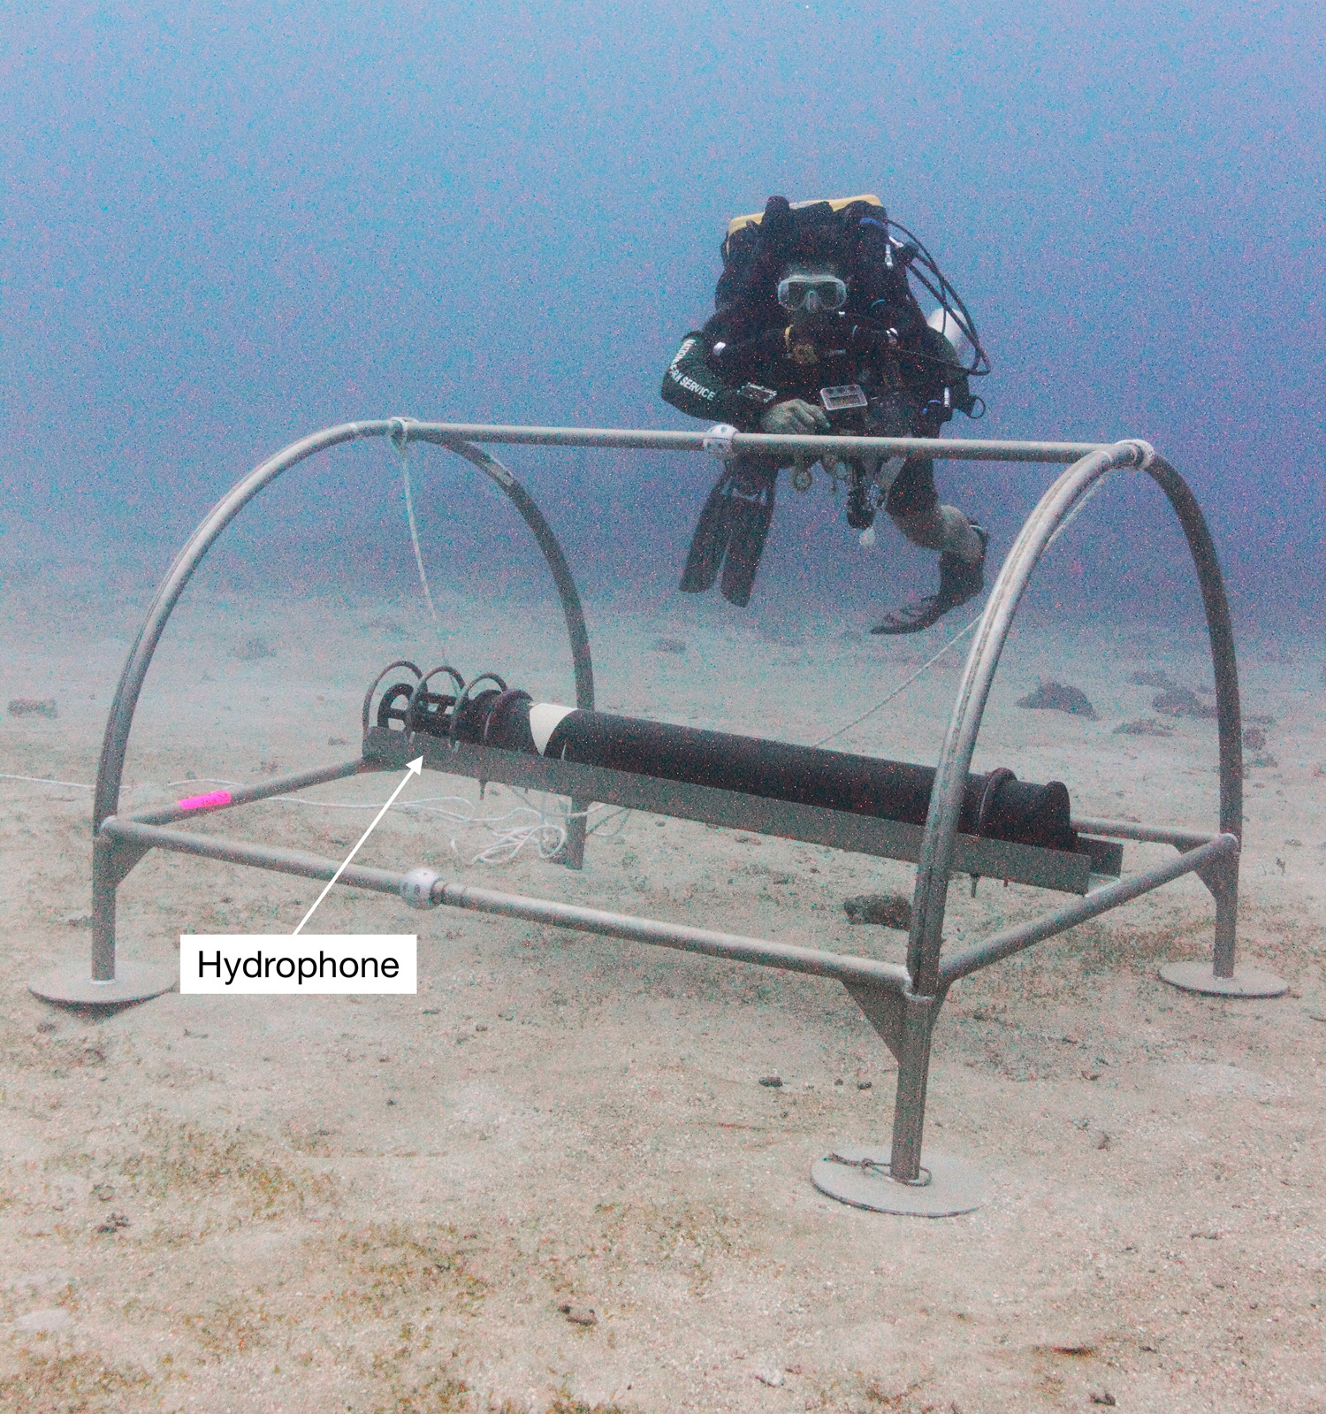





Auscultating the Oceans:
Developing a Marine Stethoscope
OUTCOMES
Ability to provide activity-based information in and across regions
Data-informed basis for policy and a management of anthropogenic ocean noise
Integrate acoustics into broader ocean communication and outreach.
Auscultate is to examine a patient by listening to sounds. Just like doctors need stethoscopes, we need tools to measure ocean health.
PUBLIC HEALTH
OCEAN HEALTH
Doctors
Science Practitioners
Use tools like stethoscopes
Use tools like hydrophones
BACKGROUND
Sound travels efficiently in water and carries a rich amount of information.
Sound allows us to peer into vast swatches of our ocean’s interior.
These traits make ocean acoustic research an effective ocean health tool.
We can listen to the full range of consonant and cacophonous sounds in the ocean and objectively assess its current and future health.
W.M. Keck Foundation/WHOI
➢3D Hydrophone Phased Array
➢Real-Time Data Telemetry
To collect data like heart rate
To collect baseline acoustic data
Then calculate and examine metrics
Then calculate and examine metrics
To inform treatment
To inform policy and management action.
For more details click here
Health

Slide 2

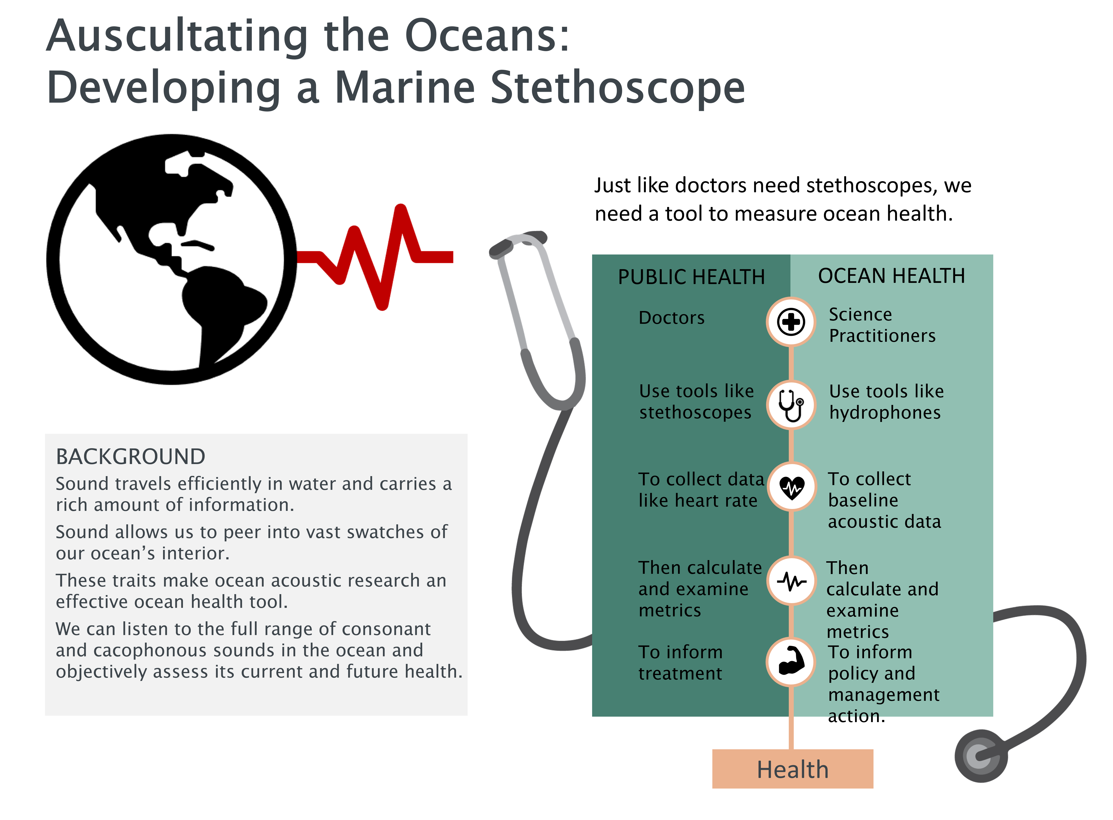
The Vision:
Partners & Connections
Sound carries with it a rich amount of information pertaining to both sources and the environment.
With the efficiency at which it travels in water, sound provides a vantage point for peering into vast swatches of our ocean’s interior. Using these traits, envisioned is a capacity for listening to the full range of consonant and cacophonous sounds in the ocean and objectively assessing its current and future state.
The marine stethoscope concept is inspired by recent advances, including the use of machine learning, to aid listening to, and labeling, heart and lung sounds as has been done starting with the invention of the stethoscope in 1816.
The vision will be enabled by technology, information processing capabilities, and standards for characterizing the undersea acoustic environment at temporal and spatial scales relevant to human and marine life.
These will be used to establish objective baselines for acoustic environments and provide activity-based information in and across regions. It will be transformative in that these newly identified patterns of natural and anthropogenic sound can be monitored and assessed to enable diagnostic capabilities.
This new capability will provide a data-informed basis for recommending policy and management of anthropogenic sound in the context of extant regional soundscapes.
Ocean Acoustics is highly intertwined with both the physical and biological aspects of the ocean that define the field of Oceanography, yet it is often underrepresented in the ocean sciences community.
This topic will integrate acoustics into the broader ocean sciences community as well as engage expertise in fields such as Machine Learning, Artificial Intelligence, Pattern Recognition, Signal Processing, Information Theory, Statistics, Geospatial Analysis, and others.
Drawing on people’s affinity for music, biology, and exploration a robust and inclusive education/outreach program will encourage development of a multi-disciplinary community with the knowledge and skillset required to understand the ocean through sound.
Outreach & Engagement
This concept promotes sound as a defining characteristic of the ocean environment that is intertwined with both the physical and biological aspects of oceanography. It reveals a hidden demand signal for needed training in acoustics alongside the physical, biological, mathematical, and engineering sciences required to support the ocean sector.
Making connections with music, exploration, medicine, and other fields can further encourage development of education/outreach programs to build a diverse community.
Development of an inexpensive junior ocean stethoscope (akin to what’s found in a children’s medical kit) could attract the k-12 set and citizen scientists.
Auscultate: examine a patient by listening to sounds (from the heart, lungs, or other organs)
Connections to existing infrastructure
A recent inventory of federally funded passive acoustic monitoring assets included over 120 entries with support coming from 8 agencies plus NOPP, and the National Fish and Wildlife Foundation, Packard Foundation, Greenland Institute of Natural Resources, and Korea Polar Research Institute. The International Quiet Ocean Experiment (IQOE) has documented a mix of cabled, fixed-autonomous, and mobile-autonomous observation totaling around fifty (50) around the globe having acoustic capabilities. CTBTO provides a good example for low-frequency sound. The Exploration and Production Sound and Marine Life Joint Industry Program (JIP) can provide direct connectivity to the petroleum industry. Communication, coordination, and collaboration among entities to agree upon metrics, measurement and data accessibility practices, and sustainment approaches will bring the vision to realization. This includes developing new technology solutions as required for the benefit of the community. The strategy for mapping, exploring, and characterizing the US EEZ provides an implementation path.

