Slide 1
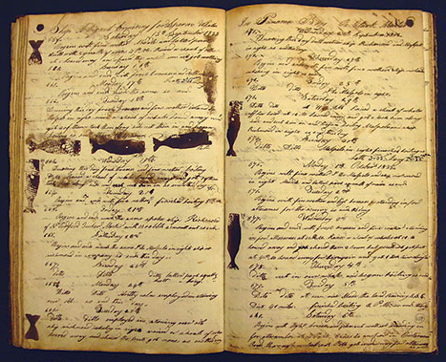
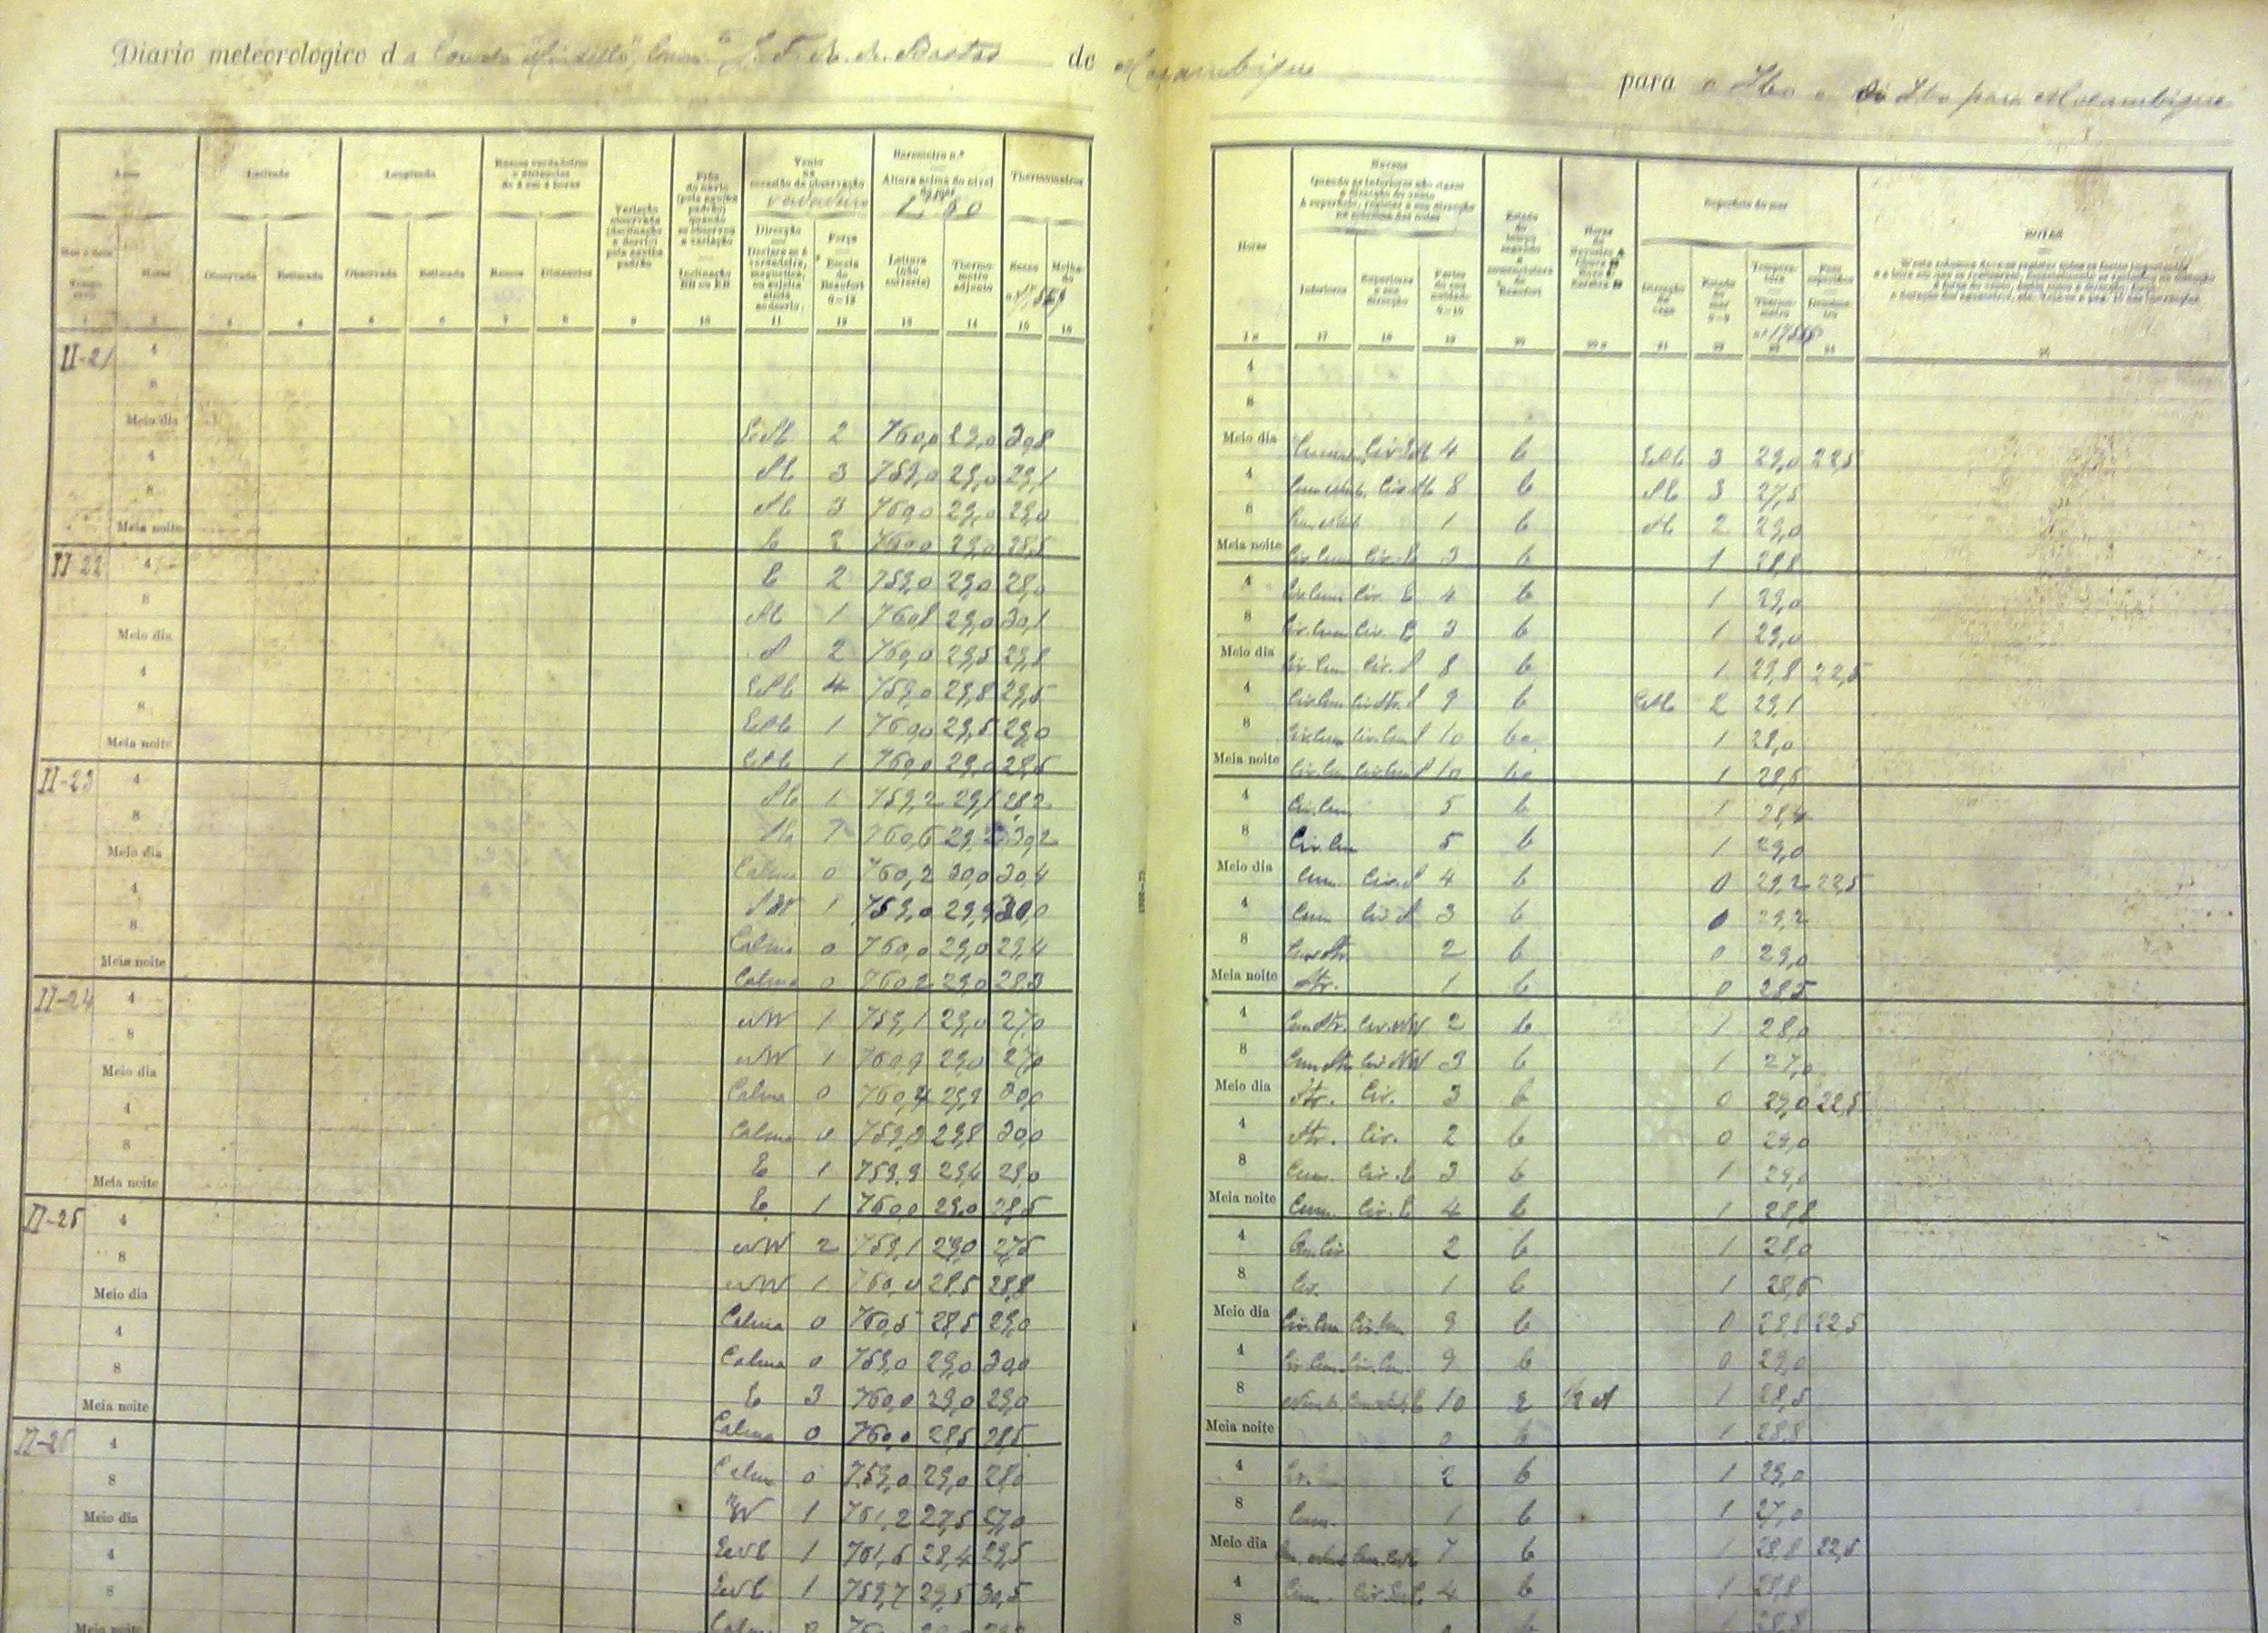
Mining Five Centuries of Climate and Maritime Weather Data from Historic Records
Caroline C. Ummenhofer¹ and Timothy D. Walker²
¹Department of Physical Oceanography, Woods Hole Oceanographic Institution, Woods Hole, MA, USA;
²Department of History, University of Massachusetts, Dartmouth, MA, USA
Abstract
Long datasets are invaluable to establishing baseline weather and climate conditions. Yet pre-19th century instrumental data are sparse, especially over oceans. A growing field of scholarship addresses this gap by interpreting historic records. One of the richest troves of maritime weather data is contained in the vast archives of ship logs. While navy and merchant logbooks from the Royal British Navy or East India Company were targeted before, a wealth of untapped maritime weather information resides in whaling ship logbooks – with the world’s largest holdings in New England archives. This is complemented by untapped historic records such as port and customs records kept by European colonial powers of the 15th-19th century in enclaves around the world. Building on established protocols from prior data rescue efforts to transfer qualitative information to quantitative weather records, digitizing and extracting historic observations greatly expands current records of maritime weather around the world back to ~1500 CE, feeds into community reanalysis modeling efforts, and offers the opportunity to engage the public through citizen science.
More than 4400 whaling ship logbooks detailing sub-daily and daily weather conditions from ~5000, often multi-year, voyages with global reach over the period 1790-1910 are held in New England whaling archives alone.
New Bedford whaleship Abigail logbook (1831-1835);
Voyage included the Atlantic, Indian, and Pacific Oceans
New Bedford Whaling Museum Library
Portuguese vessel Mindelo; East Africa (Mozambique), 1877, Arquivo Histórico de Moçambique; Maputo

Slide 2
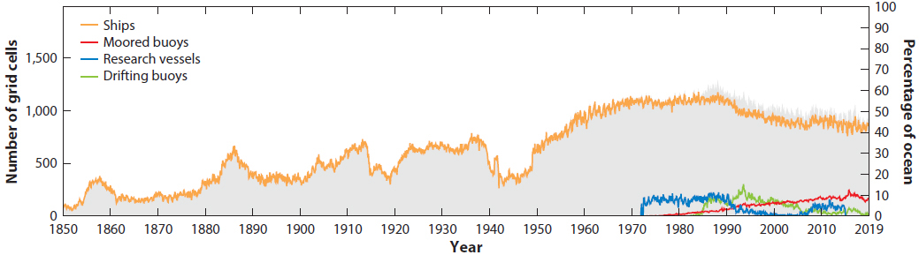
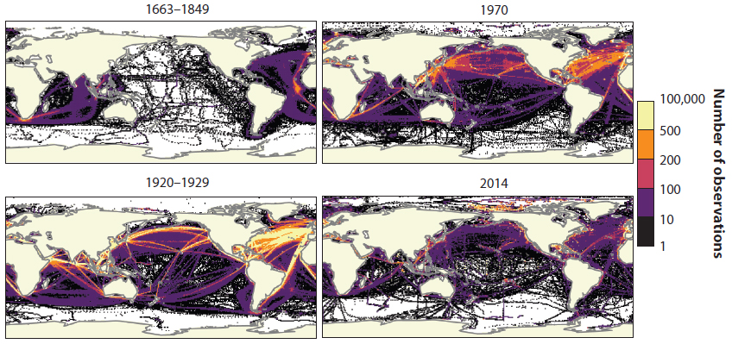
Mining Five Centuries of Climate and Maritime Weather Data from Historic Records
Caroline C. Ummenhofer¹ and Timothy D. Walker²
¹Department of Physical Oceanography, Woods Hole Oceanographic Institution, Woods Hole, MA, USA;
²Department of History, University of Massachusetts, Dartmouth, MA, USA
Challenges addressed
Challenge 5: Enhance understanding of the ocean-climate nexus and generate knowledge and solutions to mitigate, adapt and build resilience to the effects of climate change across all geographies and at all scales, and to improve services including predictions for the ocean, climate and weather.
Challenge 6: Enhance multi-hazard early warning services for all geophysical, ecological, biological, weather, climate and anthropogenic related ocean and coastal hazards, and mainstream community preparedness and resilience.
Challenge 8: Through multi-stakeholder collaboration, develop a comprehensive digital representation of the ocean, including a dynamic ocean map, which provides free and open access for exploring, discovering, and visualizing past, current, and future ocean conditions in a manner relevant to diverse stakeholders.
Number of 5° monthly grid cells with at least 10 marine air temperature observations over the period 1850–2019 (acc. to ICOADS database). Gray shading shows the number (left axis) and percentage (right axis) of ocean grid cells sampled for all observation types. [From Kent & Kennedy 2021]
Pre-1900 maritime weather data is sparse
In climate science, long datasets are invaluable to
Establish baseline weather and climate conditions
Assess change in the climate system
Validate models used for predictive purposes
Mitigate, adapt, and build resilience to climate and weather (extremes)
Yet, weather recordings outside Europe and North America are sparse prior to the 20th century, especially over the oceans.
Numbers of marine air temperature observations per 1° grid cell during periods shown. [Adapted from Kent & Kennedy 2021]

Slide 3
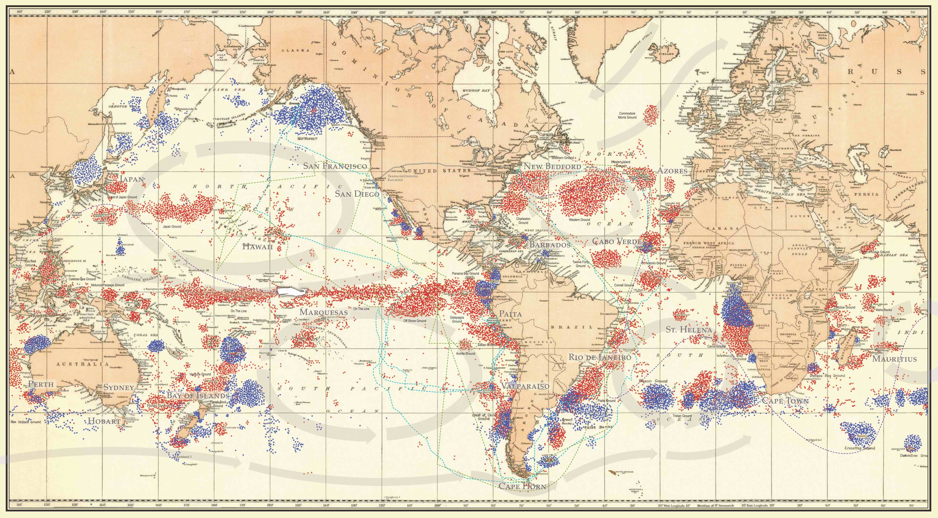
Mining Five Centuries of Climate and Maritime Weather Data from Historic Records
Caroline C. Ummenhofer¹ and Timothy D. Walker²
¹Department of Physical Oceanography, Woods Hole Oceanographic Institution, Woods Hole, MA, USA;
²Department of History, University of Massachusetts, Dartmouth, MA, USA
Vision & transformative impact
Potential for historic weather and climate records
Historic documentation (e.g., navy, merchant, and whaling ship logbooks, colonial port records) contain untapped potential for daily, quantifiable maritime weather information. Recording atmospheric conditions in the nautical context was essential to safe travel. Ship logbooks and port records by European colonial powers (e.g., British, Dutch, French, Portuguese, Spanish) in enclaves around the world contain a wealth of systematic weather observations.
Nearly 90% of all extant whaling ship logbooks (~5000 logbooks), often covering multi-year, voyages with global reach over the period 1790-1910, are held in New England archives alone.
Location | No. of whaling logbooks held
New Bedford Whaling Museum | 2300
New Bedford Free Public Library | 500
Providence Public Library | 900
Nantucket Historical Association | 450
Mystic Seaport (Blunt White Library) | 250
Map by New Bedford Whaling Museum, using data from the Townsend charts (1935).
CLICK FOR VISION, PAGE 2

Slide 4
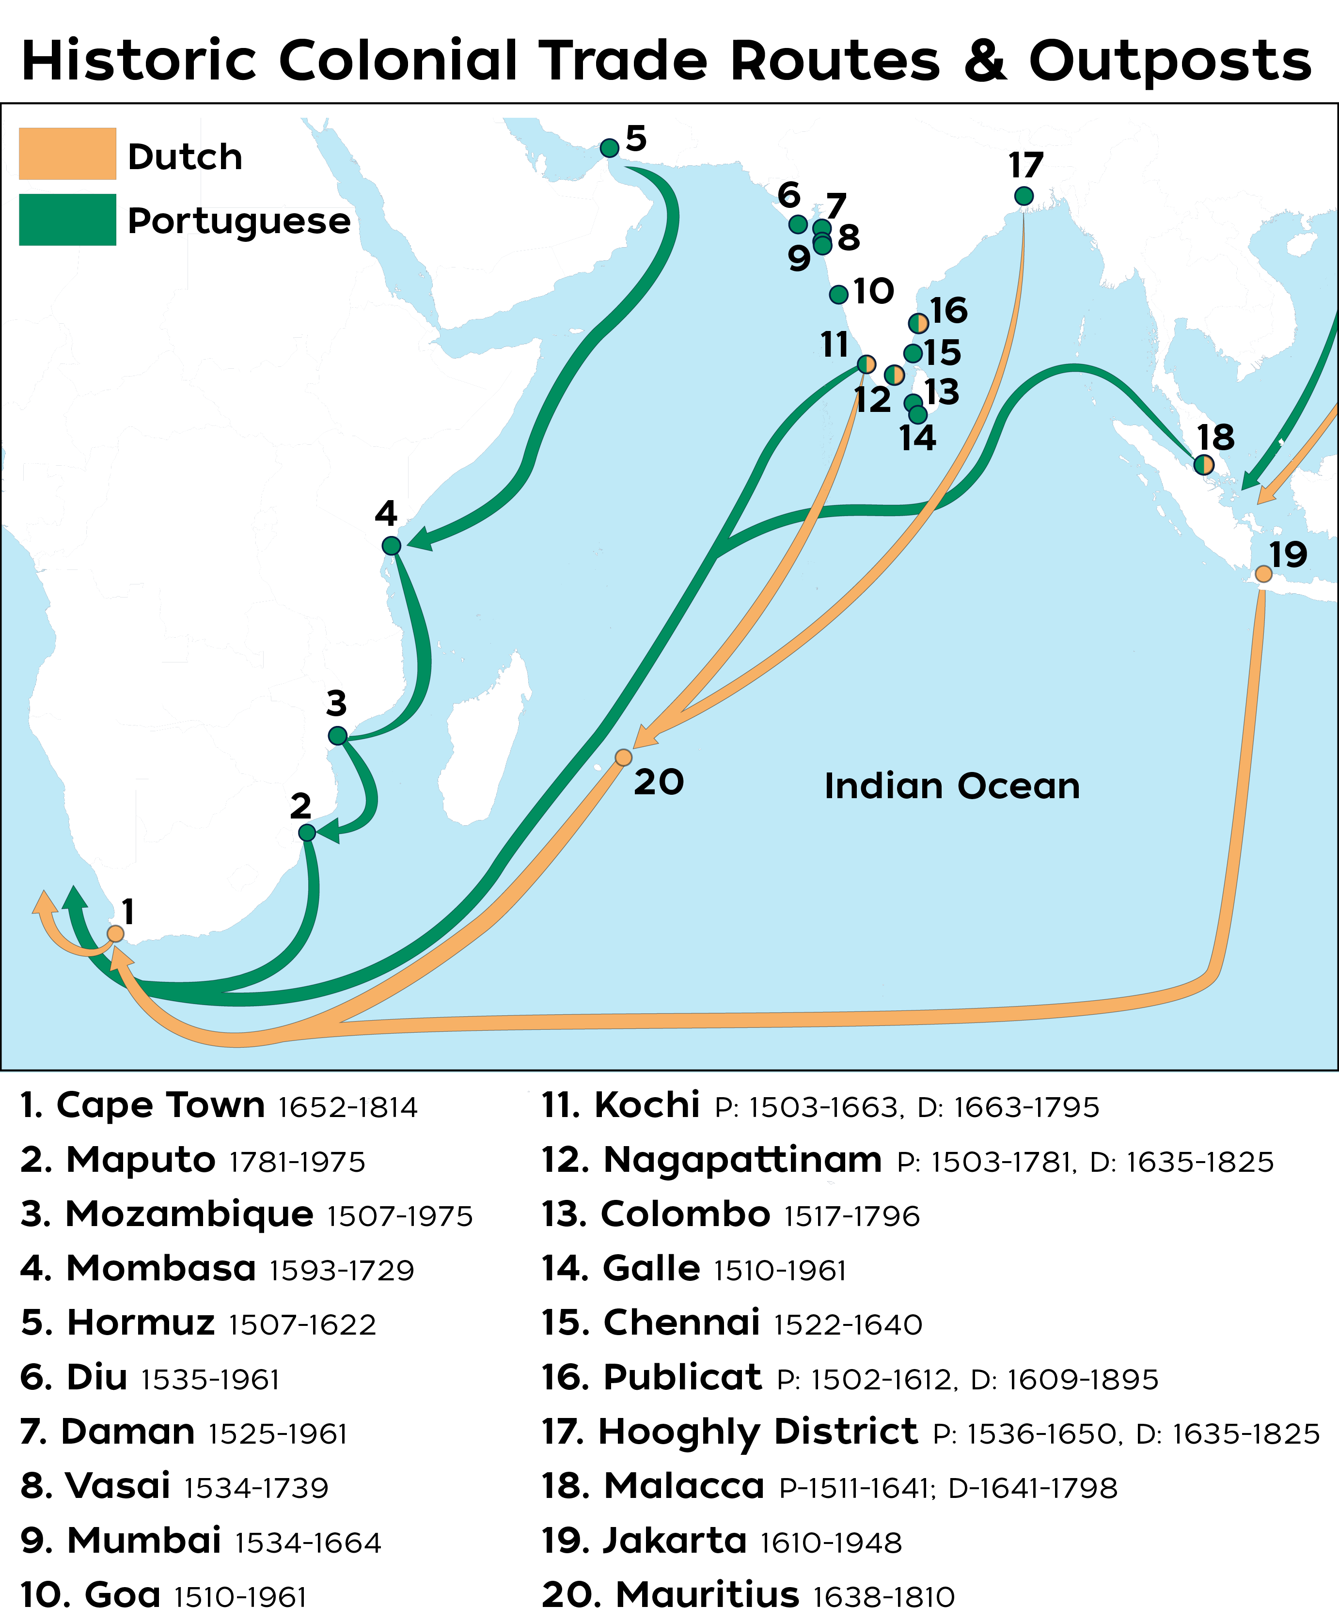
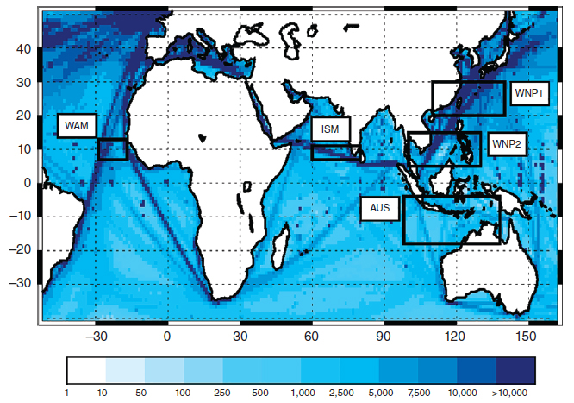
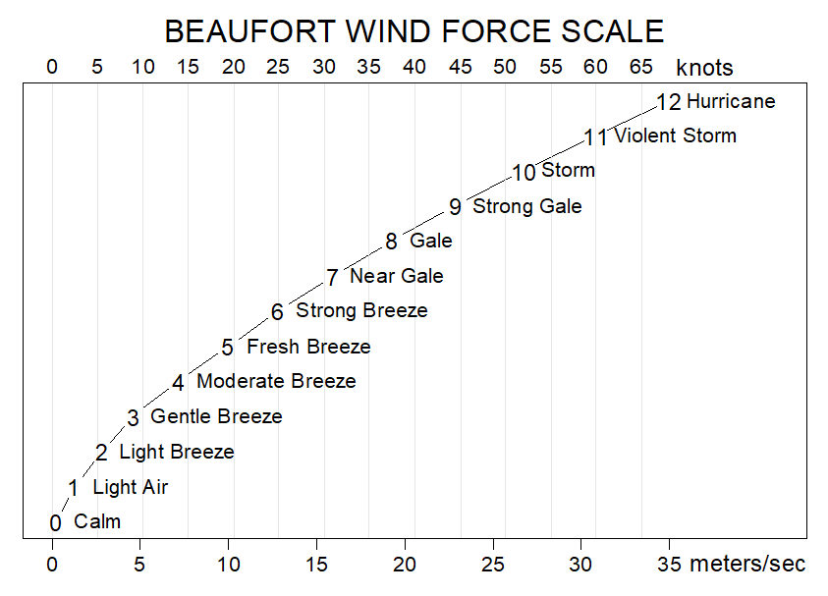
Mining Five Centuries of Climate and Maritime Weather Data from Historic Records
Caroline C. Ummenhofer¹ and Timothy D. Walker²
¹Department of Physical Oceanography, Woods Hole Oceanographic Institution, Woods Hole, MA, USA;
²Department of History, University of Massachusetts, Dartmouth, MA, USA
Vision & transformative impact
How to transfer qualitative to quantitative information
Building on established protocols to transfer qualitative information to quantitative weather records from prior data rescue efforts (e.g., Wheeler 2014), digitizing and extracting historic observations greatly expands current records of maritime weather around the world back to ~1500 CE.
Ship logbook entries are available for date, ship position (latitude & longitude), and time (daily at noon), landmarks with range and bearing, wind direction and force (incl. changes over time), sea state, weather (e.g., precipitation, cloudiness).
Qualitative wind descriptions can be quantified given systematic terminology used even prior to the introduction of the Beaufort wind force scale.
Untapped potential
The ship logbooks from underexplored archives are complemented by untapped historic records such as port and customs records kept by European colonial powers of the 15th-19th century in enclaves around the world that provide maritime weather and trade information.
These caches of historic weather observations are unique and invaluable, as colonial records cover regions where extended climate data are often lacking such as over the Indian Ocean, the least observed of all the tropical ocean basins.
Furthermore, whalers routinely traveled remote ocean regions far from the traditional merchant or military shipping routes already analyzed.
Number of wind direction observations in 1° grid for the 1800-2014 period in ICOADS. Black rectangles (labeled by white boxes) indicate areas selected to compute monsoonal indices. Major colonial shipping routes are apparent as increased density of observations. [From Garcia-Herrera et al. 2018].
Beaufort wind force and scale to wind speed in knots and m/s. [From De Cola 2018].
Notes:
De Cola L (2018). Beaufort wind scale. Accessed on Jan. 12, 2021, at https://commons.wikimedia.org/wiki/File:Beaufort_wind_scale.png.

Slide 5
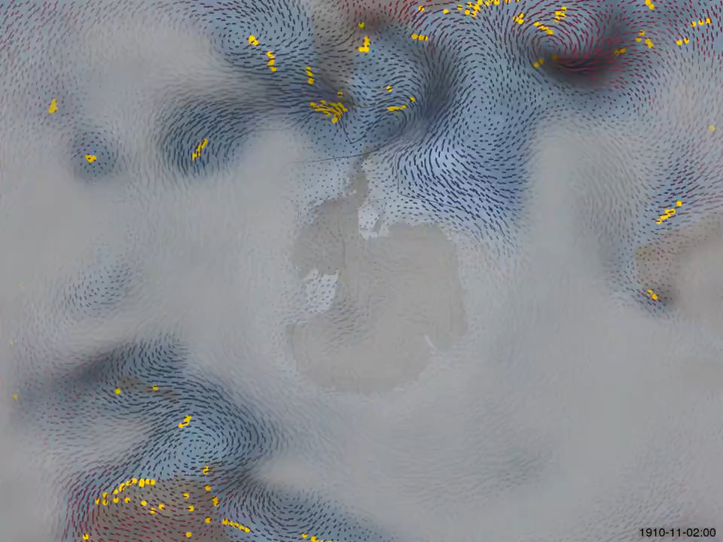


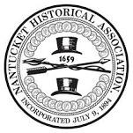



Mining Five Centuries of Climate and Maritime Weather Data from Historic Records
Caroline C. Ummenhofer¹ and Timothy D. Walker²
¹Department of Physical Oceanography, Woods Hole Oceanographic Institution, Woods Hole, MA, USA;
²Department of History, University of Massachusetts, Dartmouth, MA, USA
Connections to existing infrastructure, technology, and partnerships
Synergies with extant science community efforts
The proposed ocean shot complements and builds on established community efforts and databases, such as those housed and advanced by the U.S. National Oceanic and Atmospheric Administration (NOAA) National Centers for Environmental Information (NCEI), and the NOAA Physical Sciences Laboratory (PSL) that supports climate modeling and atmospheric reanalysis efforts (e.g., reanalyses.org.), such as exemplified by the 20th Century reanalysis.
Public-private partnerships
There is also considerable potential for public-private partnerships, which include links and synergistic opportunities with regional archives and museums across New England, such as the Nantucket Historical Association, New Bedford Whaling Museum, New Bedford Free Public Library, and Providence Public Library, as well as depositories around the U.S. where historic maritime documentation is held. Nationally, the proposed ocean shot complements priorities of the U.S. National Archives Foundation: namely, to incentivize and support expanded digitization of archival holdings, in turn facilitating citizen science and web-based consultation/analysis of primary sources.
Enduring impact
Uncovering this trove of untapped historic weather information, paired with increasingly sophisticated community reanalysis modeling, will provide crucial context for contemporary extreme climate and weather events and their impacts, informing 21st century governments, militaries, and commercial interests.
Exploring Antarctic weather 1910-1912 Surface wind (vectors), temperature (red = warm, blue = cold), sea-ice (white shading) and precipitation (black shading) from 20th Century reanalysis. Grey fog masks regions where the analysis is uncertain (as there are too few nearby observations). Yellow dots mark observations. [From Brohan 2015].
Notes:
Brohan (2015). Exploring Antarctic weather 1910-1912, accessed on Jan. 12, 2021, at https://vimeo.com/100102993.

Slide 6
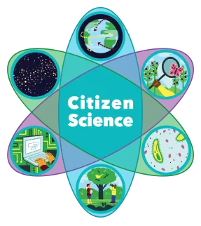
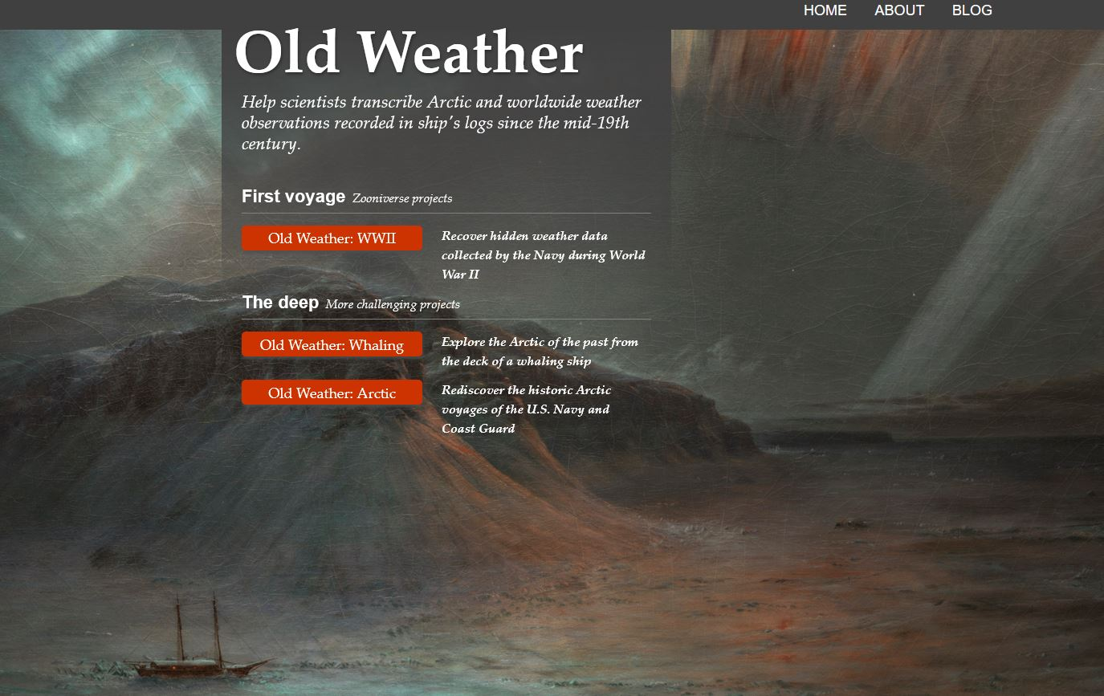
Mining Five Centuries of Climate and Maritime Weather Data from Historic Records
Caroline C. Ummenhofer¹ and Timothy D. Walker²
¹Department of Physical Oceanography, Woods Hole Oceanographic Institution, Woods Hole, MA, USA;
²Department of History, University of Massachusetts, Dartmouth, MA, USA
Opportunities for international collaboration and capacity-building
Interdisciplinary capacity-building
The effort helps educate the next generation of interdisciplinary scientists, enabling collaborations between researchers, practitioners, and students in oceanography, climate and atmospheric sciences, paleo reconstructions, maritime/colonial history, historical climatology, environmental history, and archaeology.
Initiatives can also facilitate training in developing countries, promoting knowledge transfer and capacity-building across disciplines:
training in paleography skills;
transcription and interpretation of primary sources;
cataloging and conservation of historic documentary material;
dataset evaluation and data analysis;
scientific visualization; and
reanalysis and climate modeling.
Synergies with international community efforts
The initiative implements WCRP and WMO priorities. Weather data, collated using established International Maritime Meteorological Archive standards for meteorological data from marine sources and delivered to community databases (ICOADS, ISPD), complements efforts by the Global Climate Observing System Working Group on Surface Pressure, extends observations further back, fills data gaps, and reduces uncertainties.
It adds to Atmospheric Circulation Reconstructions over the Earth (ACRE), Old Weather, Climate Reconstruction and Impacts from the Archives of Societies under PAGES – an international Future Earth effort for past global change research – by connecting historical weather information to the broader oceanographic research community.
Public engagement through citizen science
Well-suited for citizen science, it encourages participatory science from grade school through senior citizens in climate data rescue through online evaluation of historical records, building on established practices in data rescue (e.g., Mateus et al. 2020) or already implemented as part of Old Weather for Arctic whaling voyages.
This fundamental training provides a means for dialogue across disciplinary frontiers, fostering convergence, and builds enduring research capacity among a new generation of interdisciplinary scholars that span across the natural sciences-humanities divide.

