Slide 1
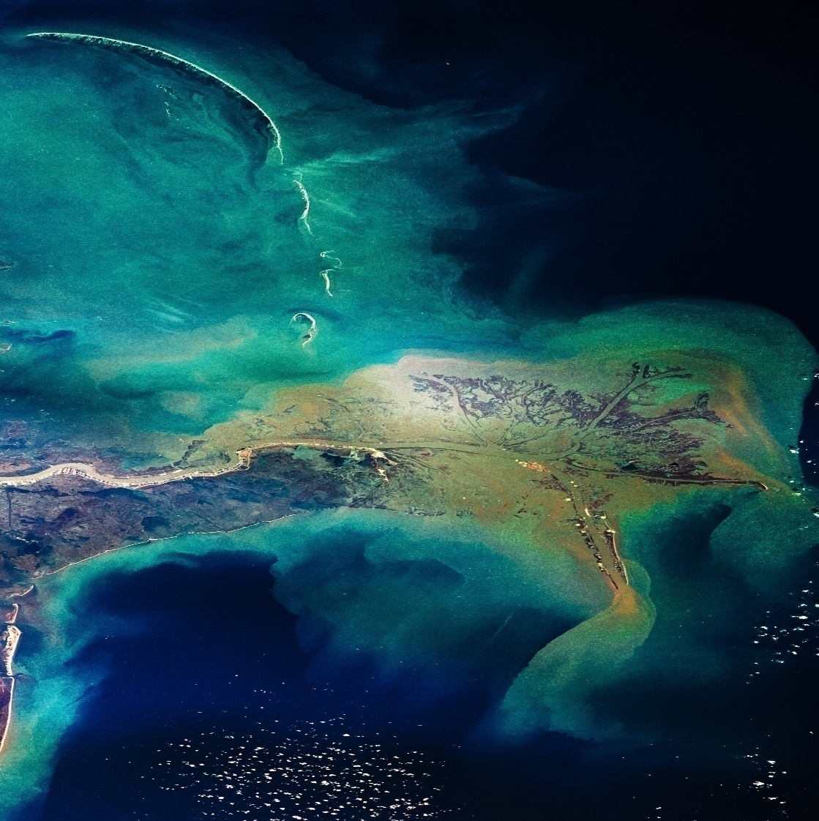

GULF RESEARCH PROGRAM
SCIENCE POLICY FELLOWSHIP
November 2022 update

Slide 2
OFFICE HOUR SESSION AGENDA
Overview of the Fellowship
  What fellows receive
  Eligibility
  Application Resources
  Host Office/Placements
  Selection Process
  Key Dates
  Q & A
2025 – 2026 Cohort

Slide 3
HOUSEKEEPING
Submitting Questions
Please submit all questions via the Zoom chat at any time during the presentation.
We’ll address questions during the moderated Q&A portion at the end.
We’ll prioritize frequently asked questions and group similar ones together.
To keep us on time, verbal questions will not be taken.
Questions requiring individual circumstances, follow-up or tailored guidance should be directed to gulffellowships@nas.edu
Time Considerations
We may not get to every question live.
Questions will be used to update our website.

Slide 4
SCIENCE POLICY FELLOWSHIP
Helps scientists hone their skills by putting them to practice for the benefit of Gulf Coast communities and ecosystems.
Fellows gain first-hand experience as they spend one year on the staff of federal, state, local, or non-governmental agencies in the Gulf region – with the guidance of a mentor.
Host offices get a talented technical expert with a fresh perspective and a new network of contacts across the Gulf region.
One-year fellowship (September 1 – August 31)

Slide 5
WHAT DO FELLOWS RECEIVE?
Annual Stipend ($63,800 – $69,800) – one year program +:
  Health Allowance of $5,500 and one-time relocation payment in the beginning of the fellowship.
Professional Development:
  They receive $5,000 in addition to their stipend to focus on their professional development.
  GRP staff organizes monthly webinars to enhance peer-connection and learning.
Mentoring:
  Each fellow has an official mentor at the host office and a peer-mentor (alumni).
  GRP staff also provides informal mentoring to fellows through bi-monthly check-in calls.
Networking:
  Access to a network of professionals through their host office, within their fellowship cohorts and opportunities to network with the Early Career Research fellows through GRP Connects platform.

Slide 6
ELIGIBILITY
Be currently enrolled in a doctoral program or hold Masters’ or PhD. For applicants not currently enrolled in a doctoral program, eligible degrees must be completed by August 15, 2026, and conferred by December 31, 2026. Applicants currently enrolled in a doctoral program must take a leave of absence for the duration of the fellowship.
Come from an area of research, including social and behavioral sciences, health sciences and medicine, engineering and physical sciences, earth and life sciences, and interdisciplinary scientific fields, relevant to the mission of the Gulf Research Program.
Open to U.S. citizens only.
Not be currently employed by the U.S. Federal Government. Full-time, paid, permanent Federal employees are not eligible for the fellowship.

Slide 7
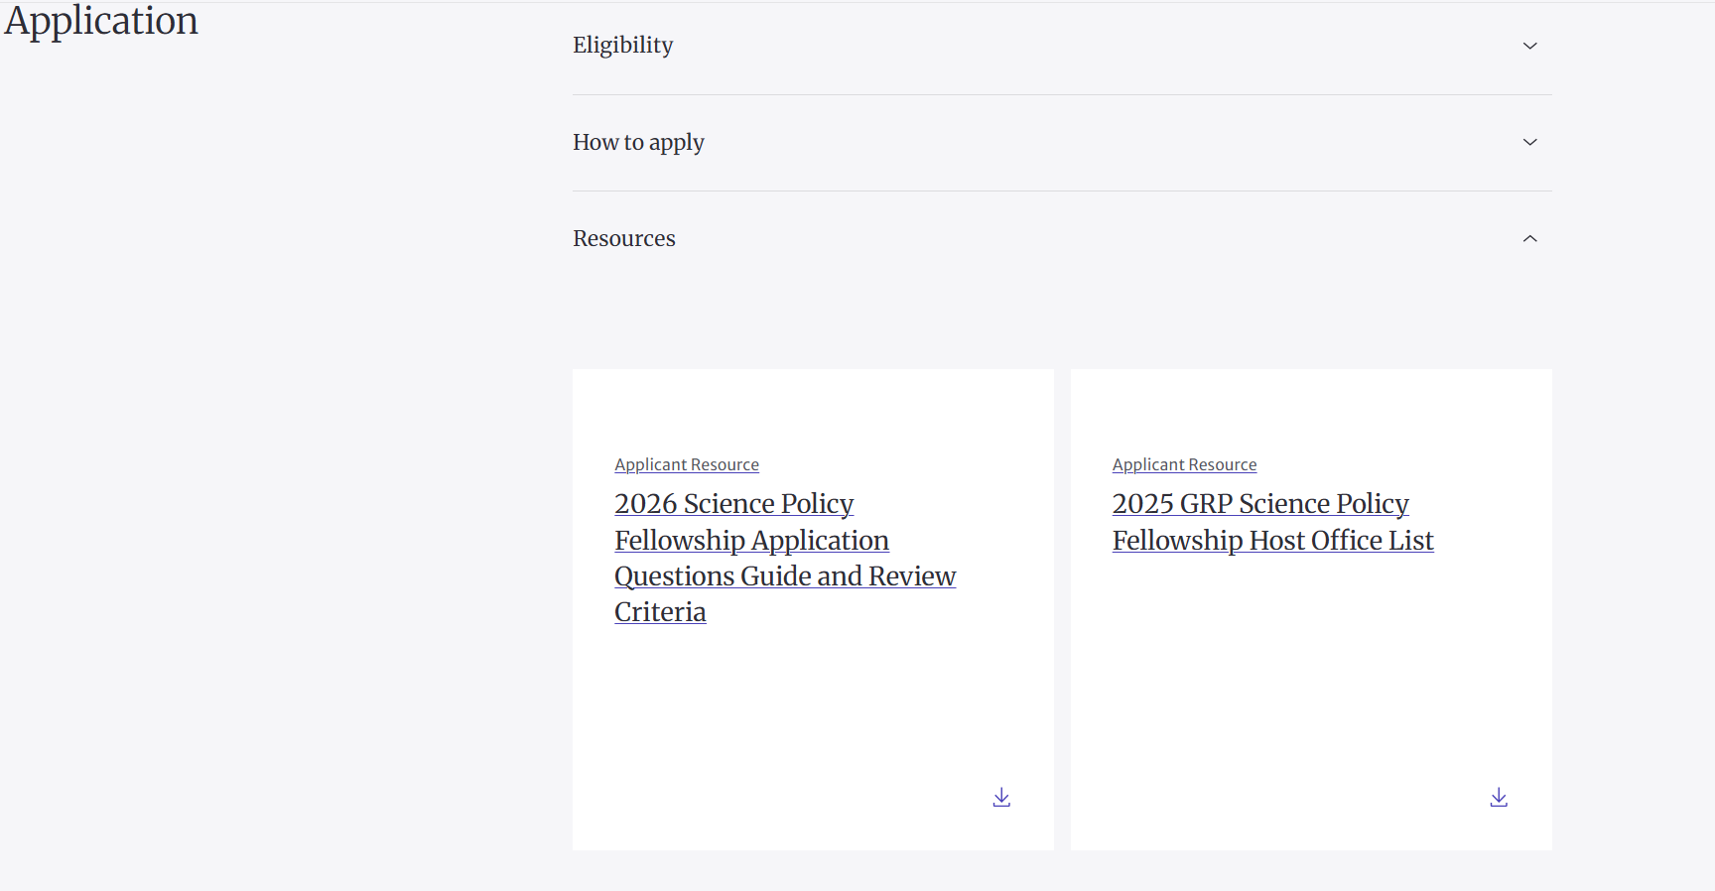
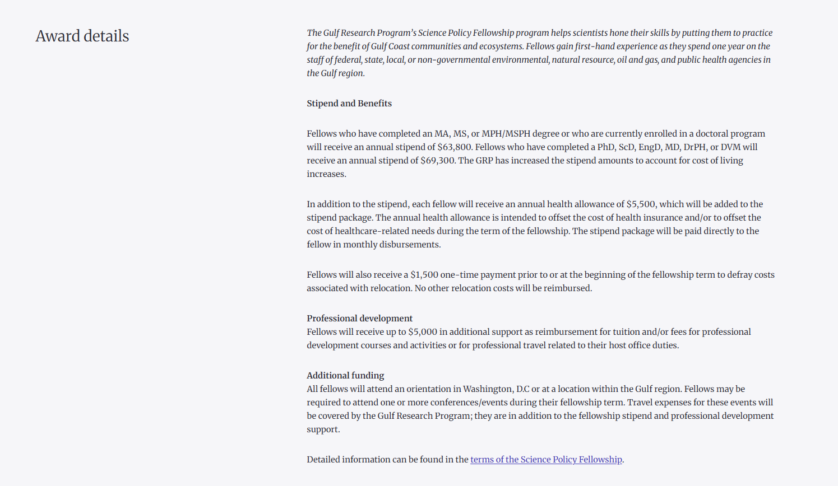
APPLICATION PROCESS - RESOURCES
APPLICATION QUESTION GUIDANCE DOCUMENT
REVIEW CRITERIA
HOST OFFICE PLACEMENT DESCRIPTIONS
TERMS OF AGREEMENT

Slide 8
HOST OFFICES
We are currently recruiting host offices for the upcoming fellowship cycle.
The host office list will continue to be updated as agencies are confirmed.
We will share a finalized list ahead of the interview process.
In the meantime, the 2025 host office list provides a strong snapshot of the types of placements typically available to fellows.

Slide 9
SELECTION AND MATCHING PROCESS
Dr. Rachel Kirpes
Host Office: Host Office: U.S. Fish and Wildlife Service| 2019 Science Policy Fellow
Eligibility Review (~2 weeks):
  Internal Review
Peer Review (~ month)
  Each application reviewed by three reviewers (mix of fellowship alumni and subject matter experts).
Finalist Virtual Interviews (April)
Placement Process (May – June):
Kick-Off Webinars (May)
Interview Period (mid May – mid June)
Rankings & Justifications Due (mid June)
Matching & Confirmation (late June):

Slide 10
KEY DATES
February 26, 2026, 5:00 pm ET/4:00 pm ET/2:00 pm PT: Application deadline
March - April 2026: Review of written applications and selection of finalists
April 2026: Finalist interviews, selection of fellows
May 2026: All applicants notified of decision
May – June 2026: Host office interviews and placement
August 25-26, 2026: Fellowship orientation
September 1, 2026: Fellowships begin
September 1, 2026: Report to host office
February 28, 2026: Progress reports due
August 31, 2027: End of fellowship
September 30, 2027: Final reports due

Slide 11
MODERATED Q & A SESSION

Slide 12
Thank you for joining us today!
REMINDERS:
If your question wasn’t answered live or if new questions come up. Reach out to gulffellowships@nas.edu
Helpful resources
  Gulf Research Program website
  GRP Science Policy Fellowship website
    Application instruction
    Review Criteria
    Host Office List

