Slide 1
NCHRP 20-102(29) New Mobility Options in Travel Demand Forecasting and Modeling: Research Presentation
Final Project Presentation
Jan 5, 2024
Presented by
Prof. Naveen Eluru
University of Central Florida

Slide 2
Outline
Background
Phase I
Phase II: Guidebook
Project Objectives
Project Timeline
Team Introduction
Task I: Literature Review
Task II: Selection of NMOs
Task III: Stakeholder Survey
Performance Metrics
TDFM Updates
TDFM Use Case Analysis
Implementation of Research Findings

Slide 3
Outline
Background
Phase I
Phase II: Guidebook
Project Objectives
Project Timeline
Team Introduction
Task I: Literature Review
Task II: Selection of NMOs
Task III: Stakeholder Survey
Performance Metrics
TDFM Updates
TDFM Use Case Analysis
Implementation of Research Findings

Slide 4
Panel
Panel Chair
Katie Beck, Michigan DOT
Johanna Cockburn, City of Greensboro
Carrie McInerney, Massachusetts DOT
Suman Mitra, University of Arkansas, Fayetteville
Lubna Shoaib, East-West Gateway Council of Governments
Stan Young, National Renewable Energy Laboratory
Jeremy Raw, FHWA
Panel Members
Zhongren Wang, California DOT (CALTRANS)
Trey Wadsworth, TRB
CRP Staff
Agency Liaisons
Dalia Leven, Cambridge Systematics

Slide 5
Research Team
Tanmoy Bhowmik
Senior Personnel
Statistical models, transportation planning and emerging transportation
Naveen Eluru
PI, UCF
Travel demand forecasting, emerging transportation modes, and econometric models
Dewan Ashraful Parvez
Research Assistant
Data analysis, TNC ridership analysis, and statistical modeling

Slide 6
Project Objectives (from RFP)
Develop a practitioners’ guide for implementation of best practices for DOTs and MPOs looking to incorporate NMOs into TDFMs
Identify key TDFM data, methods related to travel behavior, proclivity of travelers to adopt NMOs and performance measures that estimate the benefits from deployment of NMOs.
Objective 1
Objective 2

Slide 7
Project Timeline (Phase I)
Task 1: Review existing research related to NMOs and their application in TDFMs as well as alternative approaches to TDFMs.
08/22/2022-11/30/2022
Task 2: Enumerate and define NMOs. Identify which NMOs will be included and considered in subsequent tasks
09/01/2022-12/31/2022
Task 3: Conduct a stakeholder survey of agency practices for including NMOs in TDFMs. Submit an Interim Report and Phase II research plan
10/01/2022-02/28/2023

Slide 8
Project Timeline (Phase II)
Task 4: Develop a practitioners’ guide for implementation
02/01/2023-08/31/2023
Task 5: Develop final deliverables
06/01/2023-12/31/2023

Slide 9
Outline
Background
Phase I
Phase II: Guidebook
Project Objectives
Project Timeline
Team Introduction
Task I: Literature Review
Task II: Selection of NMOs
Task III: Stakeholder Survey
Performance Metrics
TDFM Updates
TDFM Use Case Analysis
Implementation of Research Findings

Slide 10
Phase I: NMO selection, current analysis, and TDFM applications

Slide 11
Task I: Literature Review
Shared micro mobility
Variable of Interest
Modeling Approach
Relevant TDFM
Components of TDFM
Considered Independently?
Literature Review
TNC
Connected and autonomous
vehicles
Micro transit

Slide 12
Task I: Literature Review
Shared micro mobility
Variable of Interest
Modeling Approach
Relevant TDFM
Components of TDFM
Considered Independently?
Dimensions of interest
Demand at the aggregate level: 11 out of 21
Individual level: 3 out of 21
Literature Review
TNC
Connected and autonomous
vehicles
Micro transit

Slide 13
Task I: Literature Review
Shared micro mobility
Variable of Interest
Modeling Approach
Relevant TDFM
Components of TDFM
Considered Independently?
Models adopted for demand analysis
Linear regression: 8 out of 21
Negative binomial or Zero inflated negative binomial
Models for shared micro mobility adoption:
Multinomial logit model and variants (Mixed logit or Nested logit model)
Literature Review
TNC
Connected and autonomous
vehicles
Micro transit

Slide 14
Task I: Literature Review
Shared micro mobility
Variable of Interest
Modeling Approach
Relevant TDFM
Components of TDFM
Considered Independently?
TDFM relevancy
Trip based: 17 out of 21
Activity based: 1 out of 21
(San Diego Regional Plan, 2021)
Literature Review
TNC
Connected and autonomous
vehicles
Micro transit

Slide 15
Task I: Literature Review
Shared micro mobility
Variable of Interest
Modeling Approach
Relevant TDFM
Components of TDFM
Considered Independently?
Analyzed components
Trip generation: 15 out of 21
Trip distribution: 4 out of 21
Mode choice: 3 out of 21
Literature Review
TNC
Connected and autonomous
vehicles
Micro transit

Slide 16
Task I: Literature Review
Shared micro mobility
Variable of Interest
Modeling Approach
Relevant TDFM
Components of TDFM
Considered Independently?
Independent: 20 out of 21
Integrated: 1 out of 21
(San Diego Regional Plan, 2021)
Literature Review
TNC
Connected and autonomous
vehicles
Micro transit

Slide 17
Task I: Literature Review
Shared micro mobility
Variable of Interest
Modeling Approach
Relevant TDFM
Components of TDFM
Considered Independently?
Literature Review
TNC
Dimensions of interest
Spatial resolution
City, TAZ, borough, taxi zone, census tract, census bloc, neighborhood tabulation area
Temporal resolution
Trips in every 10 minutes, daily trips, weekend/weekday trips, monthly trips
Connected and autonomous
vehicles
Micro transit

Slide 18
Task I: Literature Review
Shared micro mobility
Variable of Interest
Modeling Approach
Relevant TDFM
Components of TDFM
Considered Independently?
Literature Review
TNC
Demand analysis
Linear regression model variants (GWR, Spatial lag/error models)
Deep learning models
TNC adoption
Multinomial logit model variants (Nested logit)
Ordered probit model
Connected and autonomous
vehicles
Micro transit

Slide 19
Task I: Literature Review
Shared micro mobility
Variable of Interest
Modeling Approach
Relevant TDFM
Components of TDFM
Considered Independently?
Literature Review
TNC
TDFM relevancy
Trip based: 25 out of 27
Activity based: 2 out of 27
(San Diego Regional Plan, 2021,
Gurumurthy et al., 2020)
Connected and autonomous
vehicles
Micro transit

Slide 20
Task I: Literature Review
Shared micro mobility
Variable of Interest
Modeling Approach
Relevant TDFM
Components of TDFM
Considered Independently?
Literature Review
TNC
Analyzed components
Trip generation: 18 out of 27
Trip distribution: 2 out of 27
Mode choice: 9 out of 27
Traffic assignment: 1 out of 27
Connected and autonomous
vehicles
Micro transit

Slide 21
Task I: Literature Review
Shared micro mobility
Variable of Interest
Modeling Approach
Relevant TDFM
Components of TDFM
Considered Independently?
Literature Review
TNC
Only 2 integrated studies
Framework developed by Caliper for the North Carolina Research Triangle region, 2021
San Diego Regional Plan, 2021
Connected and autonomous
vehicles
Micro transit

Slide 22
Task I: Literature Review
Dimensions of interest
Influence on system mileage
Individual preference in adoption of AVs
Shared micro mobility
Variable of Interest
Modeling Approach
Relevant TDFM
Components of TDFM
Considered Independently?
Literature Review
TNC
Connected and autonomous
vehicles
Micro transit

Slide 23
Task I: Literature Review
Research approach
Survey data collection with hypothetical scenario questions
Simulation approaches
Scenario specific parameters approach
Shared micro mobility
Variable of Interest
Modeling Approach
Relevant TDFM
Components of TDFM
Considered Independently?
Literature Review
TNC
Connected and autonomous
vehicles
Micro transit

Slide 24
Task I: Literature Review
TDFM relevancy
Trip based: 14 out of 25
Activity based: 10 out of 25
Higher share of activity-based model compared to previous two NMOs
Shared micro mobility
Variable of Interest
Modeling Approach
Relevant TDFM
Components of TDFM
Considered Independently?
Literature Review
TNC
Connected and autonomous
vehicles
Micro transit

Slide 25
Task I: Literature Review
Analyzed components
Trip generation: 5 out of 25
Mode choice: 8 out of 25
All modules: 7 out of 25
Shared micro mobility
Variable of Interest
Modeling Approach
Relevant TDFM
Components of TDFM
Considered Independently?
Literature Review
TNC
Connected and autonomous
vehicles
Micro transit

Slide 26
Task I: Literature Review
5 studies out of 25 considered and integrated TDFM process
Virginia DOT, 2020
Childress et al., 2015 – Seattle region
Vyas et al., 2019 – Columbus, Ohio
NCHRP Research Report 896, 2018
SMART Mobility CAV Capstone Report, 2020
Shared micro mobility
Variable of Interest
Modeling Approach
Relevant TDFM
Components of TDFM
Considered Independently?
Literature Review
TNC
Connected and autonomous
vehicles
Micro transit

Slide 27
Task I: Literature Review
Shared micro mobility
7 studies based on survey data
No studies incorporating micro transit into TDFM
Can be considered among NMOs of interest for the future
TNC related approaches can be carefully modified for micro transit
Literature Review
TNC
Connected and autonomous
vehicles
Micro transit

Slide 28
Task I: Literature Review
Study efforts relevant to the preparation of the guidebook:
San Diego Activity based model
TNC single and TNC pooled is considered in mode choice component
Data and model accessible via GitHub
North Carolina Research Triangle trip-based model
TNC included as non household auto alternatives along with taxi, rental cars
Data and models are not accessible
Puget Sound Regional Council
Potential impact of CAVs inclusion via simulation approach (Childress et al., 2015)
Puget Sound TDFM is an open-source platform and accessible via GitHub

Slide 29
Task I: Literature Review
Study efforts relevant to the preparation of the guidebook:
Columbus, Ohio
Mid-Ohio Regional Planning Commission (MORPC) was employed to evaluate the impact of AVs under several AV penetration scenarios (Vyas et al., 2019)
The study considered mixed vehicle fleets with AV proportion ranging from 0 to 100%
The research team will explore access to this data for use case examples
Virginia DOT
Policies and procedures manual version 3.0 was developed for NMOs including shared micro-mobility, TNC and CAVs
Qualitative recommendations provided in the report will be considered while preparing the guidebook.

Slide 30
Task II: Selection of NMOs
Shared Micro-mobility
Transportation Network Companies (TNC)
Connected and Autonomous Vehicles (CAV)

Slide 31
Task III: Stakeholder Survey
Questionnaire preparation
Three different sections
Current travel demand forecasting modeling tools,
Potential changes already made or in consideration for new mobility options
Jurisdiction and respondent specific questions
IRB Approvals
UCF IRB approval
Exempt Human Subjects’ certification

Slide 32
Task III: Stakeholder Survey
Dissemination
NCHRP Panel Members
TRB Committee Chairs
Travel Model Improvement Program (TMIP) list serve
DOT & MPO Personnel
Private Consulting Organization Personnel

Slide 33
Task III: Stakeholder Survey (cont.)
Travel Demand Forecasting Model Section
New Mobility Options
Jurisdiction and respondent characteristics

Slide 34
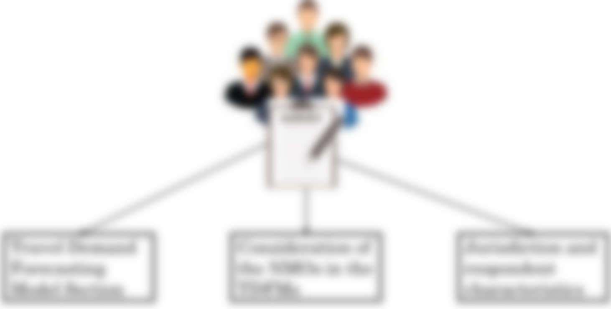
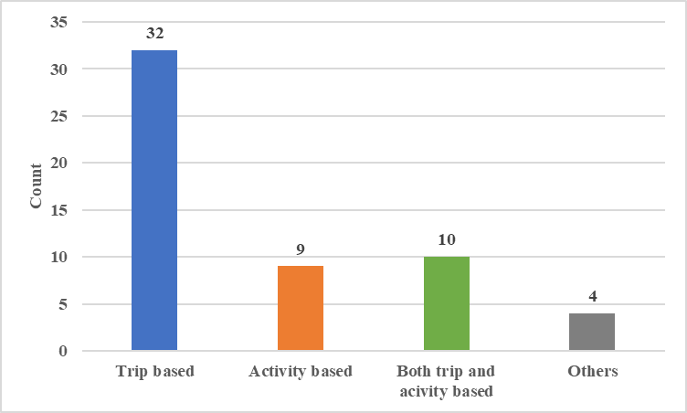
Task III: Stakeholder Survey (cont.)
55 complete responses
What is the main Travel Demand Forecasting Model (TDFM) framework operationalized in your agency?
Travel Demand Forecasting Model Section

Slide 35
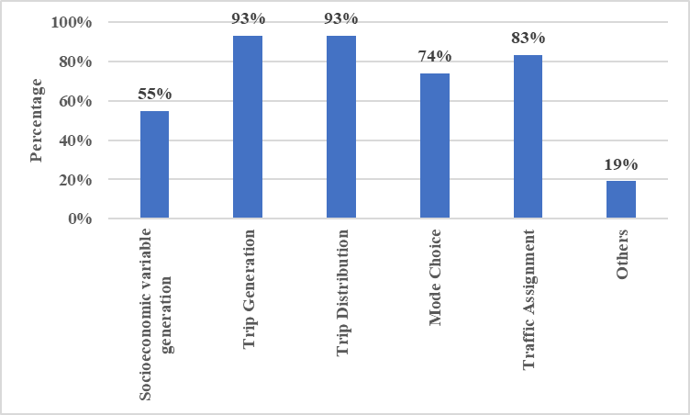
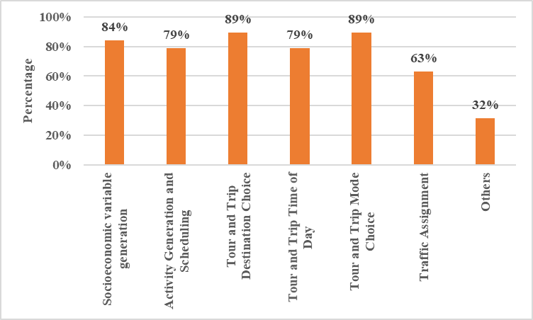
Task III: Stakeholder Survey (cont.)
Considered Module in:
Trip-based TDFM
Activity-based TDFM
Travel Demand Forecasting Model Section

Slide 36
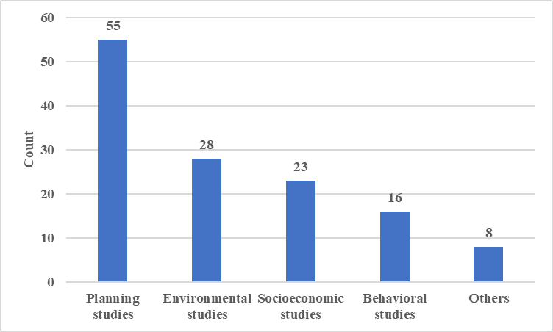
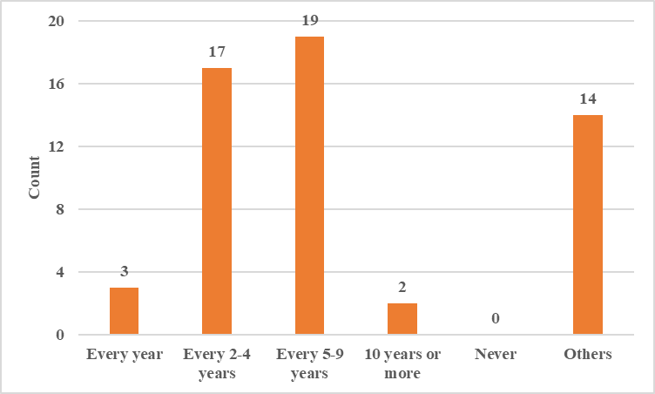
Task III: Stakeholder Survey (cont.)
TDFM employed by purpose
TDFM update by frequency
Travel Demand Forecasting Model Section

Slide 37
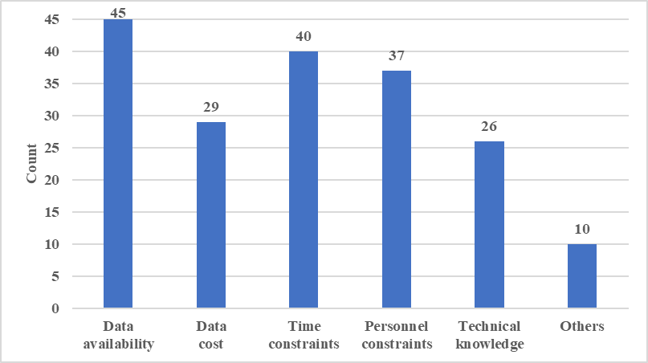
Task III: Stakeholder Survey (cont.)
Challenges faced by the agencies with TDFM update
Travel Demand Forecasting Model Section

Slide 38
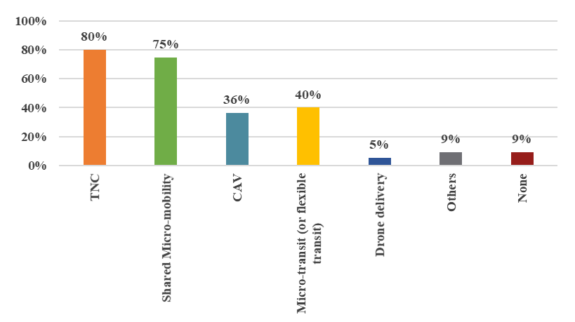
Task III: Stakeholder Survey (cont.)
Percentage of jurisdiction
by operational NMOs
New Mobility Options

Slide 39
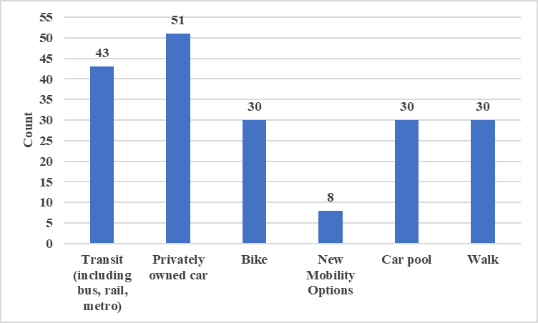
Task III: Stakeholder Survey (cont.)
Existing TDFM by mobility options
New Mobility Options

Slide 40
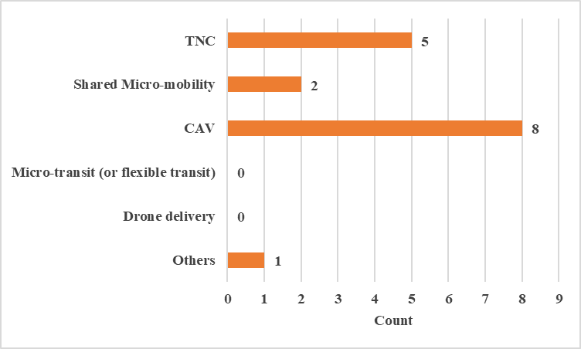
Task III: Stakeholder Survey (cont.)
Existing TDFM by NMOs
New Mobility Options

Slide 41
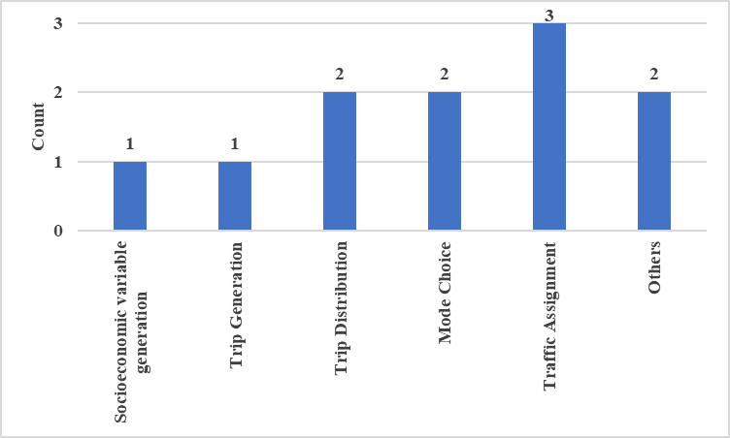
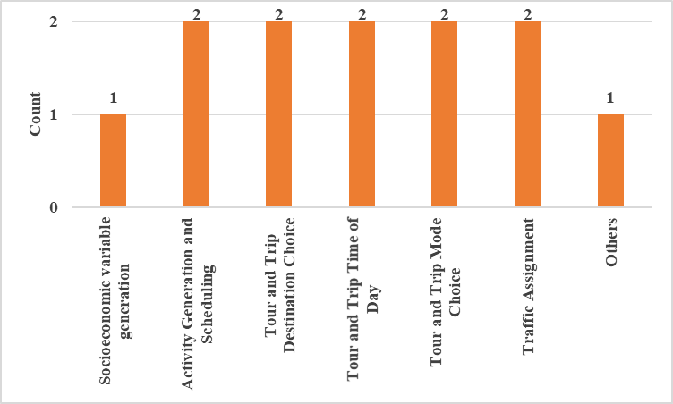
Task III: Stakeholder Survey (cont.)
Impacted modules due to NMO consideration:
Trip-based TDFM
Activity-based TDFM
New Mobility Options
Availability of resources documentation for NMO consideration
5
1

Slide 42
Task III: Stakeholder Survey (cont.)
Count of TDFM by NMO consideration in Future
Yes
No
28
18
New Mobility Options

Slide 43
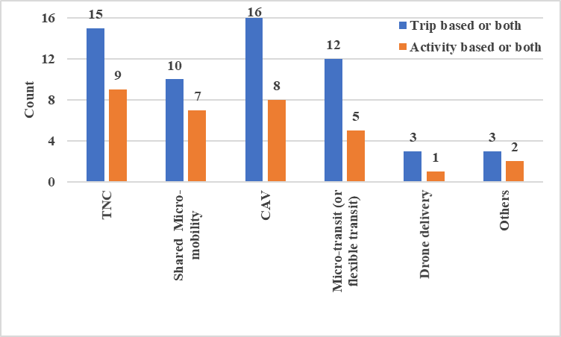
Task III: Stakeholder Survey (cont.)
Count of TDFM by NMO consideration in Future
Yes
No
28
16
New Mobility Options

Slide 44
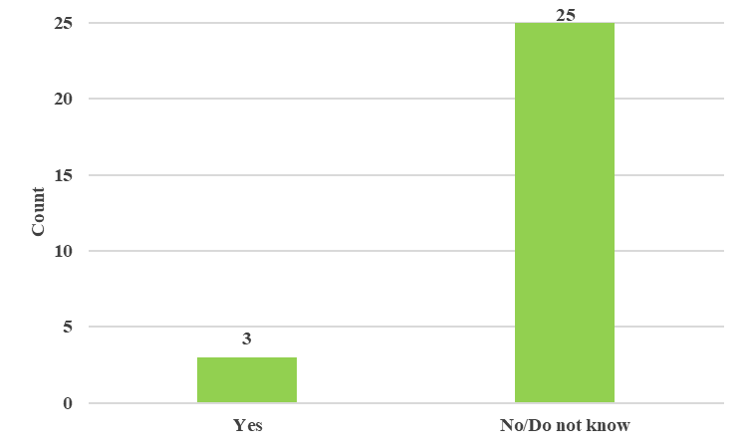
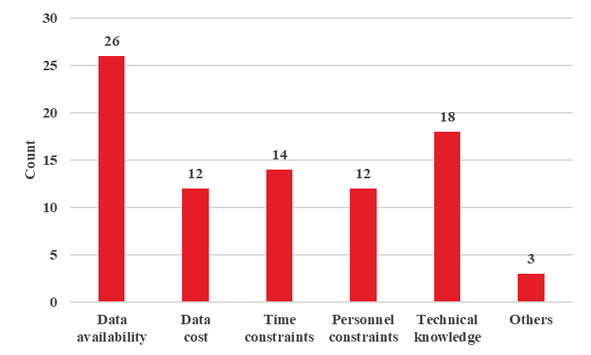
Task III: Stakeholder Survey (cont.)
Availability of Resources for potential NMO consideration
Constraints affecting potential NMO consideration
New Mobility Options

Slide 45
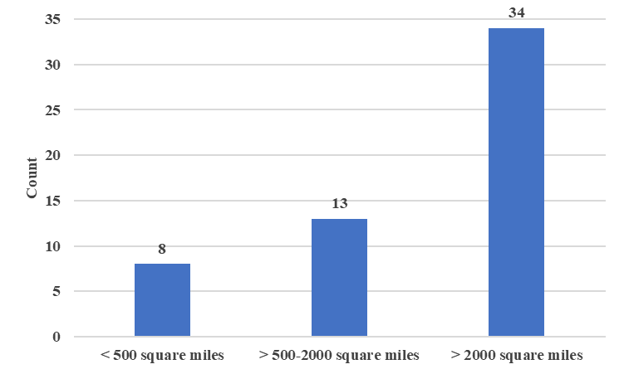
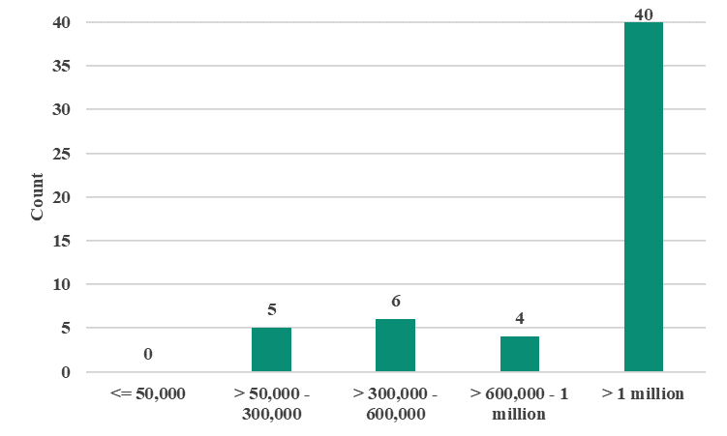
Task III: Stakeholder Survey (cont.)
Area under jurisdiction of the agency
2020 census population of the jurisdiction
Jurisdiction and respondent characteristics

Slide 46
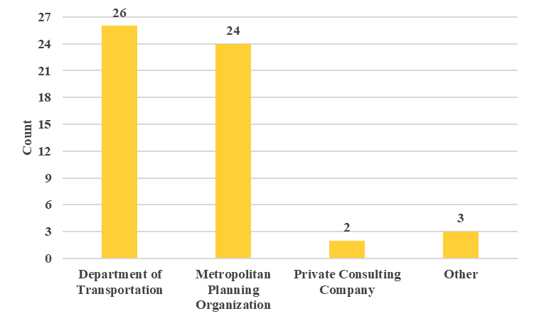
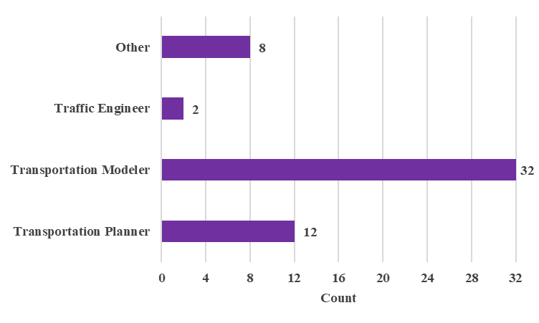
Task III: Stakeholder Survey (cont.)
Agency affiliation of the respondents
Role of the respondents
Jurisdiction and respondent characteristics

Slide 47
Outline
Background
Phase I
Phase II: Guidebook
Project Objectives
Project Timeline
Team Introduction
Task I: Literature Review
Task II: Selection of NMOs
Task III: Stakeholder Survey
Performance Metrics
TDFM Updates
TDFM Use Case Analysis
Implementation of Research Findings

Slide 48
Phase II: Guidebook

Slide 49
Guidebook Outline
Two major focus items
Performance Metrics
Measures for trip-based TDFM
Measures for activity-based TDFM
TDFM update procedures
Limited implementation examples in literature
Build synthetic data to develop future scenarios of expected change
Implement models for current and synthetic data to illustrate change to TDFM components

Slide 50
Performance Metrics
Trip-based Model
Component | Performance Metrics computed as change after NMO adoption | Data Source
Socio-demographic and socio-economic variables | Population composition (age, gender, ethnicity and income) | US Census data
 | Vehicle Ownership (household and regional) | NHTS/Local jurisdiction travel data, US Census, and State/County Vehicle Registration
 | Job accessibility | US Census or local data
Trip generation | Trip rates by trip purpose, demographic segment and spatial location | National Household Travel Survey (NHTS) or local jurisdiction travel data

Slide 51
Performance Metrics
Trip-based Model
Component | Performance Metrics computed as change after NMO adoption | Data Source
Trip distribution | Generalized Cost function, trip length distribution | Jurisdiction specific Calibrated functions
Mode choice | Mode adoption | American Community Survey, NHTS or local data
 | NMO Demand (shared mobility and TNC flows) | Shared mobility data and TNC data for jurisdiction
 | Value of time | Emerging data on Value of time with CAV adoption
Trip assignment | Travel times, capacity improvements and infrastructure changes | Expected changes based on various technology adoption rates

Slide 52
Performance Metrics
Activity-based Model
Component | Performance Metrics computed as change after NMO adoption | Data Source
Socio-demographic and socio-economic variables including long-term choices | Population composition (age, gender, ethnicity and income) | US Census data
 | Vehicle Ownership (household and regional) | NHTS/Local jurisdiction travel data, US Census, and State/County Vehicle Registration
 | Job accessibility | US Census or local data
Activity generation and scheduling | Activity participation | NHTS or local jurisdiction travel data
Trip generation | Time of Day scheduling | NHTS or local jurisdiction travel data

Slide 53
Performance Metrics
Activity-based Model
Component | Performance Metrics computed as change after NMO adoption | Data Source
Destination choice | Generalized Cost function, transit accessibility | Jurisdiction specific Calibrated functions
Tour and trip level mode choice | NMO adoption in jurisdiction, demographic segments and specific zones | American Community Survey, NHTS or local data
 | NMO Demand (shared mobility and TNC flows) | Shared mobility data and TNC data for jurisdiction
 | Value of time | Emerging data on Value of time with CAV adoption
Trip assignment | Travel times, capacity improvements and infrastructure changes | Expected changes based on various technology adoption rates

Slide 54
Potential Impact of NMOs
Metric | Potential Impact of NMOs
Average HH Vehicle Ownership | Reduced private vehicles ownership due to increased NMO usage
Proportion of Vehicle Ownership | Higher share of 0 vehicle households, fewer multi-car households
Trip generation rates/ activity generation | Increased trip rates for discretionary activities combined with work activities
Jobs/destinations accessible within 15 minutes | NMOs may alter accessibility by different modes and overall; alter friction factors or destination choice parameters

Slide 55
Potential Impact of NMO
Metric | Potential Impact of NMOs
Trip length and generalized costs | The emergence of NMOs can reduce out of vehicle time, reduce cost of vehicle ownership and contribute to a reduced generalized cost; Improvements in routing due to CAVs can contribute to reduced congestion and lower travel times.
Mode choice / Trip and Tour level | NMOs can potentially alter how non-automobile modes are used by providing first mile last mile connectivity in denser urban areas (in particular shared micro-mobility and TNCs); The emergence of NMOs can increase multi-modal trips and tours due to ease of connectivity across shared micro-mobility and TNC.

Slide 56
Potential Impact of NMO
Metric | Potential Impact of NMOs
Value of time | The emergence of NMOs (in particular CAVs) is likely to reduce value of time (travelers can do other activities).
Roadway capacity (for assignment) | CAV may alter roadway capacity depending on fleet mix and roadway type (may increase or decrease susceptibility to congestion)

Slide 57
TDFM Updates
Framework for Update Process
Synthesize datasets from real-world that are currently employed for base model development and adapt them to reflect potential NMO related scenarios

Slide 58
TDFM Updates
Framework for Update Process
Synthesize datasets from real-world that are currently employed for base model development and adapt them to reflect potential NMO related scenarios
2017 Data
Do not have adequate share of shared mobility and/or TNC

Slide 59
TDFM Updates
Framework for Update Process
Synthesize datasets from real-world that are currently employed for base model development and adapt them to reflect potential NMO related scenarios
2017 Data
Updated 2025 data
Do not have adequate share of shared mobility and/or TNC
Reflects growing proportion of shared mobility and/or TNC

Slide 60
TDFM Updates
Base model
Use case example 1
HH vehicle ownership
we build a model specification for observed real data in the absence of NMOs
Use case example 2
HH trip rate
Use case example 3
Trip mode choice

Slide 61
TDFM Updates
Base model
Use case example 1
HH vehicle ownership
we build a model specification for observed real data in the absence of NMOs
Model considering the impact of NMO
Use case example 2
HH trip rate
represents a modification of the dependent variable (from real data) in response to NMO introduction
Simulated Scenarios
Model without
considering the impact
of NMO
Use case example 3
Trip mode choice
represents a modification of the dependent variable over time without any significant impact from NMO addition

Slide 62
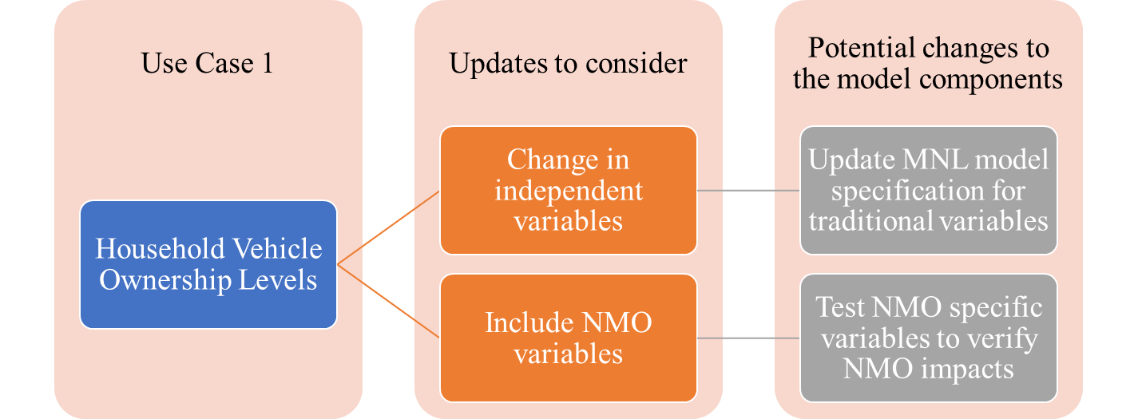
Use Case Example 1

Slide 63
Use Case Example 1
Share of Vehicle Ownership
Vehicle Ownership | Base model (%) (a) | Model considering the impact of NMO (%) (b) | Model without considering the impact of NMO (%) (c)
0 | 4.2 | 11.6 | 10.6
1 | 25.2 | 25.8 | 23.6
2 | 42.8 | 39.6 | 33.3
3 or more | 27.8 | 23.1 | 32.5

Slide 64
Use Case Example 1
Vehicle Ownership Model Result
Variable | Base model (a) |  |  | Model considering impact of NMO (b) |  |  | Model without considering the impact of NMO (%) (c)
Vehicle ownership level | 0 | 1 | 2 | 0 | 1 | 2 | 0 | 1 | 2
Constant | -2.343 | -1.317 | 0.338 | -3.310 | -1.195 | 0.293 | -1.689 | -0.869 | -0.068
Ratio of workers to drivers | -2.161 | 0.357 | -- | -0.889 | 0.179 | -- | -0.400 | -- | --
Ratio of people age 6-15 to drivers | -- | -0.160 | 0.382 | -- | -- | 0.412 | -- | -- | 0.227
Ratio of people age 18-24 to drivers | -1.704 | -2.420 | -2.067 | -- | -- | -- | -2.001 | -1.574 | -1.561
Ratio of people age 80 or older to drivers | -- | 0.484 | -- | -- | 0.439 | -- | -- | 0.322 | --
Parameters are significant at 90% confidence level

Slide 65
Use Case Example 1
Vehicle Ownership Model Result
Variable | Base model (a) |  |  | Model considering impact of NMO (b) |  |  | Model without considering the impact of NMO (%) (c)
Vehicle ownership level | 0 | 1 | 2 | 0 | 1 | 2 | 0 | 1 | 2
Household income <=$10,000 | 5.254 | 4.076 | 1.257 | 5.547 | 3.467 | 0.952 | 3.913 | 2.764 | 1.374
$10,000 < Household income <= $30,000 | 3.379 | 2.886 | 0.677 | 3.645 | 2.491 | 0.437 | 2.398 | 1.850 | 0.628
$30,000 < Household income <= $60,000 | 1.069 | 1.784 | 0.407 | 1.919 | 1.538 | 0.191 | 1.131 | 1.099 | 0.298
$60,000 < Household income <= $100,000 | -0.760 | 0.518 | -- | -- | 0.388 | -- | 0.381 | 0.168 | --
Parameters are significant at 90% confidence level

Slide 66
Use Case Example 1
Vehicle Ownership Model Result
Variable | Base model (a) |  |  | Model considering impact of NMO (b) |  |  | Model without considering the impact of NMO (%) (c)
Vehicle ownership level | 0 | 1 | 2 | 0 | 1 | 2 | 0 | 1 | 2
NMO availability indicator (urban household indicator) | -- | -- | -- | 3.817 | 1.637 | 1.247 | -- | -- | --
NMO availability *Presence of worker in HH | -- | -- | -- | 0.905 | -- | -- | -- | -- | --
NMO availability *Household income >= $60,000 | -- | -- | -- | 1.019 | 0.811 | -- | -- | -- | --
Parameters are significant at 90% confidence level

Slide 67
Use Case Example 2

Slide 68
Use Case Example 2
Descriptive Statistics of HH Trip Rate
Dependent variables | Mean | Std. dev. | Min./Max.
Number of HH trips for model (a) | 9.11 | 7.44 | 0/64
Number of HH trips for model (b) | 10.15 | 7.61 | 0/67
Number of HH trips for model (c) | 9.15 | 7.50 | 0/63

Slide 69
Use Case Example 2
HH Trip Rate Model Result
Variable | Base model (a) | Model considering impact of NMO (b) | Model without considering the impact of NMO (%) (c)
Constant | 2.138 | 2.264 | 2.197
Number of workers | 2.403 | 2.900 | 2.373
Number of retired persons | 1.008 | 1.003 | 1.011
Number of homemakers | 1.712 | 1.721 | 1.674
Number of students | 2.058 | 2.071 | 2.030
Number of children | 2.189 | 2.177 | 2.192
Zero vehicle household | 0.665 | 1.332 | 0.622
Household with cars < drivers | 0.778 | 0.893 | 0.836
Household with cars > workers | 0.890 | 0.892 | 0.934
Household income > $100,000 | 0.301 | 0.317 | 0.325
Parameters are significant at 90% confidence level

Slide 70
Use Case Example 2
HH Trip Rate Model Result
Variable | Base model (a) | Model considering impact of NMO (b) | Model without considering the impact of NMO (%) (c)
NMO availability indicator (urban household indicator) | -- | 0.844 | --
NMO availability * zero vehicle HH | -- | 1.233 | --
NMO availability * HH with cars < drivers | -- | 1.368 | --
Parameters are significant at 90% confidence level

Slide 71
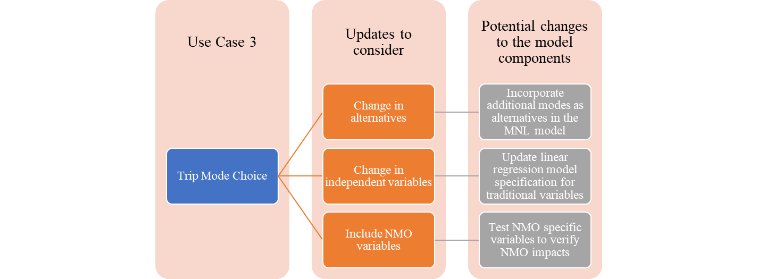
Use Case Example 3

Slide 72
Use Case Example 3
Mode Share by Transportation Alternatives
Mode | Percent Share
 | Base model (%) (a) | Model considering NMO alternatives (%) (b)
Drive | 64.7 | 61.7
Passenger | 5.5 | 5.3
Transit | 19.7 | 18.8
Bike | 1.3 | 1.1
Walk | 5.2 | 4.2
Park & ride/Kiss & ride | 3.4 | 3.4
Other | 0.2 | 0.3
TNC | -- | 4.0
Micro-mobility | -- | 1.2

Slide 73
Use Case Example 3
Trip Mode Choice Model Result
Variable | Base model (a)
 | Drive | Passenger | Transit | Walk | Bike | PRKR
Constant | 3.623 | 0.770 | 3.667 | 4.577 | 1.187 | 1.043
Travel time | -0.052 | -0.052 | -0.052 | -0.052 | -0.052 | -0.052
Travel cost | -0.346 | -- | -0.346 | -- | -- | -0.346
Origin distance from CBD | -- | -- | -- | -- | -- | 0.080
Destination distance from CBD | 0.114 | 0.073 | -- | -- | -- | --
Male | -- | -1.364 | -0.295 | -0.295 | -- | -0.295
Age ≤ 20 | -- | 0.577 | 0.577 | -- | 0.577 | --
Age 21-40 | -- | -- | 0.270 | -- | -- | --
Household with 1 person | -- | -1.375 | -- | -- | -- | --
Zero car household | -- | -- | 1.107 | 1.107 | 1.107 | --
Household with 2 cars | 0.967 | -- | -- | -- | -- | --
Morning peak | -- | -- | 0.347 | -- | -- | 1.092
Parameters are significant at 90% confidence level

Slide 74
Use Case Example 3
Trip Mode Choice Model Result
Variable | Model considering NMO alternatives (b)
 | Drive | Passenger | Transit | Walk | Bike | PRKR | TNC | Micro-mobility
Constant | 3.664 | 0.565 | 3.477 | 3.744 | 0.237 | 2.281 | -4.994 | -3.604
Travel time | -0.054 | -0.054 | -0.054 | -0.054 | -0.054 | -0.054 | -0.054 | -0.054
Travel cost | -0.362 | -- | -0.362 | -- | -- | -0.362 | -0.362 | -0.362
Destination distance from CBD | 0.076 | 0.042 | -- | -- | -- | -- | -- | --
Male | 0.216 | -1.144 | -- | -- | 1.269 | -- | 0.790 | 0.681
Age ≤ 20 | -- | -- | -- | -- | -1.919 | -2.038 | -- | --
Age 21-40 | -- | -- | 0.314 | 0.460 | -- | -- | -- | --
Parameters are significant at 90% confidence level

Slide 75
Use Case Example 3
Trip Mode Choice Model Result
Variable | Model considering NMO alternatives (b)
 | Drive | Passenger | Transit | Walk | Bike | PRKR | TNC | Micro-mobility
Household with 1 person | -- | -1.204 | -- | -- | -- | -- | -- | --
Zero car household | -- | -- | 1.216 | 1.216 | 1.216 | -- | -0.907 | --
Household with 2 cars | 0.758 | -- | -- | -- | -- | -- | -- | --
Morning peak | -- | -- | 0.245 | -- | -- | 0.935 | 0.245 | --
NMO availability | -- | -- | -- | -- | -- | -- | 5.637 | 5.637
NMO availability* HH car ≤ 1 | -- | -- | -- | -- | -- | -- | 1.587 | 1.587
NMO availability* High income HH | -- | -- | -- | -- | -- | -- | 3.785 | --
Parameters are significant at 90% confidence level

Slide 76
Outline
Background
Phase I
Phase II: Guidebook
Project Objectives
Project Timeline
Team Introduction
Task I: Literature Review
Task II: Selection of NMOs
Task III: Stakeholder Survey
Performance Metrics
TDFM Updates
TDFM Use Case Analysis
Implementation of Research Findings

Slide 77
Implementation of Research Findings
The research team suggests the selection of agencies for pilot projects based on panel member inputs and presentation of the project guidebook in TRB committee meetings.
Pilot projects will allow us to
Update the guidebook through practical implementation and allow us to further refine the metrics and update strategies.
Broaden the scope of the guidebook and allow for wider applicability
Develop a lessons learned guide for practitioners on what are the most important challenges for NMO related TDFM update implementation process

Slide 78
Thank you
The National Cooperative Highway Research Program (NCHRP) is sponsored by the individual state departments of transportation of the American Association of State Highway and Transportation Officials. NCHRP is administered by the Transportation Research Board (TRB), part of the National Academies of Sciences, Engineering, and Medicine, under a cooperative agreement with the Federal Highway Administration (FHWA). Any opinions and conclusions expressed or implied in resulting research products are those of the individuals and organizations who performed the research and are not necessarily those of TRB; the National Academies of Sciences, Engineering, and Medicine; the FHWA; or NCHRP sponsors.

