Slide 1

NCHRP Project 08-145
NCHRP Research Report 1080: Using Cooperative Automated Transportation Data to Enhance Freeway Operational Strategies
Final Project Presentation
July 2023

Slide 2
Project Team
Meenakshy Vasudevan
Principal Investigator
Noblis
James O’Hara
Software Developer
Noblis
Matt Samach
Data Scientist
Noblis
Claire Silverstein
Senior Transportation Research Scientist
Noblis
Sampson Asare
Senior Transportation Engineer
Noblis
Karl Wunderlich
Director of Surface Transportation
Noblis
Justin Anderson
Senior Systems Engineer
Noblis
Haley Townsend
Data Scientist
Noblis
Ian McManus
Transportation Engineer, Noblis
Kaan Ozbay
Professor and Director of C2SMART
New York University (NYU)
Jingqin (Jannie) Gao
Assistant Director for Research of C2SMART
NYU
Chuan Xu
Postdoctoral Associate
NYU
Yu Tang
Research Assistant
NYU
Di Sha
Research Assistant
NYU
Fan Zuo
Postdoctoral Associate
NYU
2

Slide 3
Project Panel
Brad Freeze, NCHRP 08-145 Panel Chair
Tennessee Department of Transportation
Daniela Bremmer
Washington State DOT
Ashely Nylen
Colorado DOT
Stephanie Palmer
Michigan DOT
Christopher Poe
Mixon-Hill Inc.
Panos Prevedouros
University of Hawaii
Gil Ramirez
Lassiter Transportation Group, Inc.
Ketan Savla
University of Southern California
Lin Zhang
Elite Transportation Group, Inc.
Jon Obenberger
FHWA R&D (FHWA Liaison)
3

Slide 4
Project Objective
Project Objective:
  Assess use cases where freeway operational strategies could be improved using data extracted from messages generated by Cooperative Automated Transportation (CAT) with the goals to:
    Spur development of enhanced and new operational strategies
    Help agencies justify gaining access to additional CAT data
Period of Performance: 14 July, 2021–14 July, 2023 (24 months)
Task 1: Project Management
Task 2: Literature Review
Task 3:
Str. Eval &
Op. Con.
Task 4: Interim Report
Task 6:
Final
Report
Task 5: Enhanced Str Dev
Project Kickoff
(April 2022)
Panel Meeting
(April 2022)
Panel Meeting
(July 2022)
Panel Meeting
(March 2023)
4

Slide 5
Literature Review
Literature Review
PURPOSE
Conduct a review of literature on existing freeway op. strategies, CAT messages and data, and the data’s use in enhancing strategies and performance measure estimation
FREEWAY STRATEGIES REVIEWED
Str. Eval & Op. Con
Ramp Metering
Variable Speed Limit (VSL)
Dynamic Lane Management/Part-Time Shoulder Use
Reversible Lane Management
Dynamic Pricing/High-Occupancy Toll (HOT) Lanes
Traffic Incident Detection/Management
Queue Warning
Work Zone Management/Advisories
Dynamic Route Guidance
Traveler Information
Road Weather Management/Advisories
Performance Monitoring
Interim Report
Enhanced Str Dev
Final Deliverables
5

Slide 6
Literature Review
Literature Review
Defined Cooperative Automated Transportation (CAT) data as data elements contained in electronic messages generated and wirelessly exchanged among connected and automated vehicles (CAVs), mobile devices, and connected infrastructure, and utilized by the transportation management system (TMS) to facilitate CAT
Identified 12 CAT Message Types Relevant to Freeway Operations:
  Basic Safety Messages (BSM) (SAE Standard J2735)
  MAP Messages (SAE Standard J2735)
  Traveler Information Messages (TIM) (SAE Standard J2735)
  Common Safety Request (CSR) Messages (SAE Standard J2735)
  Emergency Vehicle Alert (EVA) Messages (SAE Standard J2735)
  Probe Vehicle Data (PVD) Messages (SAE Standard J2735)
  Probe Data Management (PDM) Messages (SAE Standard J2735)
  Roadside Alert (RSA) Messages (SAE Standard J2735)
  Road Safety Messages (RSM) (SAE Standard J2945)
  Event Driven Configurable Messaging (EDCM) (CAMP Schema)
  Connected Mobile Devices Data
  Private Sector/Third-Party Data
Str. Eval & Op. Con
Interim Report
Enhanced Str Dev
Final Deliverables
6

Slide 7
Literature Review
Literature Review
KEY FINDINGS FROM LITERATURE REVIEW & STAKEHOLDER INPUT (#1 of 2)
Challenges with Use of CAT Data for Freeway Operational Strategy Enhancement​:
  Insufficient market penetration of CAVs, mobile devices, and connected infrastructure​
  Inaccuracies in lane-level information and vehicle heading in CAT electronic messages​
  New vulnerabilities to cyber attacks due to the CAT paradigm​
  Limited treatment of communication loss​
  Insufficient or improper treatment of imbalanced data (i.e., certain conditions such as free flow traffic are overrepresented in the data sets, while others such as crashes are underrepresented) ​
  Limited treatment of privacy, or conversely, use of data obfuscation approaches that limit value/usability of CAT data​
  Lack of real-time data cleaning and fusion techniques​
  Significant efforts needed to upgrade current field devices; wireless systems; data storage, memory, processing, and sharing; and other TMS software and hardware​
Str. Eval & Op. Con
Interim Report
Enhanced Str Dev
Final Deliverables
7

Slide 8
Literature Review
Literature Review
KEY FINDINGS FROM LITERATURE REVIEW & STAKEHOLDER INPUT (#2 of 2)
Opportunities with Use of CAT Data for Freeway Operational Strategy Enhancement​:
  Improved accuracy and reliability of data, compared to loop detector or microwave sensor data, allowing for improved strategies (and possibly improved driver compliance since expectations match experience)​
  Higher resolution data, allowing for newer methods for performance measurement, and more precise (and possibly, individualized) travel recommendations (e.g., speed, lane, pricing, route)​
  Enhanced capability to develop freeway operational strategies that improve accessibility and equity, and serve traditionally disadvantaged/underserved populations​
  More frequent data, allowing for real-time performance measurement, and improved timeliness of decision-making​
  Broader, and more continuous spatial coverage (including on ramps) than with just loop detectors and sensors
Str. Eval & Op. Con
Interim Report
Enhanced Str Dev
Final Deliverables
8

Slide 9
Operational Concepts and Use Cases
Literature Review
PURPOSE
Develop operational concepts and use cases for 10 panel-selected strategies​ that use CAT data
USE CASES AVAILABLE FOR 10 FREEWAY STRATEGIES​
Queue Warning
Ramp Metering​
Dynamic Route Guidance
Speed Harmonization and Lane Control for One Lane (e.g., hard shoulder running)​
Traffic Incident Management
Integrated Decision Support and Demand Management
Speed Harmonization for Entire Roadway (one direction on freeway)​
Performance Monitoring
Variable Pricing for One Lane ​
Variable Pricing for Entire Roadway
Str. Eval & Op. Con
Interim Report
Enhanced Str Dev
Final Deliverables
9

Slide 10
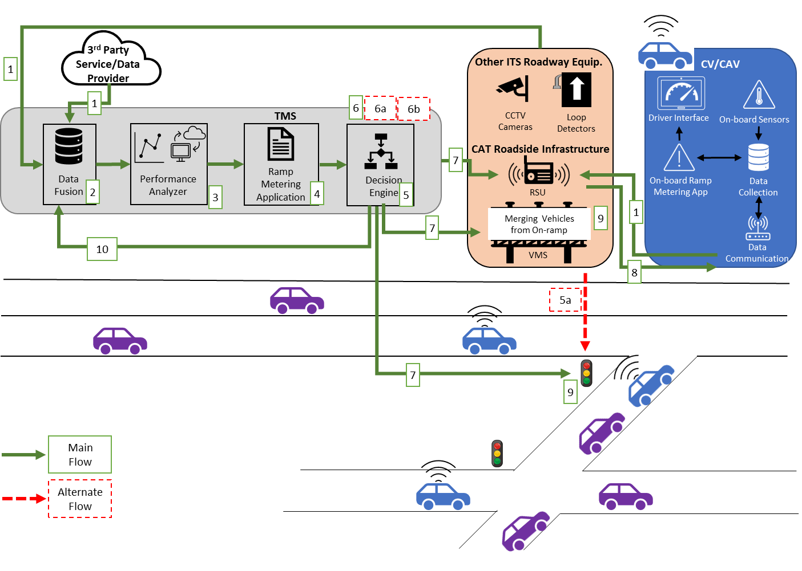
Ramp Metering Use Case (Example)
Objective: To regulate the entry of on-ramp vehicles, in order to effectively reduce overall freeway congestion, avoid queue spillback from the on-ramp to nearby local streets, minimize the impact of shockwave propagation on freeway mainlines, and improve merging safety and system-wide traffic flow.
Constraints:
  Lane-level location info of mainline vehicles needed
  Market Penetration Rates (MPR) of CVs/CAVs may impact strategy performance
  Ability of enhanced ramp metering to allow CAVs to proceed autonomously or to use CV/CAV platoons on mainline to create gaps to allow vehicles to safely merge into mainline traffic depends on MPR of CV/CAVs
10

Slide 11
Interim Report
Literature Review
PURPOSE
Develop interim report documenting results of previous tasks (Tasks 2 and 3) and an updated plan for Tasks 5 and 6
Meet with NCHRP 08-145 Panel to review report and obtain approval for subsequent tasks
APPROACH AND OUTCOME
Interim report was delivered on 8 March 2022 for review by the panel
Virtual meeting was held with panel on 19 and 20 April 2022
Panel selected Ramp Metering for enhancement using CAT data in a simulation environment (simulation model of I-210 EB corridor)
Str. Eval & Op. Con
Interim Report
Enhanced Str Dev
Final Deliverables
11

Slide 12
Enhanced Strategy Development
Literature Review
PURPOSE
Develop core logic for the selected case study - ramp metering strategies enhanced using data from CAT
Evaluate enhanced ramp metering strategies against baseline strategies using a calibrated simulation model
APPROACH
Str. Eval & Op. Con
Assess CAT Data Sources’ Suitability
Develop Experimental Design
Develop and Calibrate Simulation Models
Develop Baseline and Enhanced Ramp Metering Strategies
Evaluate Enhanced Ramp Metering Strategies
Interim Report
Enhanced Str Dev
Final Deliverables
12

Slide 13
CAT Data Sources’ Suitability Assessment
PURPOSE: Perform a suitability analysis of potential CAT data sources and selected a network that can be used for development and evaluation of ramp metering in a simulation environment.
Calibrated Freeway Microsimulation Models Potentially Available to the Project Team
Simulated Network | Source | Simulation Software/ Calibration Status | Type of Network | Network Geometry
New Jersey Turnpike | NYU C2SMART Center (2019) | SUMO/Calibrated to 2011 condition AM peak | Suburban Toll Roadway | 13.6 miles; 5 interchanges
I-210 Eastbound, Los Angles, California | NYU C2SMART Center (2022) | SUMO/Calibrated to 2019 PM Peak condition | Urban-Suburban Freeway corridor | 17.1 miles; 24 on-ramps & 20 off-ramps; 2 major bottlenecks Mod.to high congestion
Downtown Seattle (include I-5 and Rt. 99) | NYU C2SMART Center (2022) | SUMO/Calibrated to 2018 weekday conditions | Urban freeway corridors with surface streets | 12 on and off-ramps Dense urban network
I-405 Corridor, Seattle, Washington | Washington State DOT and U.S. DOT (2019) | VISSIM/Calibrated to AM/PM peak for six conditions | Urban freeway corridor | 29.5 miles; 2 major bottlenecks
I-44/I-270 freeway intchg, St. Louis, Missouri | Missouri State DOT and U.S. DOT | VISSIM/Calibrated | Urban freeway exchange | 6.5 mi x 4.7 mi; 1 major intchg; 8 freeway-arterial interchanges
13

Slide 14
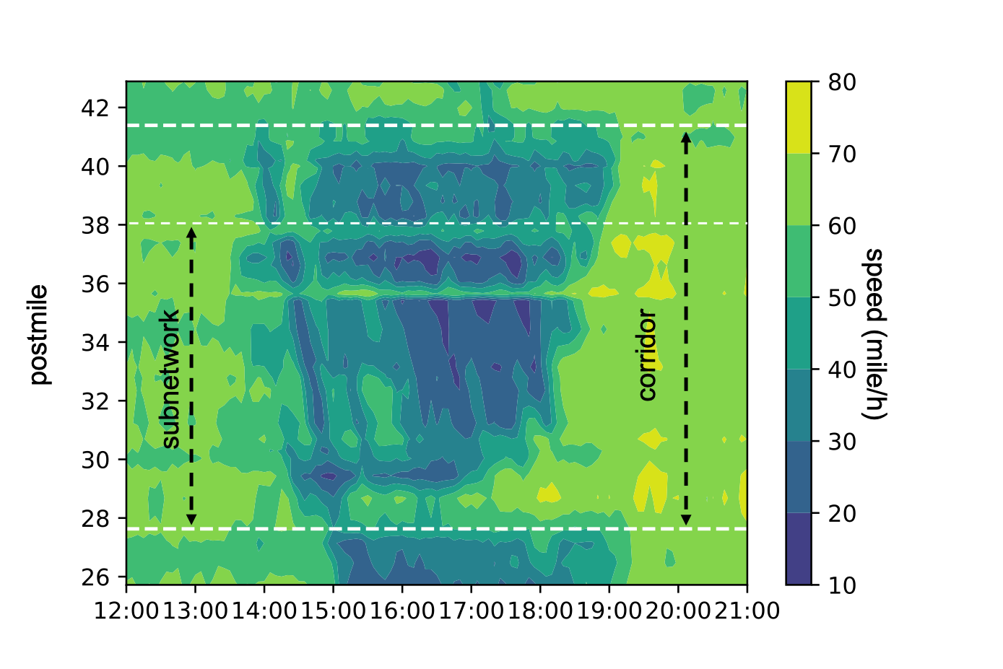
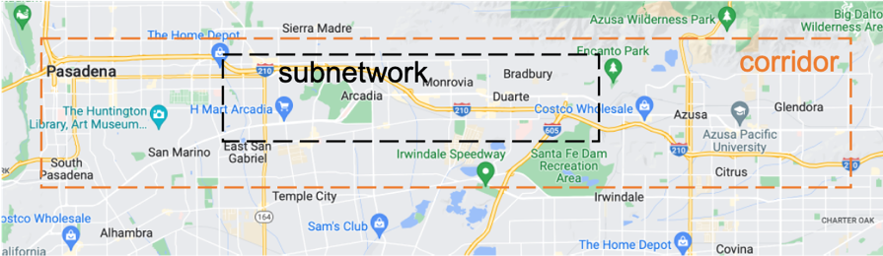
I-210 (EB) Base Model Development and Calibration
Study Area: A 9.1-mile subnetwork of the I-210 network was selected:
  Captures congestion at I-605 (extends to East Pasadena) during PM peak periods
  Includes 19 mainline sensors, 19 HOV sensors, 13 on-ramp sensor stations, and 12 off-ramp sensor stations, each equipped with lane-based induction loops
Two major bottlenecks are present, one around the interchange with I-605 and the other upstream of San Dimas.
14

Slide 15
I-210 (EB) Base Model Development and Calibration
Analysis Period: The period from 2 pm to 7 pm was chosen to allow the evaluation of ramp metering strategies using CAT data for both peak shoulder and peak hours.
Baseline Model Development Data:
  Traffic sensor data from PeMS (2019), including lane-level traffic flow, speed, and occupancy information collected by induction loop sensors for each 5-min interval on each day.
  Traffic incident data from California Highway Patrol (CHP) during the year of 2019. The data includes incident classification, severity level, start time, location, and duration information of traffic incidents.
OD Demand Estimation: OD demand matrix for each vehicle type was estimated for the selected period using:
  A built-in function in SUMO called DFROUTER which uses an intuitive method of estimating an OD matrix based on turning percentages
  Manual adjustments
Traffic Operational Conditions: Performed cluster analysis using 1 year of PeMS data, following FHWA guidance, to identify two distinct conditions:
  Peak-hour with no or few incidents
  Peak-hour with many incidents
Baseline Model Calibration: Performed calibration using FHWA Guidelines (Wunderlich et al. 2019) for each of the operational conditions
15

Slide 16
Experimental Design
PURPOSE:
Develop an experimental design for developing and evaluating ramp metering strategy for various scenarios
BASELINE SCENARIOS:
Defined 4 baseline scenarios by varying the following:
  Ramp Metering Strategies:
    Locally responsive control using ALINEA algorithm that made use of existing loop detector data
    System-wide control using HERO algorithm that made use of existing loop detector data
  Traffic Operational Conditions:
    Peak-hour with no or few incidents
    Peak-hour with many incidents
16

Slide 17
Experimental Design
Alternate Scenarios:
Defined 12 alternate scenarios by varying the following:
  Ramp Metering Strategies:
    Locally responsive Queue-Informed/Incident-Aware ALINEA using CAT and existing loop detector data
    System-wide Queue-Informed/Incident-Aware HERO using CAT and existing loop detector data
  Traffic Operational Conditions:
    peak-hour with no or few incidents
    peak-hour with many incidents
  CAV Market Penetrations Rates: 20%, 50%, 75%
  CAT Infrastructure Deployment Levels:
    RSUs deployed at 20%, 50%, 80% of interchanges and ramps
  Communication Error Rates (Packet Error Rates): 10%, 30%
  GPS Positioning Accuracy:
    Accurate lane-level positioning for a few links where specialized supporting infrastructure are deployed
    Accurate lane-level positioning throughout
  Equipment Failure Rates: 3%, 9%, 15%
17

Slide 18
Alternate Scenarios
Parameters | Alternate Scenario 1 | Alternate Scenario 2 | Alternate Scenario 3
CAV Market Penetration Rates | 20% | 50% | 75%
CAT Infrastructure Deployment Levels | 20% of interchanges and ramps (focusing on high-volume locations first) | 50% of interchanges and ramps (focusing on high-volume locations first) | 80% of interchanges and ramps (focusing on high-volume locations first)
Communication Error Rates | 10% | 30% | 30%
GPS Positioning Accuracy | Accurate lane-level positioning for a few links where specialized supporting infrastructure are deployed | Accurate lane-level positioning throughout | Accurate lane-level positioning throughout
Equipment Failure Rates | 15% | 9% | 3%
Ramp Metering Strategy | Alinea or HERO | Alinea or HERO | Alinea or HERO
Traffic Operational Conditions | Peak-hour with no/few incidents or with many incidents | Peak-hour with no/few incidents or with many incidents | Peak-hour with no/few incidents or with many incidents
18

Slide 19

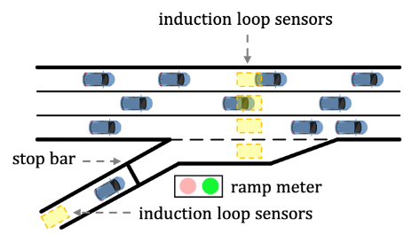
Baseline Ramp Metering Algorithms Without CAT Data
Locally Responsive Ramp Metering: ALINEA
ALINEA is one of the most widely used localized ramp metering (Papageorgiou et al. 1991). It exploits the occupancy measured by induction loops, typically downstream of the on-ramp. The control policy attempts to maintain the occupancy around its optimal value by regulating flows from the on-ramp to the mainline.
Queue Override: To prevent on-ramp queue spillover into urban streets, a queue override strategy can be added to ALINEA algorithm, based on on-ramp entry occupancy.
Where O is the desired occupancy threshold, O_{out} is the measured occupancy at time t, r(t-1) is the metering rate in the previous time period, and K_{r} is a regulatory parameter.
For the purpose of comparison, the ALINEA algorithm with the queue override function using existing sensor data was integrated into the model via API as the baseline scenarios with local ramp metering control.
19

Slide 20


Baseline Ramp Metering Algorithms Without CAT Data
Locally Responsive Ramp Metering: ALINEA
ALINEA is often favored for its ease of sensor requirements, but this simplicity can limit its ability to control traffic congestion in certain situations, such as accidents or queue override strategy leading to oscillating metering rates.
This can be enhanced by using queue length at the on-ramp, but accurate queue length may not be directly measured by induction loops. The use of CAT data can potentially enhance queue length estimation and provide more accurate information around traffic incidents.
20

Slide 21
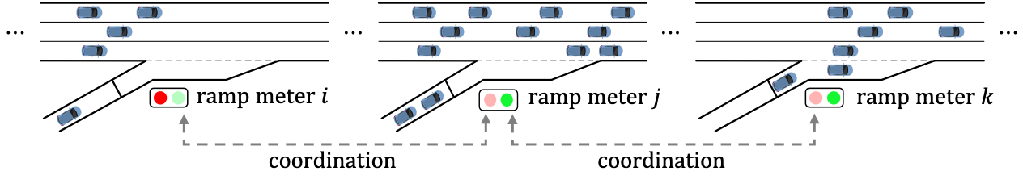
Baseline Ramp Metering Algorithms Without CAT Data
System-Wide Ramp Metering: HERO
HERO utilizes localized ramp metering, such as ALINEA, for individual on-ramps when coordination is not requested; but also includes a heuristic coordination mechanism to coordinate consecutive on-ramps. When downstream metering doesn't resolve congestion, HERO overrides upstream control and decreases metering rate. If this fails, HERO uses more upstream on-ramps as a vehicle reservoir during coordination.
For the purpose of comparison, the HERO algorithm using existing sensor data was integrated into the model via API as the baseline scenarios with system-wide metering control.
21

Slide 22
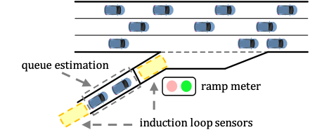
Baseline Ramp Metering Algorithms Without CAT Data
System-Wide Ramp Metering: HERO
Using induction loops, which are typically located at the beginning and end of an on-ramp, to estimate queue lengths can result in significant inaccuracies and potentially lead to biased estimations (Papamichail et al. 2010).
The use of CAT data can potentially enhance the baseline ramp metering control (e.g., increase the accuracy of queue estimation).
HERO Queue Estimation Based on Loop Detector Data
22

Slide 23
Enhanced Ramp Metering Algorithms With CAT Data
Limitations identified in literature:
Inaccuracies in vehicle position information which can lead to unreliable queue estimation
Inadequate detection coverage of fixed infrastructure which can lead to lack of accurate situational awareness of changing road conditions
Two enhancements to ramp metering using CAT data:
Improve queue length estimation by combining induction loops and CAT data, for both ALINEA and HERO algorithms.
Utilize CAT data to extract traffic information around congestion and incidents, which refine ALINEA and the local ramp metering layer of HERO to address distant downstream bottlenecks.
23

Slide 24
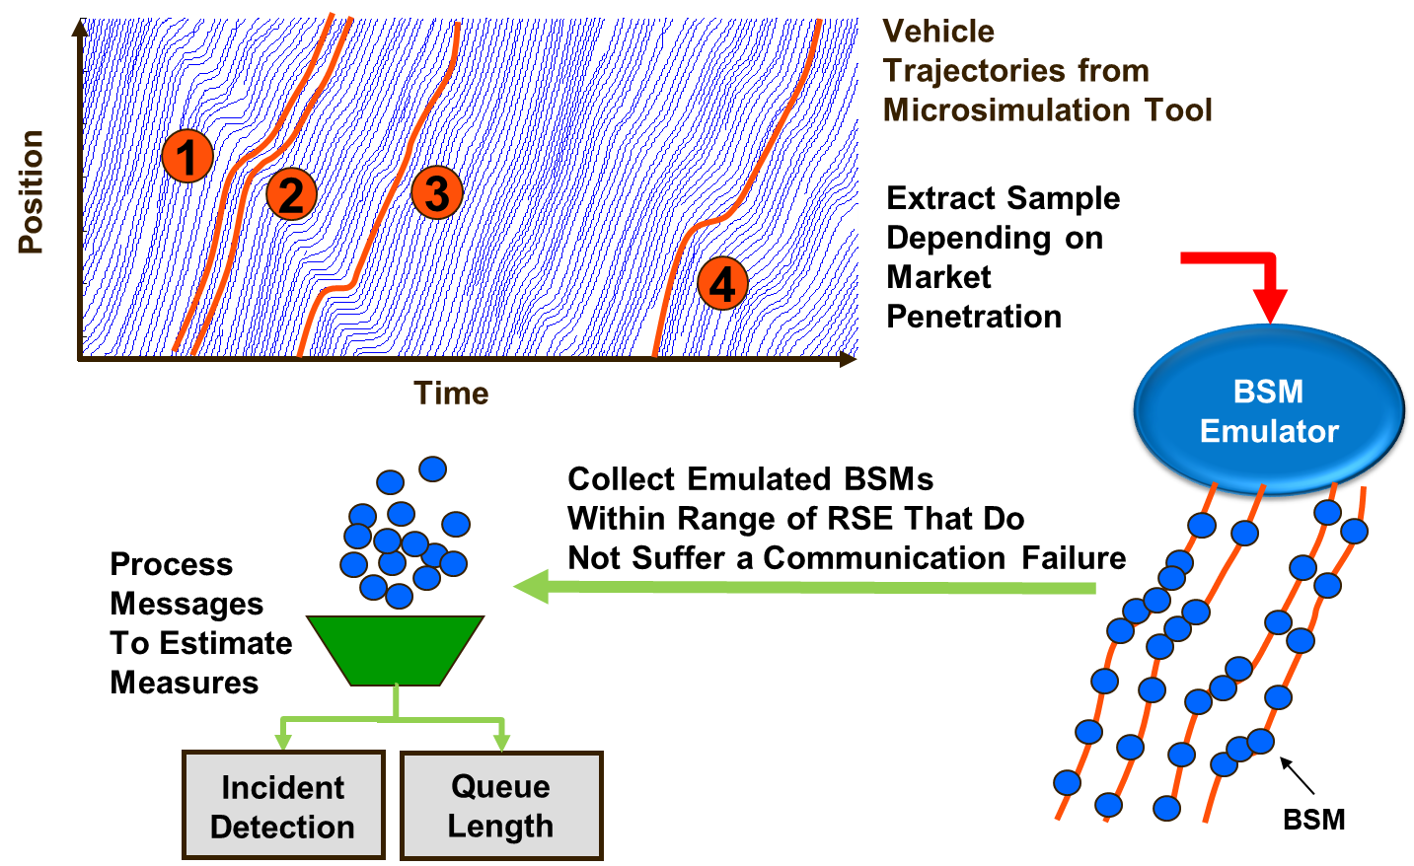
Basic Safety Message Emulation
PURPOSE:
Emulate the generation of BSMs, based on SAE J2735 standard, from simulated trajectories to mimic BSMs generated by a CAV in the real world
Enhancement Methodology:
Streamlined the Open-Source Trajectory Conversion Algorithm (TCA)
  Removed extraneous message standards, control options, and redundant data storage
Added communication failures based on set rate; equipped status from simulation; and quicker RSE range checks
24

Slide 25
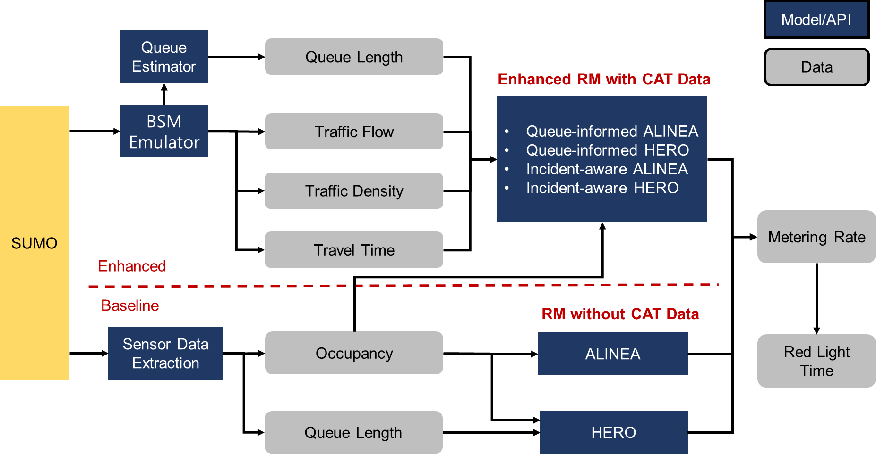
Enhanced Model Development
In addition to the BSM Emulator, multiple APIs were developed and integrated into SUMO to enable the implementation of ramp metering algorithms, queue estimation, and sensor data extraction
SUMO uses its simulation capabilities and a built-in API called TraCI (Traffic Control Interface) to simulate traffic conditions and allow for online manipulation of simulated objects and retrieval of their values via a TCP-based client/server architecture
25

Slide 26
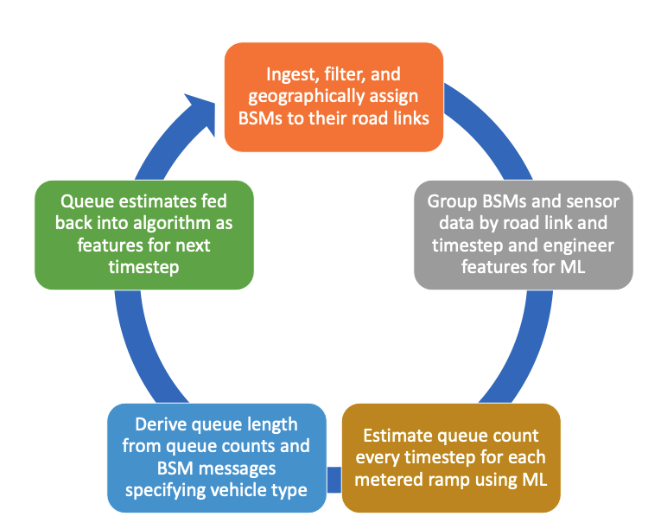
Queue Length Estimation Using CAT Data
Purpose:
Use CAT and sensor data to estimate queues at on-ramps to inform ramp metering strategy.
Queue Definition:
Vehicle is stopped or traveling at speed less than 10 ft/s and approaching another queued vehicle.
Approach:
Formulated as a regression problem with a continuous label variable for queue count.
  Used Extreme Gradient Boosting (XGBoost) algorithm with hyperparameters optimized for 50% CV market penetration.
  Used temporal grid search for hyperparameter selection.
Used vehicle type information in BSMs to estimate queue length.
26

Slide 27
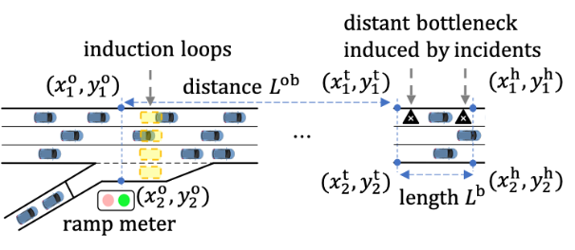
Incident Information Extraction Using CAT Data
Purpose: Use CAT data to estimate the flow of vehicles entering and exiting the distant bottleneck, the travel time from the on-ramp to the bottleneck, and the density of traffic around the bottleneck.
These information from a distant bottleneck is often “unknown” or not accurate to the local ramp control using traditional approach
All the information is extracted from BSMs (through the BSM emulator), therefore no additional protocol is needed
Layout of a Bottleneck Downstream of An On-Ramp
27

Slide 28
Ramp Metering Strategies Development
Enhanced Locally Responsive Ramp Metering
1. Queue-informed ALINEA
The developed machine learning based queue estimator that utilizes CAT data in addition to the loop detector data was integrated into an enhanced ALINEA algorithm, referred to as X-ALINEA/Q (Smaragdis and Papageorgiou 2003), to prioritize the use of queue control and prevent queue spillback. Its ramp metering control is synthesized by:
Metering rate by queue override
Metering rate by ALINEA
Metering rate by queue control
Derived from the enhanced queue length estimation
When a long queue exists, the queue control policy overwrites the metering rate set by the queue-informed ALINEA. If the queue control policy fails, the queue override strategy is used.
28

Slide 29
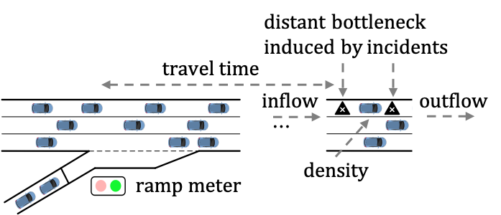
Ramp Metering Strategies Development
Enhanced Locally Responsive Ramp Metering
2. Incident-aware ALINEA
To improve situational awareness of rapidly changing road conditions, we integrated feedforward ALINEA (Frejo and De Schutter 2018), which uses CAT data to extract more precise information on traffic conditions around distant bottlenecks downstream of the on-ramp, such as traffic incidents or recurrent congestion due to lane-drop.
This approach requires accurate bottleneck detection for the enhanced ALINEA system. The baseline ALINEA is used when no incident is detected, but the incident-aware ALINEA is activated to replace it once an incident or distant bottleneck is identified.
Inputs Required by Incident-Aware ALINEA
29

Slide 30
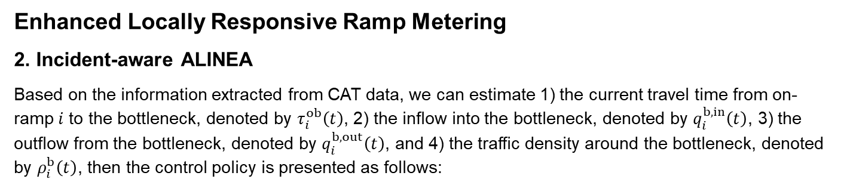
Ramp Metering Strategies Development
Enhanced Locally Responsive Ramp Metering
2. Incident-aware ALINEA
Based on the information extracted from CAT data, we can estimate 1) the current travel time from on-ramp $i$ to the bottleneck, denoted by $τ_{i}^{ob}\left(t\right)$, 2) the inflow into the bottleneck, denoted by $q_{i}^{b,in}\left(t\right)$, 3) the outflow from the bottleneck, denoted by $q_{i}^{b,out}\left(t\right)$, and 4) the traffic density around the bottleneck, denoted by $ρ_{i}^{b}\left(t\right)$, then the control policy is presented as follows:
The determined ramp metering rate is:
Metering rate by queue override
Metering rate by ALINEA
Metering rate by the incident-aware ALINEA
30

Slide 31
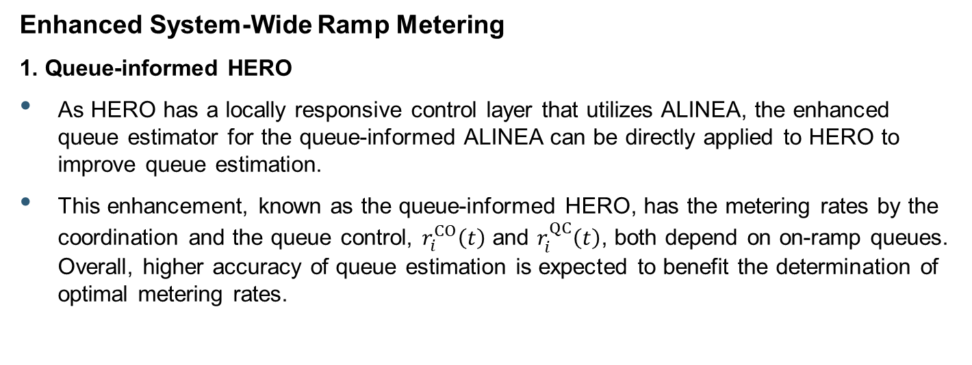
Ramp Metering Strategies Development
Enhanced System-Wide Ramp Metering
1. Queue-informed HERO
As HERO has a locally responsive control layer that utilizes ALINEA, the enhanced queue estimator for the queue-informed ALINEA can be directly applied to HERO to improve queue estimation.
This enhancement, known as the queue-informed HERO, has the metering rates by the coordination and the queue control, $r_{i}^{CO}\left(t\right)$ and $r_{i}^{QC}\left(t\right)$, both depend on on-ramp queues. Overall, higher accuracy of queue estimation is expected to benefit the determination of optimal metering rates.
31

Slide 32
Ramp Metering Strategies Development
Enhanced System-Wide Ramp Metering
2. Incident-aware HERO
Incident-aware HERO incorporates CAT data incident information into its control strategy by integrating feedforward ALINEA as local ramp metering control. In case of a traffic incident downstream of on-ramp i, the ramp metering rate is adjusted accordingly as follows:
Metering rate by ALINEA
Metering rates by the coordination
Metering rate by queue override
Metering rate by the incident-aware ALINEA
Metering rate by queue control
32

Slide 33
Recent Studies on Ramp Metering
Recent ramp metering studies were reviewed to guide the team in selecting performance measures and assessing benefits of locally responsive or system-wide strategies, without CAT data integration.
Reduced travel time: 2.5% (transitional traffic) and 13.2% (congested traffic) (Abdel-Aty et al. 2019); 3% to 4% during PM peak (VSL & ramp metering by Laval and Xu 2020); 5.8% (Skabardonis et al. 2021)
Increase in speeds for ramp and mainline traffic: 2% (HERO, Hale et al. 2020)
Reduced delay: 9% (Coordinated ramp metering. Mauch and Skabardonis 2021); 11.5% (Skabardonis et al. 2021)
Improved travel time reliability: 28% (Coordinated ramp metering, Mauch and Skabardonis 2021)
Reduce crash risk: up to 22.7% (Abdel-Aty et al. 2019)
Previous studies on ramp metering mainly compared ramp metering to not using it, while this study compared ramp metering controls with and without CAT data integration. Benefits discussed are solely due to incorporating CAT data into ramp metering control.
33

Slide 34
Selected Performance Measures
Performance measures were selected based on best practices from literature and to encompass several key objectives for freeway operations, including mobility, reliability, efficiency/productivity, and safety.
Index | Geometry Category | Performance Measures | Goal Area
1 | Network | Average travel time per vehicle | Mobility
2 | Mainline | Average corridor travel time | Mobility
3 | Network | Average travel speed per vehicle | Mobility
4 | Network | Spatial distribution of travel speeds | Mobility
5 | Mainline | Number of stops per vehicle | Mobility
6 | On-ramp | Ramp saturation per ramp (ramp queue length/storage capacity) | Mobility
7 | Network | The ratio of VMT/VHT | Efficiency/Productivity
8 | Network | Traffic throughput | Efficiency/Productivity
9 | Mainline | Travel time indexes (TTI) | Reliability
10 | Mainline | Buffer index (BI) | Reliability
11 | Mainline | Planning time index (PTI) | Reliability
12 | Mainline | Congestion frequency index (CFI) | Reliability
13 | Network | Variance of vehicle speed | Safety
14 | Mainline/On-ramp merging area | Number of hard braking events | Safety
34

Slide 35
Summary Findings
The aim of this project was to demonstrate how to develop an improved freeway operational strategy that leverages the advantages of CAT data. Both queue-informed and incident-aware ramp metering algorithms improved mobility, efficiency/productivity, reliability, and safety in most scenarios, although the extent of improvement varies based on the traffic conditions and whether the control is locally responsive or system-wide.
  Up to 13.5% travel time saving per vehicle/Up to 12.4% corridor travel time saving
  Up to 10.3% speed improvement/ up to 4.9% reduction in speed variations
  Up to 25.4% reduction in number of stops per vehicle on the mainline
  Slightly reduced ramp saturation rate variations and reduced/maintained maximum saturation rate
  Marginal increase in throughput and slightly improved travel time reliability
Overall, Scenario 3 using the enhanced system-wide ramp metering achieved the greatest benefits. Scenario 1, with a low CAV MPR and CAT infrastructure deployment rate, showed limited benefits or unchanged performance in certain cases compared to the baseline scenario.
35

Slide 36
Key Contributions – Ramp Metering
Literature Review
Enhanced ramp metering strategies utilizing CAT data:
  Implemented improved queue length estimation that combined induction loops and CAT data, in both ALINEA and HERO algorithms.
  Refined ALINEA and the local ramp metering layer of HERO by utilizing CAT data to extract traffic information around congestion and incidents, with the goal to address distant downstream bottlenecks.
Demonstrated how to develop an improved freeway operational strategy that leverages the advantages of CAT data.
  Both queue-informed and incident-aware ramp metering algorithms improved mobility, efficiency/productivity, reliability, and safety.
The code will be released as open source through ITS CodeHub.
Str. Eval & Op. Con
Interim Report
Enhanced Str Dev
Final Deliverables
36

Slide 37
Key Contributions – Queue Estimation
Literature Review
Machine Learning (ML) models were developed to estimate queues using synthetic BSMs that were generated using the BSM Emulator, that complies with SAE J2735 standard for message generation.
Queue Estimator code was successfully integrated within the SUMO simulation model for real-time queue estimation for use in queue-informed ramp metering strategies.
Temporal validation approach was used for ML model selection as traffic data contains time dependencies. Commonly used validation techniques such as out-of-sample holdout sets, and k-fold cross validation can result in overfit when there are time dependencies.
Practitioners can tailor the open source code, to be released through the ITS CodeHub, for ML models for their specific corridors and facilities with only moderate Machine Learning experience.
Str. Eval & Op. Con
Interim Report
Enhanced Str Dev
Final Deliverables
37

Slide 38
Key Contributions – TCA Enhancement
Literature Review
Synthetic BSM generation code (BSM Emulator) used in this project was adapted from the Open Source Trajectory Conversion Algorithm (TCA). The final version of the TCA was released in 2015 using Python 2.7 and was designed to handle many other message standards beyond BSM with additional customization options beyond the requirements of this project.
The BSM Emulator has an added adjustable rate for communications failures that removes generated BSMs from the output to emulate the loss of data due to random communication failures.
The BSM Emulator code includes performance updates to ensure that the process can run fast enough to meet the real time requirements:
  Removed the full data tracking of nonequipped vehicles to reduce memory usage,
  Stored the RSE locations in a numpy array to allow for quicker range checking
  Offloaded the CV equipped status to the simulation vehicle demands
The BSM Emulator is Open Source Python 3.10 code and will be released through the ITS CodeHub for use by the general public.
Str. Eval & Op. Con
Interim Report
Enhanced Str Dev
Final Deliverables
38

Slide 39
Lessons Learned
Literature Review
Optimize traffic condition recognition through clustering methods and data selection.
Select an appropriate step length in simulations to balance accuracy and computational efficiency.
Simultaneously calibrate mobility and safety conditions when using simulation approach, if safety benefits will also be assessed.
Tailor data collection and granularity to agency goals and performance measures.
During the transition period when the Market Penetration Rate of CAVs is not yet high, it is essential to integrate CAT data with traditional sensors for comprehensive traffic management.
Deploy adequate number of Roadside Units (RSU) in high-congestion areas.
Conduct comprehensive evaluations of freeway operation strategies using CAT data based on multiple goal areas, such as mobility, safety, and productivity.
Optimize output analysis methodology based on freeway facility types and chosen analysis techniques.
Balance and optimize testing scenario space for effective evaluations.
Str. Eval & Op. Con
Interim Report
Enhanced Str Dev
Final Deliverables
39

Slide 40
Recommendations for Future Work
Examine benefits of utilization of CAT data for additional freeway operational strategies
Examine impacts of providing warnings to CAVs for ramp metering as well as other relevant freeway operational strategies
Develop structured methodology to enable agencies to integrate CAT data into their transportation management systems (TMS) for managing and operating freeways
Develop best practices and processes (including integration of analysis/simulation tools for refinement of initial designs) to enable agencies to screen and scope potential new projects before committing to detailed systems engineering and eventual deployment
40

Slide 41
Acknowledgment/Disclaimer
This presentation is a deliverable of National Cooperative Highway Research Program (NCHRP) Project 08-145. NCHRP is sponsored by the individual state departments of transportation of the American Association of State Highway and Transportation Officials. NCHRP is administered by the Transportation Research Board (TRB), part of the National Academies of Sciences, Engineering, and Medicine, under a cooperative agreement with the Federal Highway Administration (FHWA). Any opinions and conclusions expressed or implied in resulting research products are those of the individuals and organizations who performed the research and are not necessarily those of TRB; the National Academies of Sciences, Engineering, and Medicine; the FHWA; or NCHRP sponsors.
41

