Slide 1
NCHRP 14-42: Determining the Impact of Connected and Automated Vehicle Technology on State DOT Maintenance Programs
The National Cooperative Highway Research Program (NCHRP) is sponsored by the individual state departments of transportation of the American Association of State Highway and Transportation Officials. NCHRP is administered by the Transportation Research Board (TRB), part of the National Academies of Sciences, Engineering, and Medicine, under a cooperative agreement with the Federal Highway Administration (FHWA). Any opinions and conclusions expressed or implied in resulting research products are those of the individuals and organizations who performed the research and are not necessarily those of TRB; the National Academies of Sciences, Engineering, and Medicine; the FHWA; or NCHRP sponsors.

Slide 2
NCHRP 14-42: Determining the Impact of Connected and Automated Vehicle Technology on State DOT Maintenance Programs
Project Summary
March 2024
Shauna Hallmark, Omar Smadi, Jon Markt, Eric Plapper, Paul Carlson, Katie Zimmerman and Greg Duncan

Slide 3
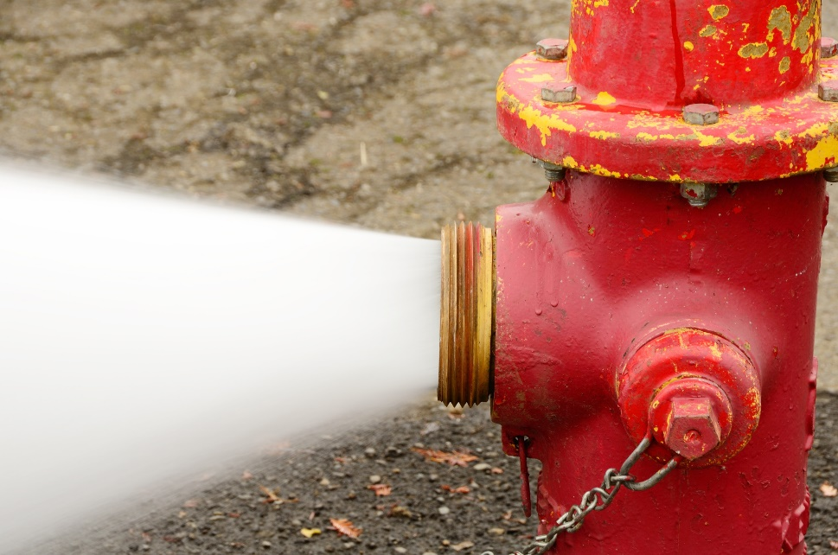
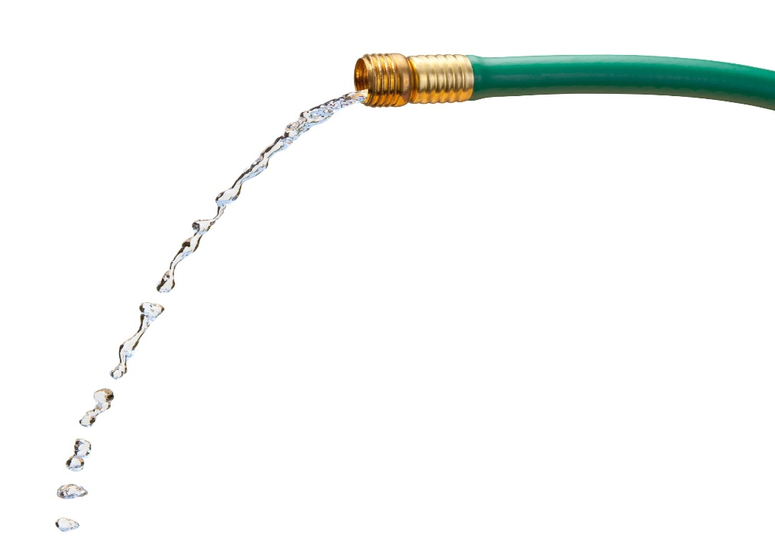
Project Objectives
Identify connected and automated vehicle (CAV) assets used by agencies (State DOT, Cities, Counties)
Identify likely maintenance needs for those assets
Develop successful strategies related to maintenance
Assess the workforce implications
Image source: Shutterstock

Slide 4
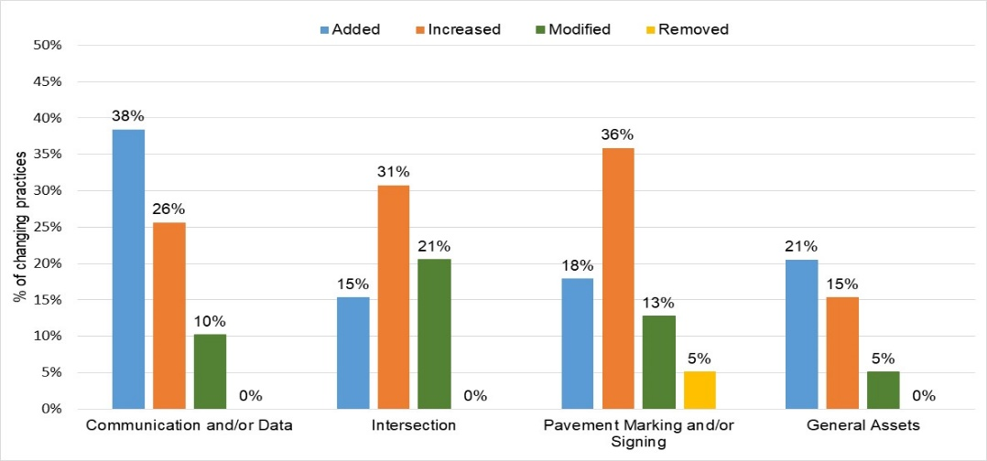
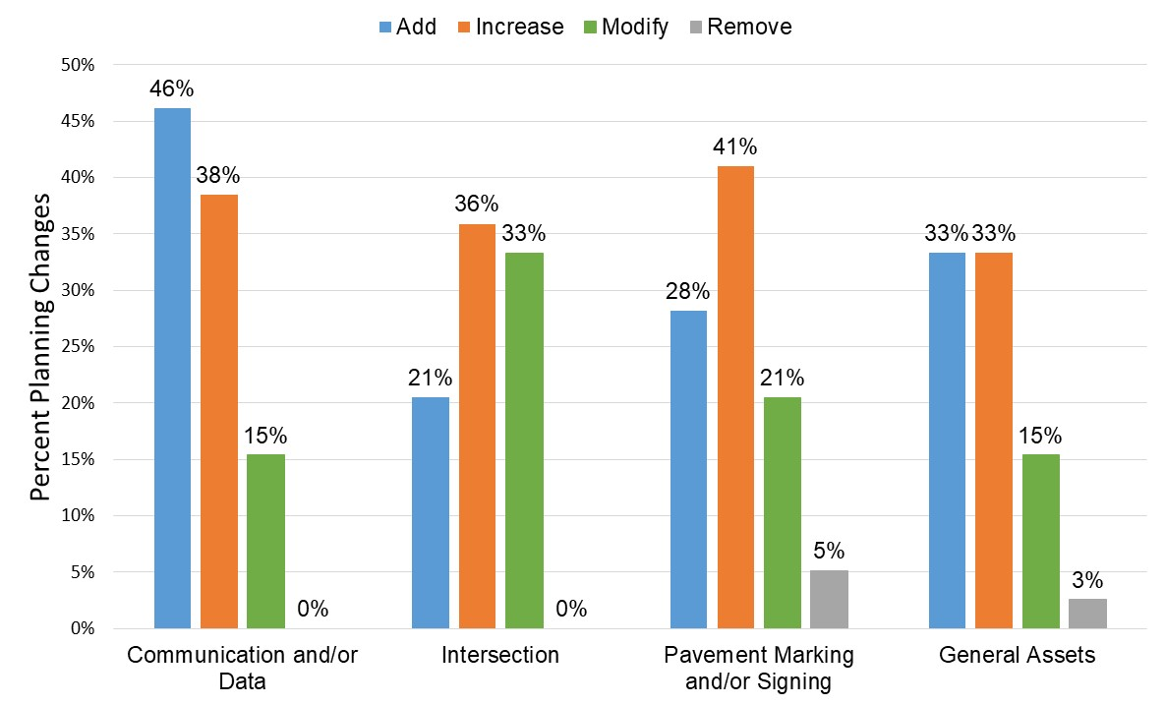
Survey of State and Local Agencies
Survey of agency current/planned use of CAV assets which targeted:
State DOTs
Smart cities
53 participants from 39 states (no local agencies)
Responses for each state were combined
Around 40% have added, increased, modified or removed assets to address CAV
Current
Planned

Slide 5
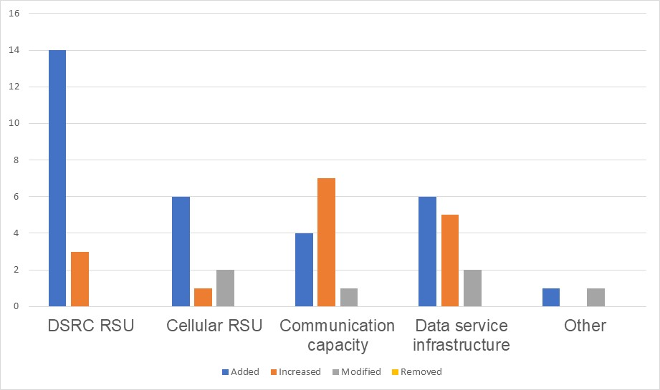
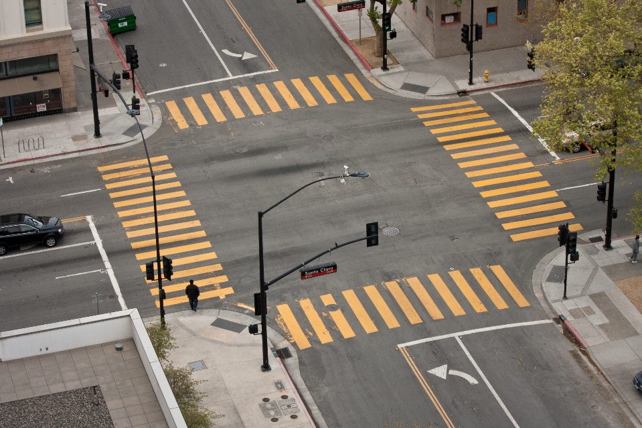
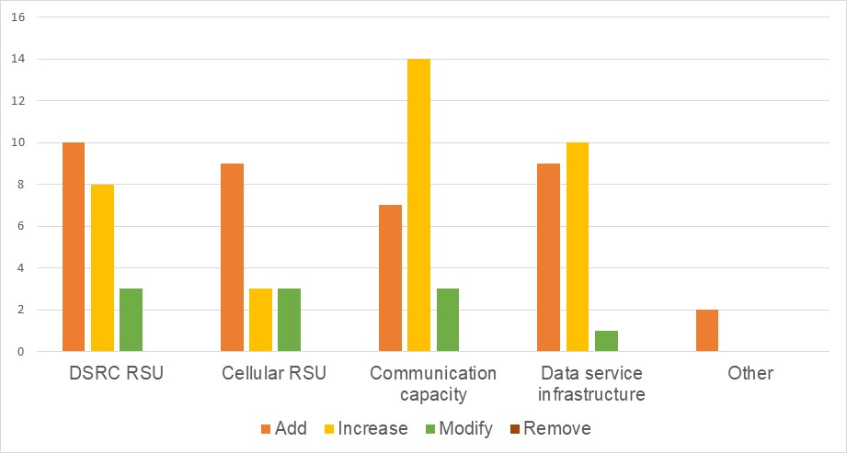
Changes to Communication/Data
Current
The most common change is the addition of dedicated short-range communications (DSRC) or increasing communication capacity.
Planned
Image source: Shutterstock

Slide 6
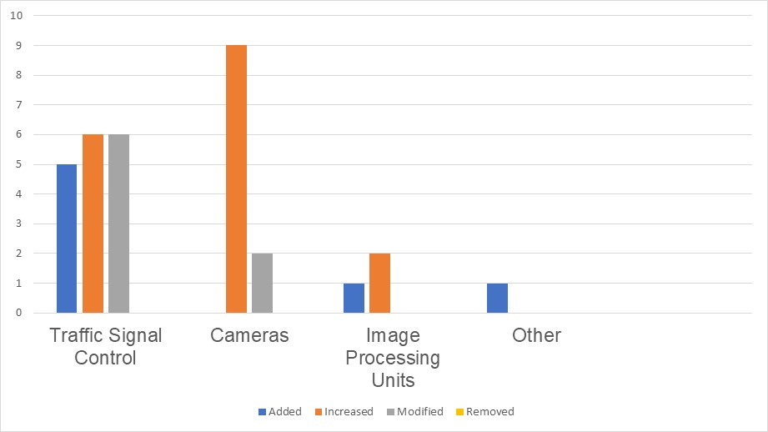
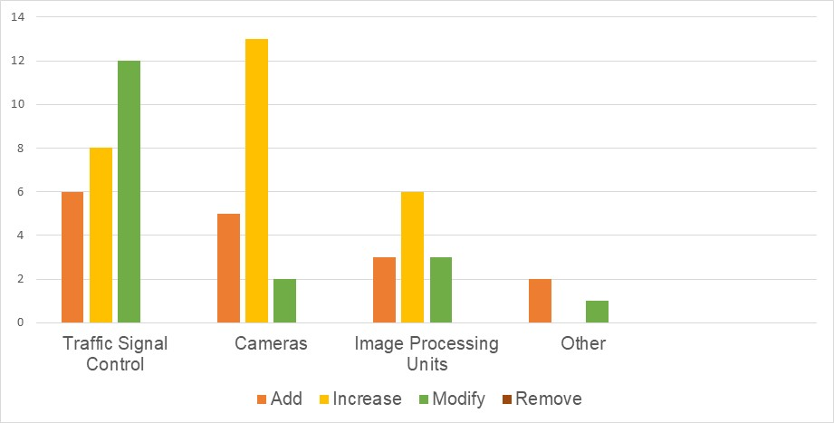
Changes in Assets
Current
Most common change is addition of or changes in traffic signal controls or an increase in cameras
Planned

Slide 7
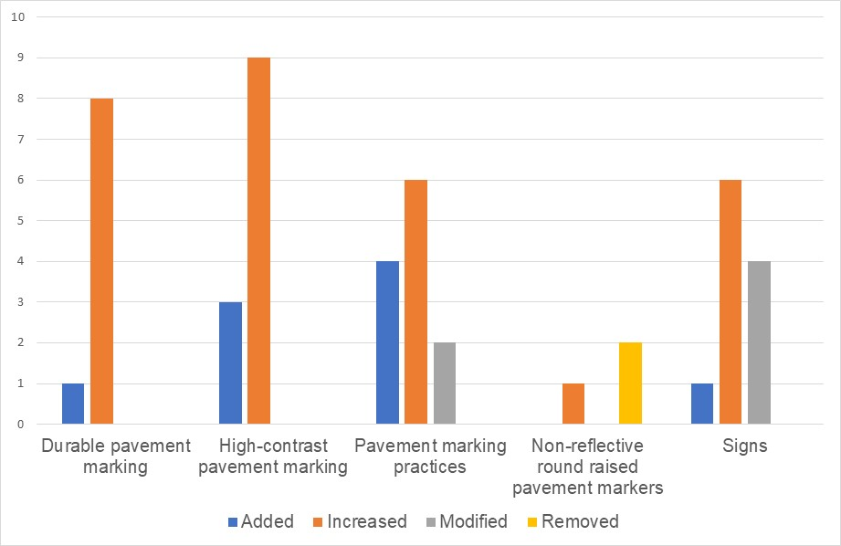
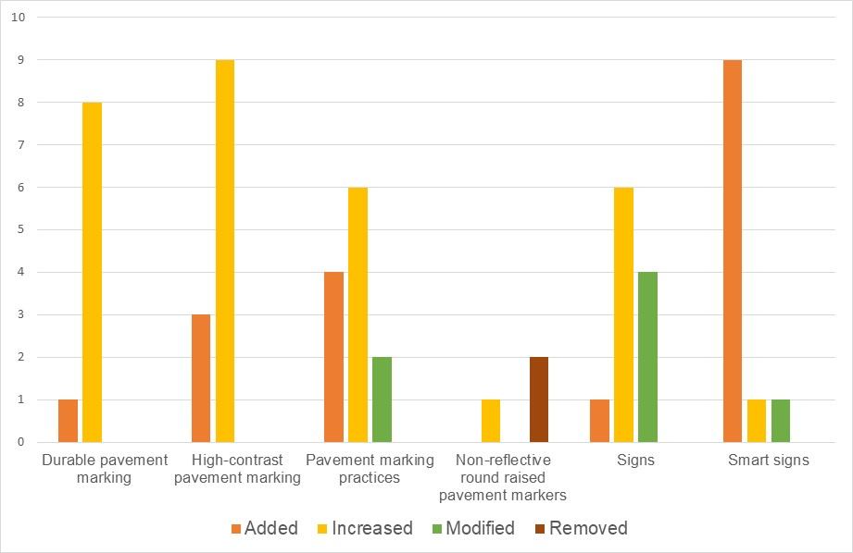
Changes in Pavement Markings
Current
Image source: www.3m.com/3M/en_US/
road-safety-us/applications/road-markings/
The most common change is the addition of high-contrast or durable markings
8% removed Botts Dotts
Planned

Slide 8
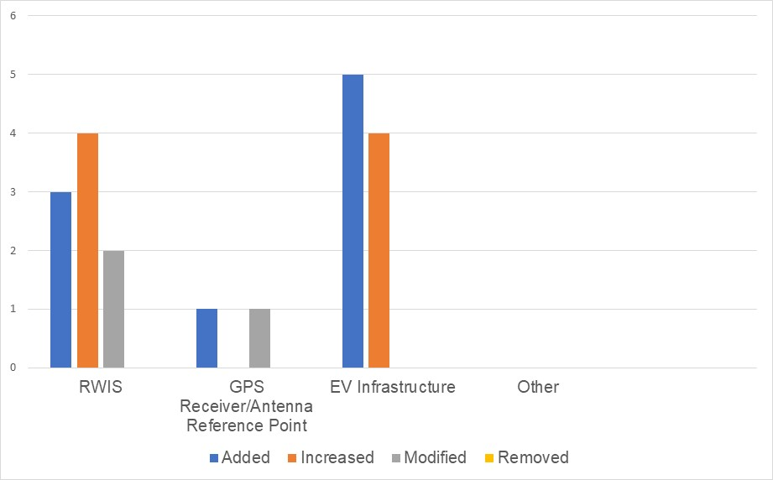
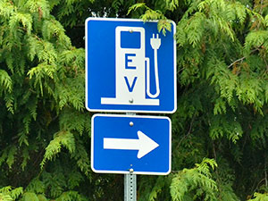
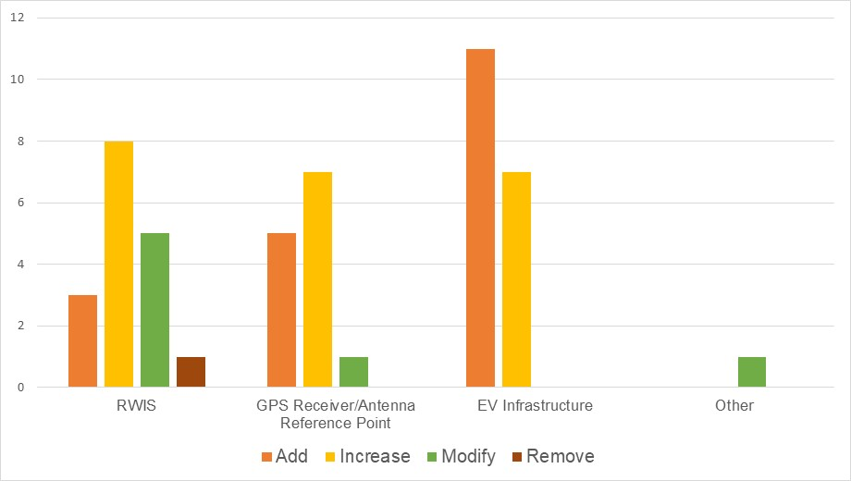
Changes in General Assets
The most common change is the addition/modification of roadway weather information system (RWIS) and electric vehicle infrastructure
Current
Planned
http://www.westcoastgreenhighway.com/

Slide 9
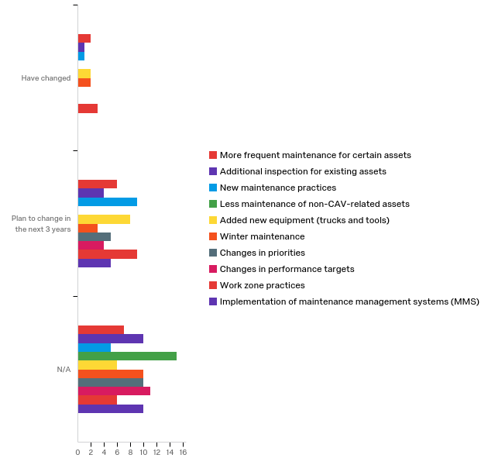
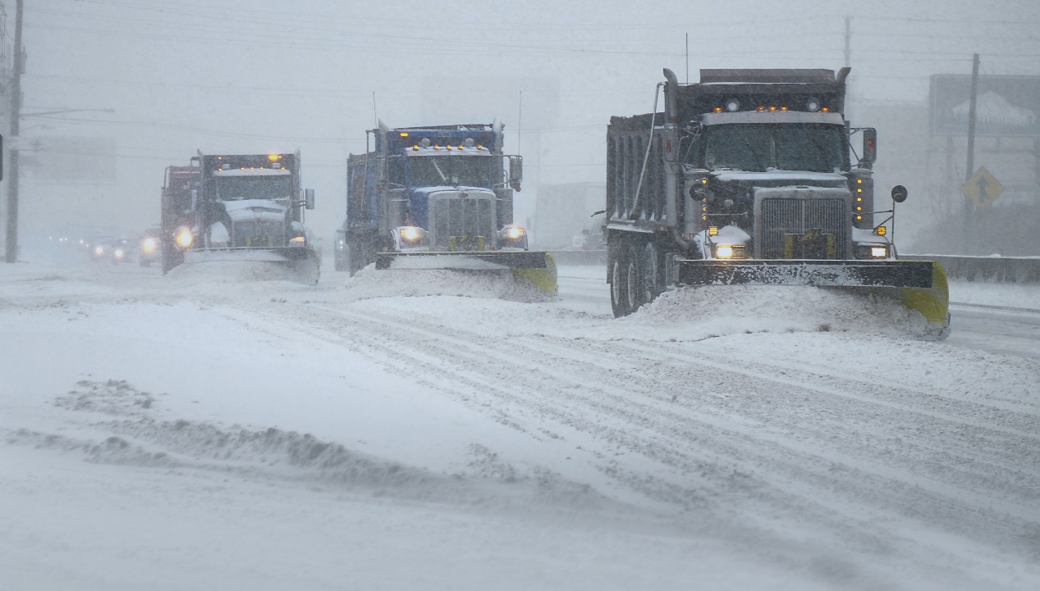
Changes in Maintenance Practices
Various changes planned
More frequent maintenance
New practices
Additional inspection, etc.
Image source: Shutterstock

Slide 10
Targeted Interviews
Focused on 4 assets
Roadside units (RSU)
Onboard units (OBU)
Pavement markings
Infrastructure based camera for AV applications
Interviews with 10 DOTS (CA, CO, FL, GA, KY, MI, MN, NV, NH, WA)
Interviews with 3 agencies (Las Vegas, Tampa Hillsborough Expressway Authority, Columbus)
Interviews with 6 asset vendors
Interviews with private highway maintenance contractors (Ferrovial Services, Roy Jorgensen, Louis Berger)

Slide 11
Overall
Technologies are new and agencies have limited maintenance experience with CAV assets
Information from OEMs has not been transparent or consistent making it difficult to invest or set performance metrics
Technology is changing rapidly
Funding is often available to implement CAV assets but not to maintain
Many agencies rely on vendors for maintenance and support
CAV assets likely to increase maintenance needs

Slide 12
Roadside Units
Provide wireless communication between roadside infrastructure and vehicles
Survey
20 agencies have them
19 agencies plan to add
Many agencies rely on private vendors or original maintenance contracts
Typical maintenance
Monitoring
Software-related maintenance
Ensure access to power
www.traffictechnologytoday.com

Slide 13
Roadside Units
Common failure issues
Weather
Security credentialing
Improper installation
Maintenance challenges
Sparse communication in rural agencies
Ability to determine whether RSUs are functioning
Time-consuming over-the-air updates

Slide 14
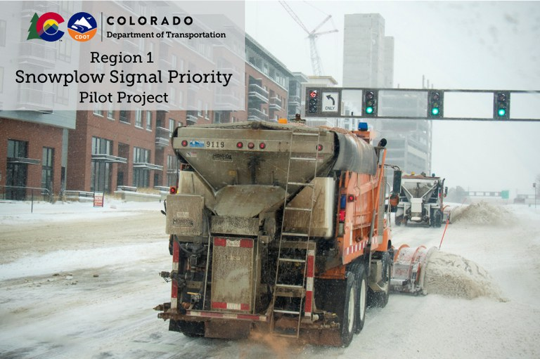
On-board Units
Vehicle-based equipment that can communicate with RSUs or other ITS infrastructure
Applications
Most common – snowplows
Bus priority
Traffic signal timing
Most agencies did not have much experience with maintenance, however OBUs are a mature technology
https://grandavebridge.codot.gov/projects/snowplowsignalpriority.

Slide 15
On-board Units
Typical maintenance
Software-related maintenance
Checking cables/sensors
Maintenance challenges
Sparse communication in rural agencies

Slide 16
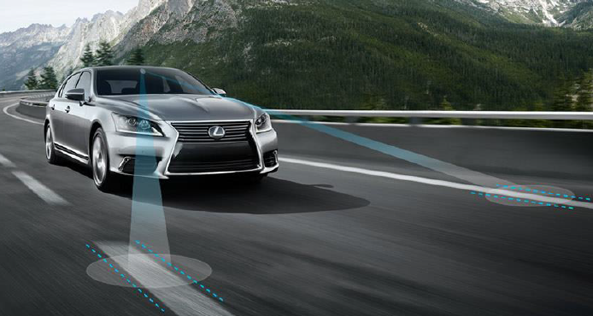
Pavement Markings
Indicate forward alignment for AV
Proposed standards
6-inch for higher speed roadways
Chevrons in gore areas
Dotted extension through exit ramp
High-contrast markings also used
Survey
26 added/increased/modified markings for AV
Hansra 2016
Paul Carlson, Texas A&M Transportation Institute (TTI).

Slide 17
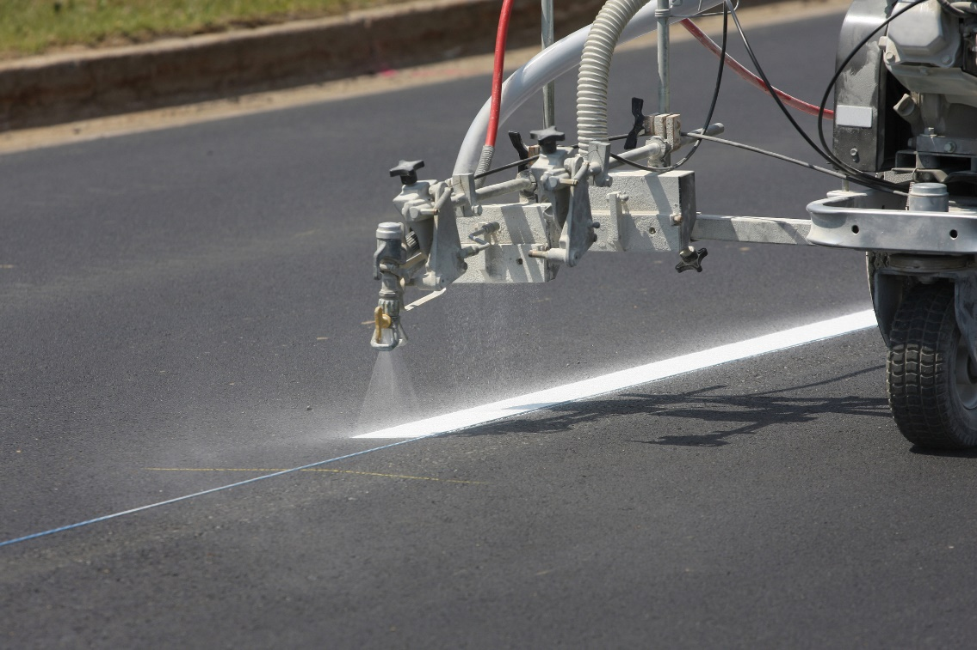
Pavement Markings
Typical maintenance
Increases cost of painting
None indicated increased restriping due to AV
Maintenance challenges
No retro-reflectivity or other maintenance standards have been established
https://ogs.ny.gov/greenny/pavement-marking-paint

Slide 18
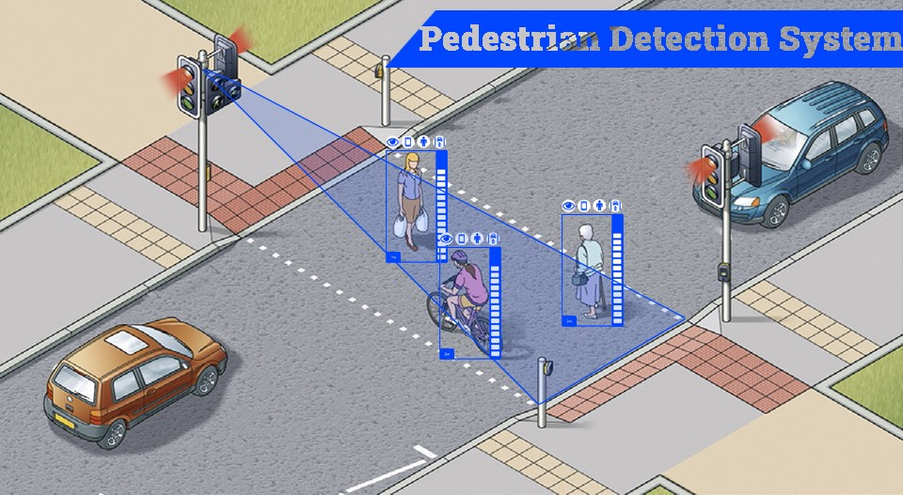
Camera-Based Pedestrian and Bicycle Detection
Used to identify the presence of vulnerable road users
System can provide info to surrounding vehicles through vehicle to infrastructure (V2I)
Survey (question was about cameras for CAV in general)
11 added/increased/modified use of cameras
20 plan to add/increase/modify the use of cameras
General Maintenance needs for ped/bike detection
Regular cleaning particularly in adverse weather situations
Checking placement
Checking cables
Maintenance Standards
None specific to CAV applications
https://transit-signal-priority.medium.com/

Slide 19
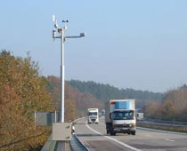
Other Assets/Information
Focused Phase II efforts on previous assets
Summarized available maintenance information for 6 additional assets
Signs
Traffic signal controllers
RWIS
Additional communication capacity
Machine-readable signs
Data and digital infrastructure
https://climateillinois.wordpress.com/

Slide 20
Workforce Needs
Summarized agency workforce concerns
The current mix of skills within the DOT workforce is not oriented toward technology
Position classifications and pay ranges are not sufficient for recruiting and retaining needed new talent
Internal training programs to develop skills within the current DOT workforce are needed or have not yielded the expected benefits
Many states are currently using contractors to maintain CAV equipment
Agencies noted uncertainty about the adoption timelines of technology and the absence of guidance from OEMs makes planning future investments difficult

