Slide 1
Appendix J: HCM: Urban Streets Weaving Analysis Method
Highway Capacity Analysis
NCHRP 15-66: Operational Performance and Safety Effects
of Arterial Weaving Sections
September 2023

Slide 2
Outline
HCM: Urban Street Weaving Method
Overview of the HCM 7th Edition’s “Urban Streets Segment Analysis” method.
Overview of the HCM’s proposed method on “Arterial’s Weaving Operational Performance” based on NCHRP 15-66
Case Study #1, Settlers Blvd in Round Rock, TX; Assessing the impact of channelized right turn on urban street segment performance due to weaving
Case Study #2, Y Freedom Dr, Charlotte, NC; Assessing the impact of an access point on urban street segment performance due to weaving
Safety Analysis of Arterial Weaving Segments
Conclusions and Take Aways

Slide 3
About the HCM
HCM OVERVIEW
Overseen by TRB committee on Highway Capacity and Quality of Service (hcqstrb.org)
Most methods are developed via national level projects such as NCHRP Projects*.
Four Volumes:
I. Concepts
II. Uninterrupted Flow
III. Interrupted Flow
IV. Applications Guide (Online only)
(*) NCHRP: National Cooperative Highway Research Program

Slide 4
Urban Street Segments HCM Chapter 18 Based on the 7th Edition of Highway Capacity Manual (HCM7)

Slide 5
Urban Streets Characteristics
URBAN STREETS - OVERVIEW
They are part of the “Interrupted Flow” methods
Traffic control devices creating delay
Stop signs, traffic signals, roundabouts
Traffic flow patterns inherent to control type
Platoons of vehicles vs. random arrivals
Presence of pedestrians and bicycles also evaluated as part of interrupted flow methods

Slide 6
Urban Streets Components
URBAN STREETS - OVERVIEW
Intersection 1
Intersection 2
Intersection 3
Segment 1
Segment 2
Interchange
Urban Street Facility

Slide 7
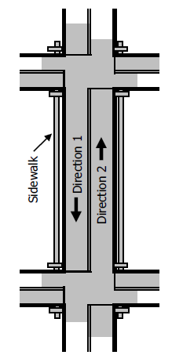
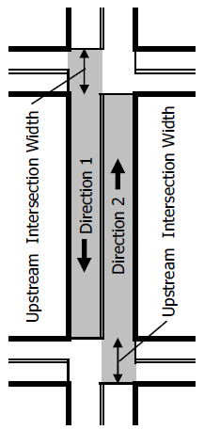
Urban Streets Analysis
URBAN STREET SEGMENTS
Analysis boundaries include:
Roadway right-of-way
Operational influence area of each boundary intersection
Interdependent with operation at boundary intersections
Service Measure: Travel Speed (mi/h)
HCM Pages 18-4 & 18-5

Slide 8
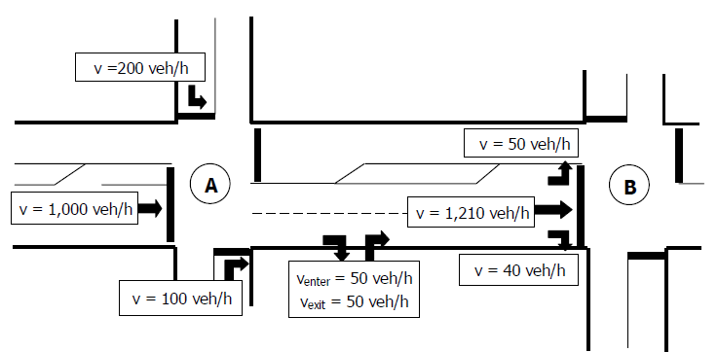
Volume Balancing
URBAN STREET SEGMENTS
Entering and exiting volumes must be balanced for accurate analyses
Unbalanced volumes due to:
Different counting times for boundary intersections
Uncaptured midblock demand
Counting inaccuracy
Entering Volume
Exiting Volume
Entering volume:
200 + 1,000 + 100 + 50 = 1,350 veh/h
=
Exiting volume:
50 + 1,210 + 40 + 50 = 1,350 veh/h
HCM Exhibit 18-9 & 18-10

Slide 9
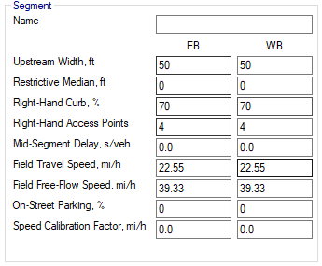
Base Free-Flow Speed
URBAN STREET SEGMENTS
Determined as function of segment geometric inputs:
Length of street with a restrictive median (raised curb)
Proportion of segment with curb on the right-side
Number of active access points (> 10 veh/h) on the right side of street
Manual input for additional mid-segment delay sources not addressed by HCM (e.g. mid-block pedestrian crossing)
Proportion of segment’s right-hand curb line with parking stalls (parallel or angle)
Manual calibration factor
HCM Equation 18-3

Slide 10
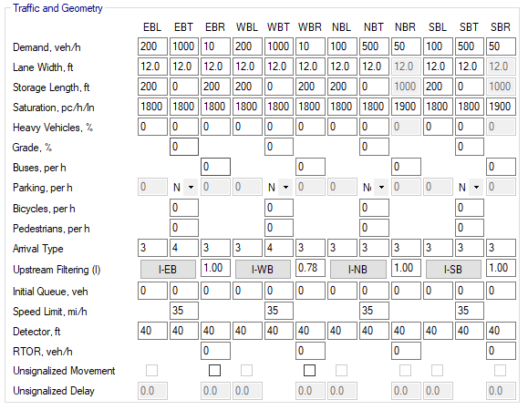
Base Free-Flow Speed
URBAN STREET SEGMENTS
Determined as function of segment geometric inputs:
Speed constant
HCM Equation 18-3

Slide 11
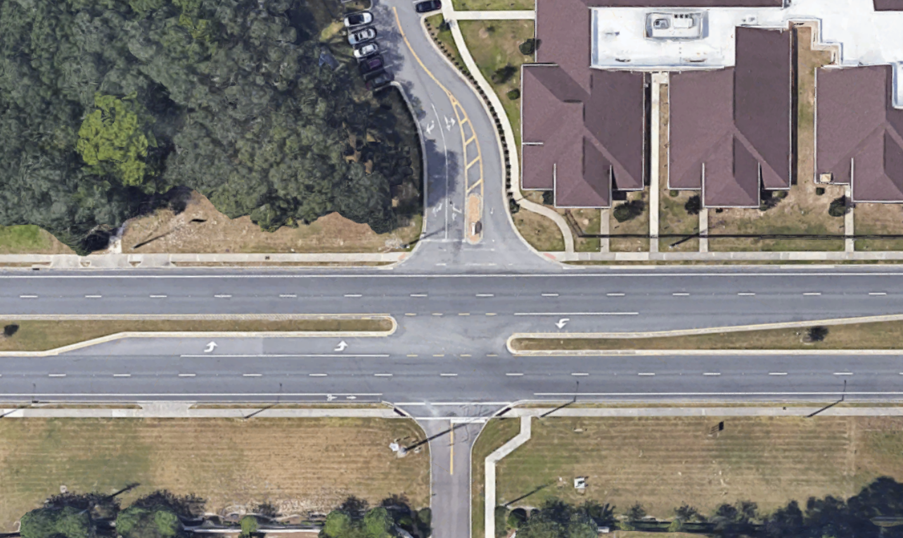
Access Points
URBAN STREET SEGMENTS
Can be modeled in Urban Streets
Inputs:
Turning movement demands
Number of lanes for each movement
PHF
HCM Equation 18-3

Slide 12
Definitions
URBAN STREET SEGMENTS
Running Time
The time a vehicle spends in motion through the segment
Through delay
Control delay of the through movement in the boundary downstream intersection
Automobile Traveler Perception Score
Optional performance measure to indicate traveler’s perception of quality of service

Slide 13
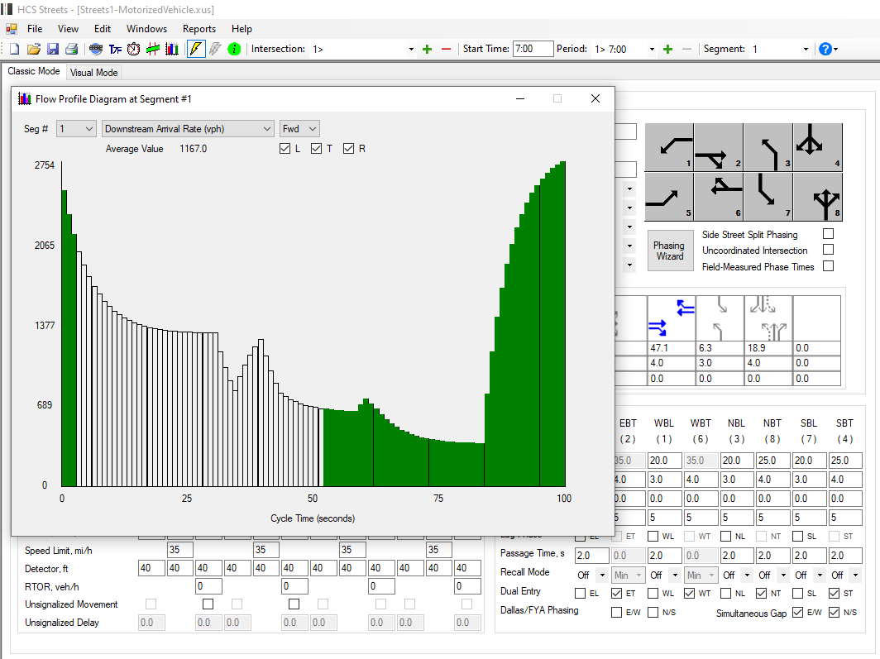
Flow Profile
URBAN STREET SEGMENTS
Applies for downstream signalized intersection only
Measures the proportion of traffic arriving downstream during green
Green part of the graph = vehicles arriving on green
The higher the better
Improves intersection uniform delay (d₁)
HCM Exhibit 18-9

Slide 14
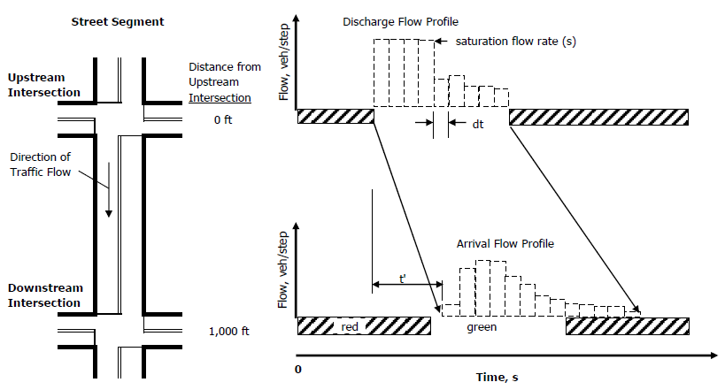
Platoon Dispersion Model
URBAN STREET SEGMENTS
Platoons from the upstream signal degrade while traveling the segment, due to differing speeds of vehicles
Arrival flow rate lower than discharge flow rate
HCM Exhibit 30-3

Slide 15
Running Time
URBAN STREET SEGMENTS
$$t_{R}=\frac{6.0−l_{1}}{0.0025L}f_{x}+\frac{3,600L}{5,280S_{f}}f_{v}+\sum_{i=1}^{N_{ap}}{d_{ap,i}+d_{other}}$$
$$t_{R}=\text{segment} \text{running} \text{time}\text{ (}\text{s}\text{)}$$
$$l_{1}=\text{start}\text{−}\text{up} \text{lost} \text{time}\text{ = 2.0 }\text{if} \text{signalized}\text{, 2.5 }\text{if} \text{STOP}\text{− }\text{or} \text{YIELD}\text{− }\text{controlled}\text{ (}\text{s}\text{)}$$
$$L=\text{segment} \text{length}\text{ (}\text{ft}\text{)}$$
$$f_{x}=\text{control}\text{−}\text{type} \text{adjustment} \text{factor}$$
$f_{x}=\left\{\begin{aligned}1.00 (\text{signalized} \text{or} \text{STOP}\text{−}\text{controlled} \text{through} \text{movement}) \\ 0.00 \text{(}\text{uncontrolled} \text{through} \text{movement}\text{)} \\ \text{min}\left[{v_{th}}/{c_{th},1.00}\right] (\text{Y}\text{I}\text{E}\text{L}\text{D}\text{−}\text{controlled} \text{through} \text{movement}\text{)}\end{aligned}\right.$
$$d_{ap,i}=\text{delay} \text{due} \text{to} \text{left} \text{and} \text{right} \text{turns} \text{from} \text{the} \text{street} \text{into} \text{the} \text{access} \text{point} \text{intersection} i\text{ (}\text{s}\text{/}\text{veh}\text{)}$$
$$d_{other}=\text{delay} \text{due} \text{to} \text{other} \text{sources} \text{along} \text{the} \text{segment}\text{ (}\text{e}\text{.}\text{g}\text{. }\text{curb} \text{parking}\text{, }\text{pedestrians}\text{, }\text{etc}\text{.) (}\text{s}\text{/}\text{veh}\text{) }$$
HCM Equation 18-15

Slide 16
Running Time
URBAN STREET SEGMENTS
$$t_{R}=\frac{6.0−l_{1}}{0.0025L}f_{x}+\frac{3,600L}{5,280S_{f}}f_{v}+\sum_{i=1}^{N_{ap}}{d_{ap,i}+d_{other}}$$
$$v_{th}=\text{through} \text{demand} \text{flow} \text{rate}\text{ (}\text{veh}\text{/}\text{h}\text{)}$$
$$c_{th}=\text{through} \text{movement} \text{capacity}\text{ (}\text{veh}\text{/}\text{h}\text{)}$$
$$d_{ap,i}=\text{delay} \text{due} \text{to} \text{left} \text{and} \text{right} \text{turns} \text{from} \text{the} \text{street} \text{into} \text{access} \text{point} \text{intersection} \text{i}\text{ (}\text{s}\text{/}\text{veh}\text{)}$$
$$N_{ap}=\text{number} \text{of} \text{influential} \text{access} \text{point} \text{approaches} \text{along} \text{the} \text{segment}\text{ = }N_{ap,s}+p_{ap,lt}N_{ap,o} \text{(}\text{points}\text{)}$$
$N_{ap,s}=$ number of access point approaches on the right side in the subject direction of “ ravel (points)
$$N_{ap,o}=\text{number} \text{of} \text{access} \text{point} \text{approaches} \text{on} \text{the} \text{right} \text{side} \text{in} \text{the} \text{opposing} \text{direction} \text{of} \text{travel}\text{ (}\text{points}\text{)}$$
$$p_{ap,lt}=\text{proportion} \text{of} N_{ap,o} \text{that} \text{can} \text{be} \text{accessed} \text{by} \text{a} \text{left}\text{−}\text{turn} \text{from} \text{the} \text{subject} \text{direction} \text{of} \text{travel}$$
$d_{other}=\text{delay} \text{due} \text{to} \text{other} \text{sources} \text{along} \text{the} \text{segment}\text{ (}\text{e}\text{.}\text{g}\text{. }\text{curb} \text{parking}\text{,}\text{pedestrians}\text{, }\text{etc}\text{.)}$ $\text{(}\text{s}\text{/}\text{veh}\text{)}$
HCM Equation 18-15

Slide 17
Travel Speed
URBAN STREET SEGMENTS
$$S_{T,seg}=\frac{3,600L}{5,280\left(t_{R}+d_{t}\right)}$$
$$S_{T,seg}=\text{travel} \text{speed} \text{of} \text{through} \text{vehicles} \text{for} \text{the} \text{segment}\text{ (}\text{mi}\text{/}\text{h}\text{)}$$
$$L=\text{segment} \text{length}\text{ (}\text{ft}\text{)}$$
$$t_{R}=\text{segment} \text{running} \text{time}\text{ (}\text{s}\text{)}$$
$$d_{t}=\text{through} \text{delay} \text{at} \text{downstream} \text{intersection}\text{ (}\text{s}\text{/}\text{veh}\text{)}$$
About the through delay:
Computed with the signalized intersection methodology (Equation 19-18)
If through movement has shared lanes → Use Equation 18-10
HCM Equation 18-15

Slide 18
Level of Service
URBAN STREET SEGMENTS
Service measure: Travel Speed (mi/h) as a percentage of base free-flow speed (BFFS)
LOS | % of BFFS | Travel Speed Threshold by BFFS (mi/h) |  |  |  |  |  |  | Volume-to-Capacity Ratio*
 |  | 55 | 50 | 45 | 40 | 35 | 30 | 25
A | > 80% | >44 | >40 | >36 | >32 | >28 | >24 | >20 | ≤ 1.0
B | 67-80% | >37 | >34 | >30 | >27 | >23 | >20 | >17
C | 50-67% | >28 | >25 | >23 | >20 | >18 | >15 | >13
D | 40-50% | >22 | >20 | >18 | >16 | >14 | >12 | >10
E | 30-40% | >17 | >15 | >14 | >12 | >11 | >9 | >8
F | < 30% | ≤17 | ≤15 | ≤14 | ≤12 | ≤11 | ≤9 | ≤8
F | any | any |  |  |  |  |  |  | > 1.0
HCM Exhibit 18-1

Slide 19
Limitations
URBAN STREET SEGMENTS
Significant Grade along the Link
Cyclic Queue Spillback (queue grows and discharges at every cycle)
Cross-street Congestion Blockage
Bicycles in Traffic Stream
HCM Page 18-13

Slide 20
Required Input Data
URBAN STREET SEGMENTS
Required Data and Units | Potential Data Source(s) |  | Suggested Default Value
Traffic Characteristics Data
Demand flow rate by movement group at boundary intersection (veh/h) | Field data, past counts | Field data, past counts | Must be provided
Access point flow rate by movement group (veh/h) | Field data, past counts | Field data, past counts | See discussion in text
Midsegment flow rate (veh/h) | Field data, past counts | Field data, past counts | Estimate using demand flow rate at the downstream boundary int. approach
HCM Exhibit 18-5

Slide 21
Required Input Data
URBAN STREET SEGMENTS
Required Data and Units | Potential Data Source(s) |  | Suggested Default Value
Geometric Data
Number of lanes by movement group at boundary intersection | Field data, aerial photo | Field data, aerial photo | Must be provided | Must be provided
Upstream intersection width (ft) | Field data, aerial photo | Field data, aerial photo | Must be provided | Must be provided
Segment approach turn bay length at boundary intersection (ft) | Field data, aerial photo | Field data, aerial photo | Must be provided | Must be provided
Number of midsegment through lanes | Field data, aerial photo | Field data, aerial photo | Must be provided | Must be provided
Number of lanes at access points – segment approach | Field data, aerial photo | Field data, aerial photo | Number of through lanes on approach = number of midsegment through lanes No right-turn lanes If median present, one left-turn lane per approach; otherwise, no left-turn lanes | Number of through lanes on approach = number of midsegment through lanes No right-turn lanes If median present, one left-turn lane per approach; otherwise, no left-turn lanes
Number of lanes at access points – access point approach | Field data, aerial photo | Field data, aerial photo | One left-turn and one right-turn lane | One left-turn and one right-turn lane
Segment approach turn bay length at access points (ft) | Field data, aerial photo | Field data, aerial photo | 40% of the access point spacing, where spacing = 2 x (5,280)/Da in feet, but not more than 300 ft nor less than 50 ft | 40% of the access point spacing, where spacing = 2 x (5,280)/Da in feet, but not more than 300 ft nor less than 50 ft
HCM Exhibit 18-5

Slide 22
Required Input Data
URBAN STREET SEGMENTS
Required Data and Units | Potential Data Source(s) |  | Suggested Default Value
Geometric Data, cont.
Segment (site) length (ft) | Field data, aerial photo | Must be provided | Must be provided
Restrictive median length (ft) | Field data, aerial photo | Must be provided | Must be provided
Proportion of segment with curb (decimal) | Field data, aerial photo | 1.0 (curb present on both sides) | 1.0 (curb present on both sides of segment)
Number of access point approaches | Field data, aerial photo | See discussion in text | See discussion in text
Proportion of segment with in-street parking (decimal) | Field data | Must be provided | Must be provided
Other Data
Analysis period duration (h) | Set by analyst |  | 0.25 h
Speed limit (mi/h) | Field data, road inventory |  | Must be provided
Performance Measure Data
Through control delay at boundary intersection (s/veh) | HCM method output |  | Must be provided
Through stopped vehicles at boundary intersection (veh) | HCM method output |  | Must be provided
2nd and 3rd term back-of-queue size for through movement at boundary intersection (veh/lane) | HCM method output |  | Must be provided
Capacity by movement group at boundary intersection (veh/h) | HCM method output |  | Must be provided
Midsegment delay (s/veh) | Field data |  | 0.0 s/veh
Midsegment stops (stops/veh) | Field data |  | 0.0 stops/veh
HCM Exhibit 18-5

Slide 23
New Method to Evaluate Operational Performance of Arterial Weaving Based on NCHRP Project 15-66

Slide 24
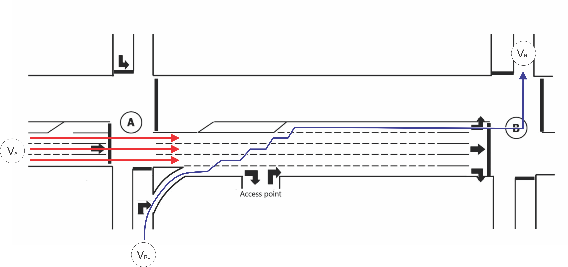
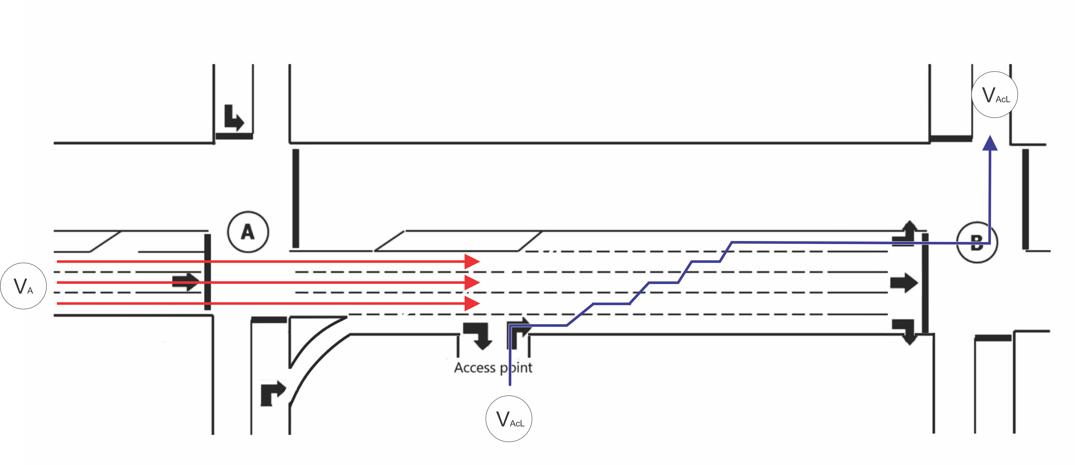
Scope of Urban Streets Weaving Analysis Method
Proposed HCM Urban Streets Weaving Method
The new method accounts for weaving movements within each urban street link.
Based on the proposed method, two movements can create a weave maneuver in urban streets links:
Right turn from access points into the link
Right turn from unsignalized channelized right turn at the upstream intersection.

Slide 25
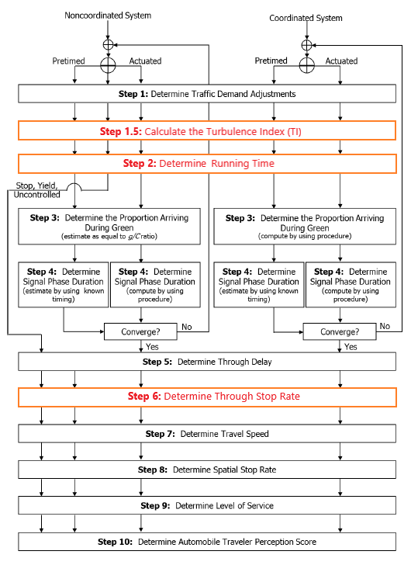
Changes to the Urban Streets Core Methodology
Proposed HCM Urban Streets Weaving Method
New Step 1.5 to estimate Turbulence Index and assess the weaving maneuver's impact
Revised Step 2 to adjust the running time to account for the through delay due to weaving

Slide 26
Step 1.5: Estimate Turbulence Index (TI)
Proposed HCM Urban Streets Weaving Method
The Turbulence Index (TI) is calculated to assess the degree of traffic turbulence caused by weaving movements:
$TI$ = Turbulence index (in units of (veh/hr)2 / ft)
${PCO}_{i}$ = The potential conflict opportunities for the weaving movement i considering the conflicting volume the movement must traverse to its destination
${SL}_{i}$ = Distance to stop bar for weaving movement i
$n$ = the Total number of weaving maneuvers within the weaving section (including weaving to and from mid-block access points)
$$TI=\sum_{i=1}^{n}{\frac{{PCO}_{i}}{{SL}_{i}} }$$

Slide 27
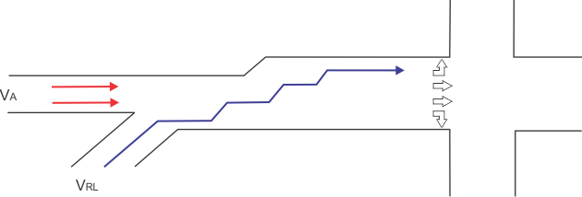
Step 1.5: Estimate Turbulence Index (TI)
Proposed HCM Urban Streets Weaving Method
The PCO for a given movement set is the product of the conflicting demands. Below is an example of a left turn at the downstream intersection originating from the access point and conflicting with the through traffic:
Where:
$V_{RL}$= Flow (veh/h) arriving from the access point and making a left turn at the downstream intersection
$V_{A}$= Total flow (veh/h) arriving from the arterial
Illustration of Potential Conflict Points Opportunities for Movement VRL
$${PCO}_{RL}=V_{RL}xV_{A}$$

Slide 28
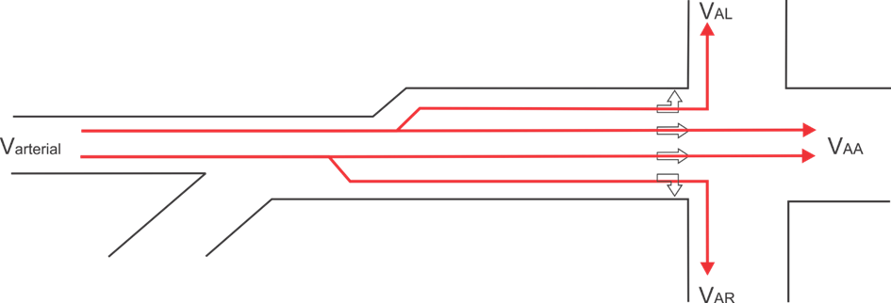
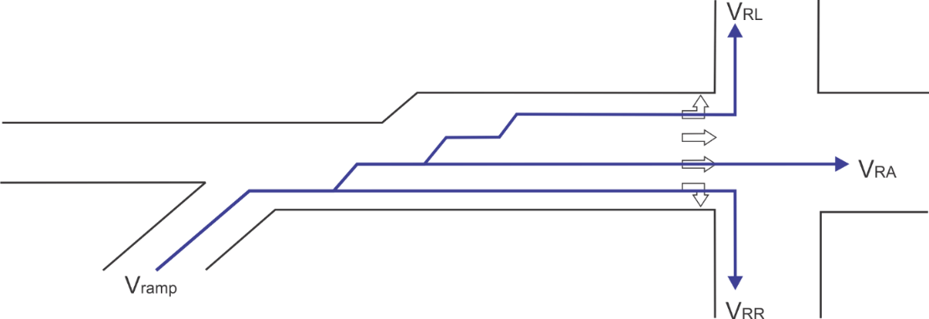
Step 1.5: Estimate Turbulence Index (TI)
Proposed HCM Urban Streets Weaving Method
The PCO must be computed for the following conflicting movements:
$$PCO= \sum_{i=1}^{n}{{PCO}_{i}}$$

Slide 29
Step 2: Include the Impact of Weaving in the Running Time
Proposed HCM Urban Streets Weaving Method
The new Through Delay due to Weave ($d_{wv}$) term is included in the running time model:
Where:
$$t_{R}=\frac{6.0 −{ l}_{1}}{0.0025 L} f_{x}+ \frac{3,600 L}{5,280 S_{f}}f_{v}+ \sum_{i=1}^{N_{ap}}{d_{ap,i}}+ d_{wv} + {d }_{other}$$
$$d_{wv}={\left(\frac{TI}{NL} \right)}^{0.773}∗{0.013}^{\left(\frac{g}{C}\right)}$$

Slide 30
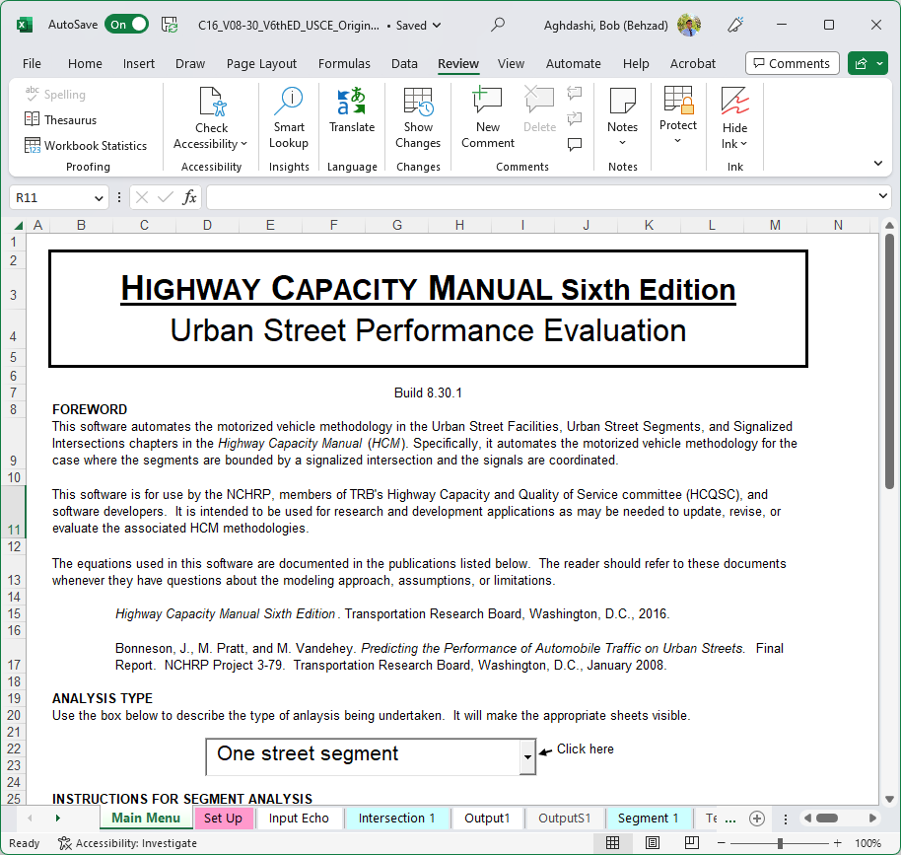
Implementation in the HCM’s STREETVAL Computational Engine
Proposed HCM Urban Streets Weaving Method
The proposed models and changes to the HCM core urban street methodology are implemented in the Excel-based STREETVAL V8.30.1
This computational engine can be used to evaluate the impact of arterial weaving in Urban Streets with Signalized Intersections.
Excel STREETVAL V8.30.1

Slide 31
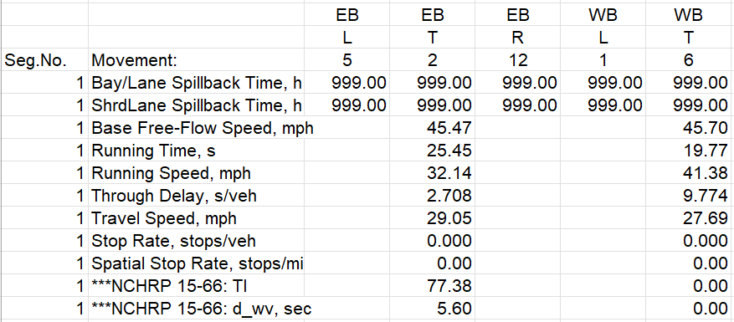
Implementation In the HCM’s STREETVAL Computational Engine
Proposed HCM Urban Streets Weaving Method
The proposed method does not require any additional information, i.e., no additional inputs are added to the STREETVAL.
However, the output page of STREETVAL shows all MOEs considering the new NCHRP 15-66 method.
Two additional MOEs are also reported in the STREETVAL 8.30.1:
Turbulence Index (TI)
Delay due to arterial weaving

Slide 32
Case Study #1 Old Settlers Blvd, Round Rock, Tx Evaluate the impact of a weaving maneuver from upstream channelized right turn

Slide 33
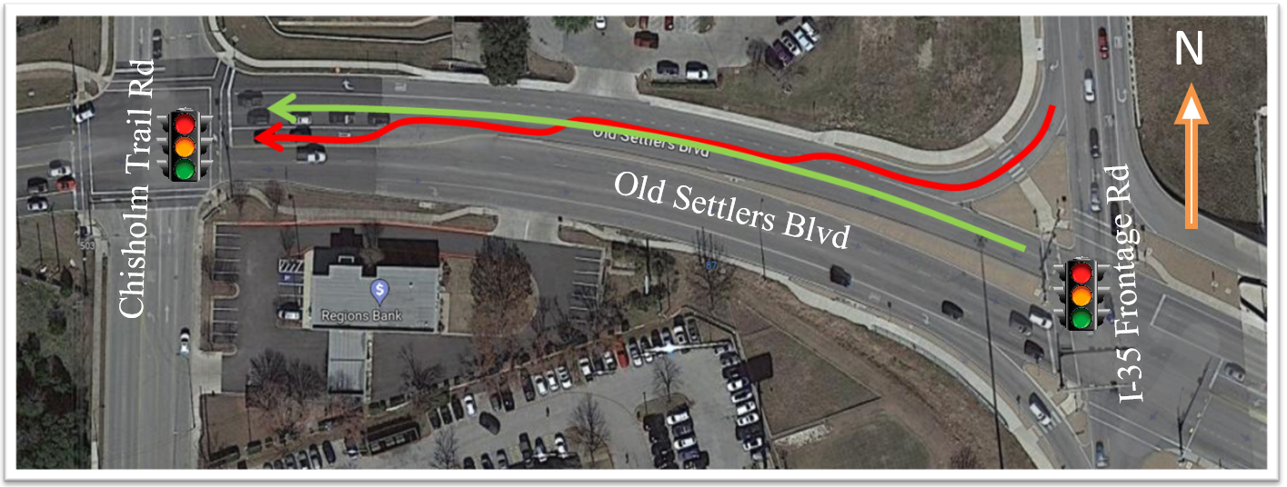
Old Settlers Blvd, Round Rock, TX
Case Study #1
The WB direction of this arterial is impacted by a weaving maneuver from an upstream unsignalized channelized right turn.
The two arrows represent two movements that conflict with one another.
N

Slide 34
Old Settlers Blvd, Round Rock, TX
Case Study #1
Urban Street Evaluation
General Information
Location: | Round Rock, TX |  |  |  |  | Analysis period: |  | 7:15 am to 7:30 am
Agency: | University of Florida |  |  |  |  | Analysis year: |  | 2023
Location: |  |  |  |  |  | Analyst: |  | Bob
Travel direction for Movement 2 at all intersections |  |  |  |  | EB | Area type: |  | Other
File name: | C:\Users\user1\Documents\NCHRP 15-66 Case Study TX
Number of analysis periods: |  |  |  |  | 1
Basic Segment Information
Segment | Cross Street Names |  |  |  | Speed Limit, mph |  | Through Lanes |  | Segment
Number | Street to West |  | Street to East |  | EB | WB | EB | WB | Length, ft
1 | Chisholm Trail RD |  | I-35 Frontage RD |  | 40 | 40 | 2 | 2 | 700
2 | I-35 Frontage RD |  | Third Avenue |  | 35 | 35 | 2 | 2 | 1800
3 | Third Avenue |  | Fourth Avenue |  |  | 35
4 | Fourth Avenue |  | Fifth Avenue
5 | Fifth Avenue |  | Sixth Avenue
6 | Sixth Avenue |  | Seventh Avenue
7 | Seventh Avenue |  | Eighth Avenue
8 | Eighth Avenue |  | Ninth Avenue
Cycle Length, s: |  | 100 |  |  | No. Intersections: |  | 2 | Total, mi: | 0.13
STREEVAL V 8.30.1 is used to model this urban street and estimate the impact of the weaving maneuver.
Site geometry is extracted from google maps
The turning volumes and signal timing are based on the data collected in this project but altered as needed to demonstrate the weaving impact.
We have used an earlier version of STREETVAL V8.30 to compare the impact of urban street weaving on key urban street performance measures.
For simplicity, the access points are not modeled in this case study to focus on the impact of the upstream unsignalized channelized right turn.

Slide 35
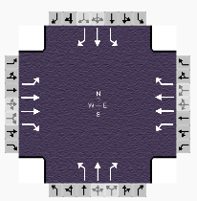
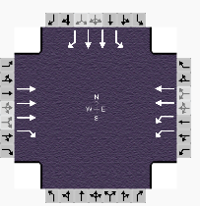
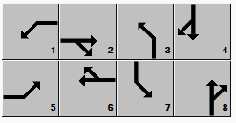
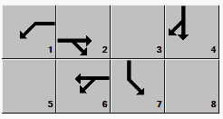
Old Settlers Blvd, Round Rock, TX
Case Study #1
Lane Geometry:
Chisholm Trail Rd
I-35 Frontage Rd
Phase Configuration:

Slide 36
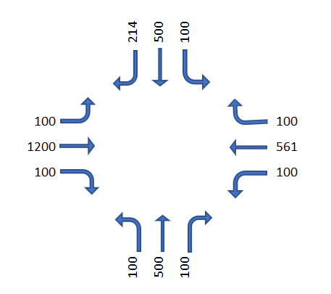
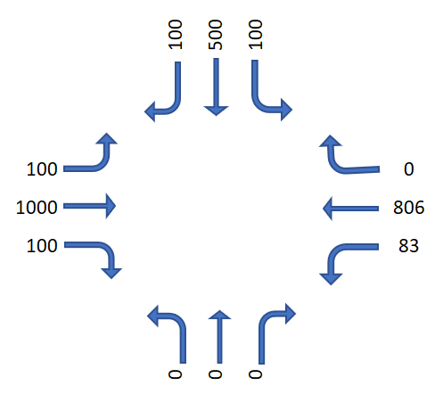
Old Settlers Blvd, Round Rock, TX
Case Study #1
Traffic Demand
Flow Rates (vph)
Chisholm Trail Rd
I-35 Frontage Rd

Slide 37
Old Settlers Blvd, Round Rock, TX
Case Study #1
The arterial weaving maneuver takes place in the EB direction.
A Turbulence Index of 36 (veh/hr)^2/ft is achieved.
Delay due to weaving is estimated to be 4.3 seconds and added to the running time.
Accounting for the impact of the weave maneuver in the EB direction, changes the LOS from D to E.
Key Urban Streets MOEs for EB Direction | Considering Delay due to Arterial Weave | Without Considering Delay due to Arterial Weave
Base Free-Flow Speed, mph | 41.41 | 41.41
Running Time, s | 18.95 | 14.52
Running Speed, mph | 25.18 | 32.87
Through Delay, s/veh | 11.51 | 11.373
Travel Speed, mph | 15.67 | 18.43
Stop Rate, stops/veh | 0.000 | 0.000
Spatial Stop Rate, stops/mi | 0.00 | 0.00
LOS | E | D
***NCHRP 15-66: TI | 38.21 | NA
***NCHRP 15-66: d_wv, sec | 4.43 | NA

Slide 38
Case Study #2 Freedom Dr, Charlotte, NC Evaluate the impact of a weaving maneuver from an access point

Slide 39
Freedom Dr, Charlotte, NC
Case Study #2
The EB direction of this arterial is impacted by a weaving maneuver from an access point with high demand (243 vph).
The two arrows represent the two selected movements that conflict with one another.
N

Slide 40
Freedom Dr, Charlotte, NC
Case Study #2
Urban Street Evaluation
General Information
Location: | Charlotte, NC |  |  |  |  | Analysis period: |  | 7:15 am to 7:30 am
Agency: | University of Florida |  |  |  |  | Analysis year: |  | 2023
Location: |  |  |  |  |  | Analyst: |  | Bob
Travel direction for Movement 2 at all intersections |  |  |  |  | EB | Area type: |  | Other
File name: | C:\Users\user1\Documents\NCHRP 15-66 Case Study NC
Number of analysis periods: |  |  |  |  | 1
Basic Segment Information
Segment | Cross Street Names |  |  |  | Speed Limit, mph |  | Through Lanes |  | Segment
Number | Street to West |  | Street to East |  | EB | WB | EB | WB | Length, ft
1 | I-85 SPUI Interchange |  | Ashley Rd |  | 45 | 45 | 3 | 4 | 1200
2 | Ashley Rd |  | Third Avenue |  | 35 | 35 | 2 | 2 | 1800
3 | Third Avenue |  | Fourth Avenue |  |  | 35
4 | Fourth Avenue |  | Fifth Avenue
5 | Fifth Avenue |  | Sixth Avenue
6 | Sixth Avenue |  | Seventh Avenue
7 | Seventh Avenue |  | Eighth Avenue
8 | Eighth Avenue |  | Ninth Avenue
Cycle Length, s: |  | 130 |  |  | No. Intersections: |  | 2 | Total, mi: | 0.23
STREEVAL V 8.30.1 is used to model this urban street and estimate the impact of the weaving maneuver.
Site geometry is obtained from google maps
The turning volumes and signal timing are based on the data collected in this project but altered as needed to demonstrate the weaving impact better.
We have used an earlier version of STREETVAL V8.30 to compare the impact of urban street weaving on key urban street performance measures.
For simplicity, the access points are not modeled in this case study to focus on the impact of upstream unsignalized channelized right turn.

Slide 41
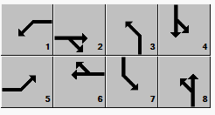
Freedom Dr, Charlotte, NC
Case Study #2
Lane Geometry:
I-85 SPUI Interchange
Ashley Rd
Phase Configuration:

Slide 42
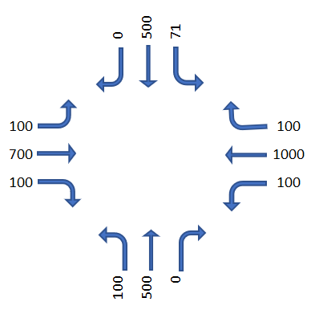
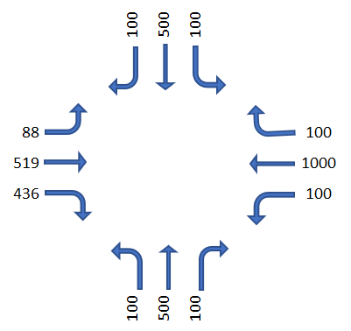
Freedom Dr, Charlotte, NC
Case Study #2
Traffic Demand
Flow Rates (vph)
I-85 SPUI Interchange
Ashley Rd

Slide 43
Old Settlers Blvd, Round Rock, TX
Case Study #2
The arterial weaving maneuver is present in the EB direction.
A Turbulence Index of 233 (veh/hr)^2/ft is achieved.
As such, the delay due to weaving is estimated to be 11 seconds and added to the running time.
Accounting for the impact of arterial weave maneuvers changes the LOS from B to D.
Key Urban Streets MOEs for WB Direction | Considering Delay due to Arterial Weave | Without Considering Delay due to Arterial Weave
Base Free-Flow Speed, mph | 43.60 | 43.60
Running Time, s | 31.41 | 19.73
Running Speed, mph | 26.05 | 41.46
Through Delay, s/veh | 4.569 | 7.118
Travel Speed, mph | 22.74 | 30.47
Stop Rate, stops/veh | 0.000 | 0.000
Spatial Stop Rate, stops/mi | 0.00 | 0.00
LOS | D | B
***NCHRP 15-66: TI | 233.23 | NA
***NCHRP 15-66: d_wv, sec | 11.67 | NA

Slide 44
Safety Analysis of Arterial Weaving Segments

Slide 45
Safety Analysis of Arterial Weaving Segments
NCHRP 15-66
Three types of safety analyses were conducted to identify the safety effects of varying geometric, volume, and traffic conditions in arterial weaving segments:
Analysis of crash data for field study sites
Analysis of conflict data for field study sites
Analysis of conflict data from a driving simulator
The goal was to:
Identify key design and safety issues that could help agencies reduce crashes along arterial weaving segments
Identify future research needs to develop methods that predict the safety performance of arterial weaving segments for inclusion in the AASHTO Highway Safety Manual (HSM)

Slide 46
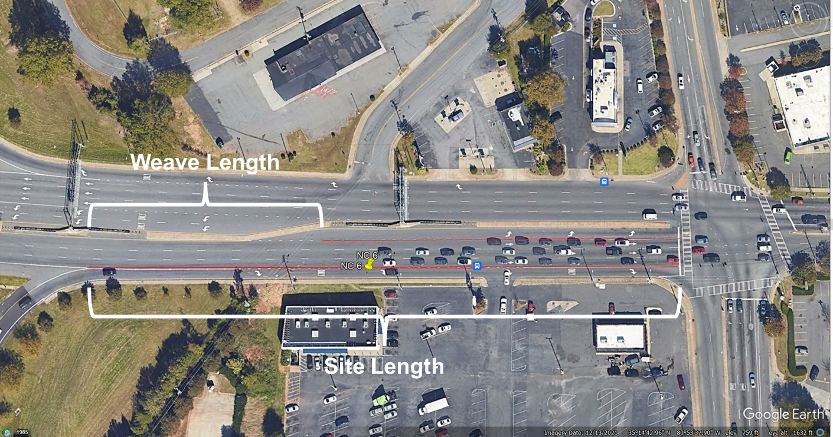
Definitions of Terms for Safety Analysis
NCHRP 15-66

Slide 47
Results of Safety Analysis
NCHRP 15-66
Results of safety analyses yielded expected results; although with a few exceptions, the parameters in the statistical models were not statistically significant:
Field Study Sites:
Analysis of crash data showed that as the ratio of the weave length to site length increases, the number of crashes decrease
Analysis of conflict data showed that as the ratio of the weave length to site length increases, the number of heavy braking (HB) conflicts decrease
Driving Simulator:
Analysis of conflict data showed that as the site length increases, the number of time-to-collision (TTC) conflicts decrease

Slide 48
Conclusions and Take Aways

Slide 49
Conclusions and Take Aways
NCHRP 15-66
The NCHRP 15-66 proposed method is capable of assessing the impact of weave maneuvers originating from:
Unsignalized channelized right turn from the upstream intersection
Right turns from access points
NCHRP 15-66 uses a newly defined term, Turbulence Index (TI), to determine the presence of arterial weave impact on predicted HCM MOEs.
NCHRP 15-66 evaluates the impact of an arterial weave on the HCM Urban Street Method by estimating its effect on the segment running time.

Slide 50
Conclusions and Take Aways
NCHRP 15-66
Based on testing the proposed method on two real work facilities in Texas and North Carolina, a significant change in the predicted MOEs found by accounting for the impact of the arterial weave.
When a channelized right turn in the upstream intersection or access points is present in the Urban Streets, it is recommended to use the proposed method within the HCM analysis to account for the potential impact of the arterial weave.
The NCHRP 15-66 research did not find any significant impact of weaving on other HCM Urban Streets performance measures such as the stop rate.

Slide 51
Conclusions and Take Aways
NCHRP 15-66
Designers should determine if there is an opportunity to close/remove mid-block access points along arterial weaving segments
Closing mid-block access points will eliminate weaving maneuvers and result in increasing the length of the weaving area along the segment
This will likely reduce potential crashes that may be attributed to weaving maneuvers
Analysis of crash and conflict data yielded sufficient information to suggest that additional research to develop methods that predict the safety performance of arterial weaving segments would yield promising results

Slide 53
The National Cooperative Highway Research Program (NCHRP) is sponsored by the individual state departments of transportation of the American Association of State Highway and Transportation Officials. NCHRP is administered by the Transportation Research Board (TRB), part of the National Academies of Sciences, Engineering, and Medicine, under a cooperative agreement with the Federal Highway Administration (FHWA). Any opinions and conclusions expressed or implied in resulting research products are those of the individuals and organizations who performed the research and are not necessarily those of TRB; the National Academies of Sciences, Engineering, and Medicine; the FHWA; or NCHRP sponsors.

