Slide 1
The following presentation is supplemental to NCHRP Web-Only Document 395: Impacts of Connected, Automated Vehicle Technologies on Traffic Incident Management Response [NCHRP Project 20-102(16)].
The National Cooperative Highway Research Program (NCHRP) is sponsored by the individual state departments of transportation of the American Association of State Highway and Transportation Officials. NCHRP is administered by the Transportation Research Board (TRB), part of the National Academies of Sciences, Engineering, and Medicine, under a cooperative agreement with the Federal Highway Administration (FHWA). Any opinions and conclusions expressed or implied in resulting research products are those of the individuals and organizations who performed the research and are not necessarily those of TRB; the National Academies of Sciences, Engineering, and Medicine; the FHWA; or NCHRP sponsors.

Slide 2
NCHRP PROJECT:20-102(16)
IMPACTS OF CONNECTED, AUTOMATED VEHICLE (CAV) TECHNOLOGIES
ON TRAFFIC INCIDENT MANAGEMENT (TIM) RESPONSE
Sept 05, 2023

Slide 3
PROJECT OBJECTIVE
The goals for the NCHRP 20-102 Task 16 project are to develop guideline materials, documents, and strategies to prepare emergency responders to join the technology development process.
Emergency responders’ perspectives and standard approaches in accommodating new technologies are incorporated into the project deliverables
This will help promote acceptance and facilitation between emergency responders and the connected, automated vehicle field.
To make this happen, we need a team that comes from both the emergency responder and connected, automated vehicle fields and has previously worked to unite both sectors in a common mission.
“Impacts of Connected, Automated Vehicle (CAV) Technologies on Traffic Incident Management (TIM) Response“

Slide 4
Guideline Document Purpose
When an incident occurs on a roadway, a multidisciplinary network of emergency responders is engaged to respond to the scene of the incident.
However, as vehicle technology advances to include more connected and automated driving features, responders are facing unprecedented circumstances and navigating many unknowns in how to engage with these vehicles―and how they should expect the vehicles to respond to their activities and procedures.
Therefore, this project aims at reaching a shared understanding of the impact of CAV technologies on TIM and emergency response, an aspect that is critical to the safe adoption of CAVs on the transportation system.
“Impacts of Connected, Automated Vehicle (CAV) Technologies on Traffic Incident Management (TIM) Response“

Slide 5
How this guide was developed…
Solicit input from TIM stakeholders. Identify emergency responders and TIM stakeholders, hold recurring meetings, and share research drafts for feedback.
Synthesize insights and findings into a series of intelligence reports and Prepare recommendations on integrating emergency response/TIM communities into the CAV technology development process.
Collect data and review literature. This includes conducting stakeholder interviews, conducting literature reviews, referencing work done in the industry prior to the onset of the project around the same topic.
Design communication products and examples of interactive tools to further the implementation of the project.
Understand the TIM timeline with the lens of CAV: This includes separating the TIM timeline into distinct pieces and looking at CAV aspects of each piece to understand the entire process.
Develop a guide to synthesize and share the information gathered in all tasks and provide recommendations to CAV and TIM communities.

Slide 6
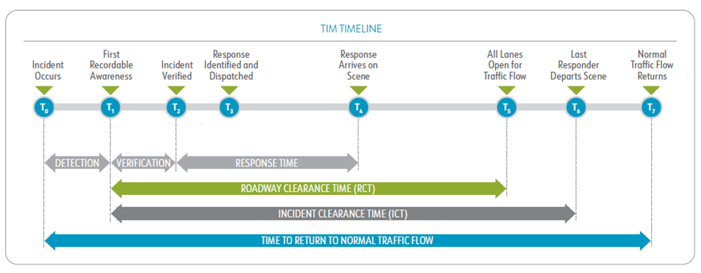
Traffic Incident Management Timeline
Traffic Incident Management or TIM is defined by USDOT as the “planned and coordinated multidisciplinary process to detect, respond to, and clear traffic incidents so that traffic flow may be restored as safely and quickly as possible” (USDOT, 2023).

Slide 7
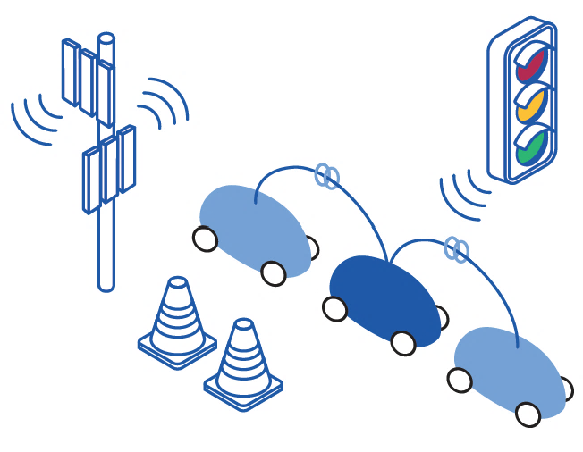
Connected Vehicles (CV)
Connected Vehicle (CV) technology refers to the suite of communication technologies that can transmit and receive data from other vehicles, nearby infrastructure, external devices, and from cloud technologies such as crowdsourcing applications or traveler information data hubs
Vehicle-to-Vehicle (V2V) is the communication between nearby vehicles, exchanging real-time data on roadway or traffic conditions, location, speed, or other vehicle and travel data.
Vehicle-to-Infrastructure (V2I or I2V) is the communication between a vehicle and surrounding roadside infrastructure. This infrastructure, equipped with intelligent transportation systems (ITS) technologies, is able to capture data about the surrounding environment (e.g., weather or traffic conditions) and transmit BSMs and other real-time data to nearby vehicles. In return, CVs are able to share their data to the ITS devices that can be monitored and managed by TMCs (e.g., enabling adjustments to signal timing).
Vehicle to Everything (V2X) encompasses all CV communications between a CV and its surroundings and sharing data to and from the cloud.

Slide 8
Automated Vehicles (AV)
Automated Vehicles (AV) are vehicles equipped with on-board sensors and equipment that enable the vehicle to perform the driving task with some to no human interaction.
SAE International established the industry standard for defining vehicle automation, using 6 levels (from Level 0-no automation to Level 5, full automation), as summarized in Figure above.

Slide 9
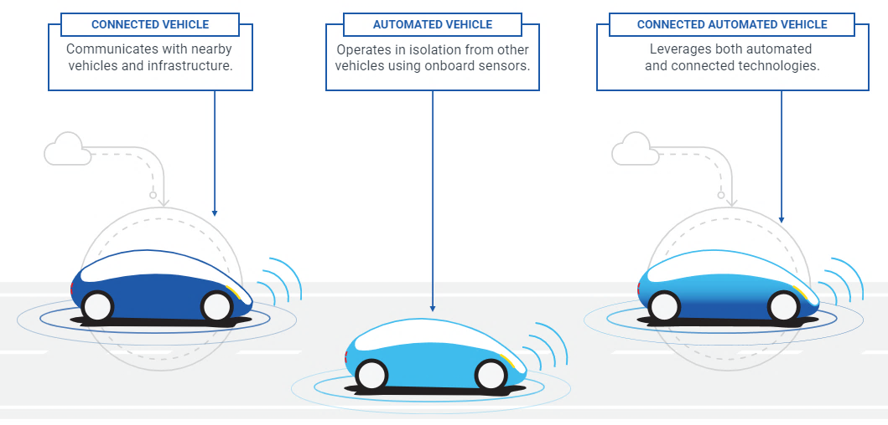
Connected and Automated Vehicles (CAV)
A Connected and Automated Vehicle or CAV includes both connective, communication technology to enable data sharing to surrounding vehicles and infrastructure (i.e., C-V2X) as well as sensors and on-board equipment (OBE) to enable the vehicle to accurately sense and respond to its surroundings and conditions.

Slide 10
THE TIES THAT BIND US
Connecting TIM and CAV partners begins with identifying the ties that bind these communities. A valuable approach to identifying these ties is to consider the overlap of their goals, resources, and activities, as shown below:
Shared Goals
Reducing the number and severity of incidents
Improving response time to improve incident outcomes and clearance time
Improving efficiency of the roadway with dynamic operations and management
Shared Resources (Data)
Vehicle data and travel data
Infrastructure and roadway feature data, including temporary traffic devices
Shared Activities
Connectivity: receiving and sharing real-time data with nearby vehicles and facilities
Responding or adapting to changes in conditions
“A Conversation Between Communities“

Slide 11
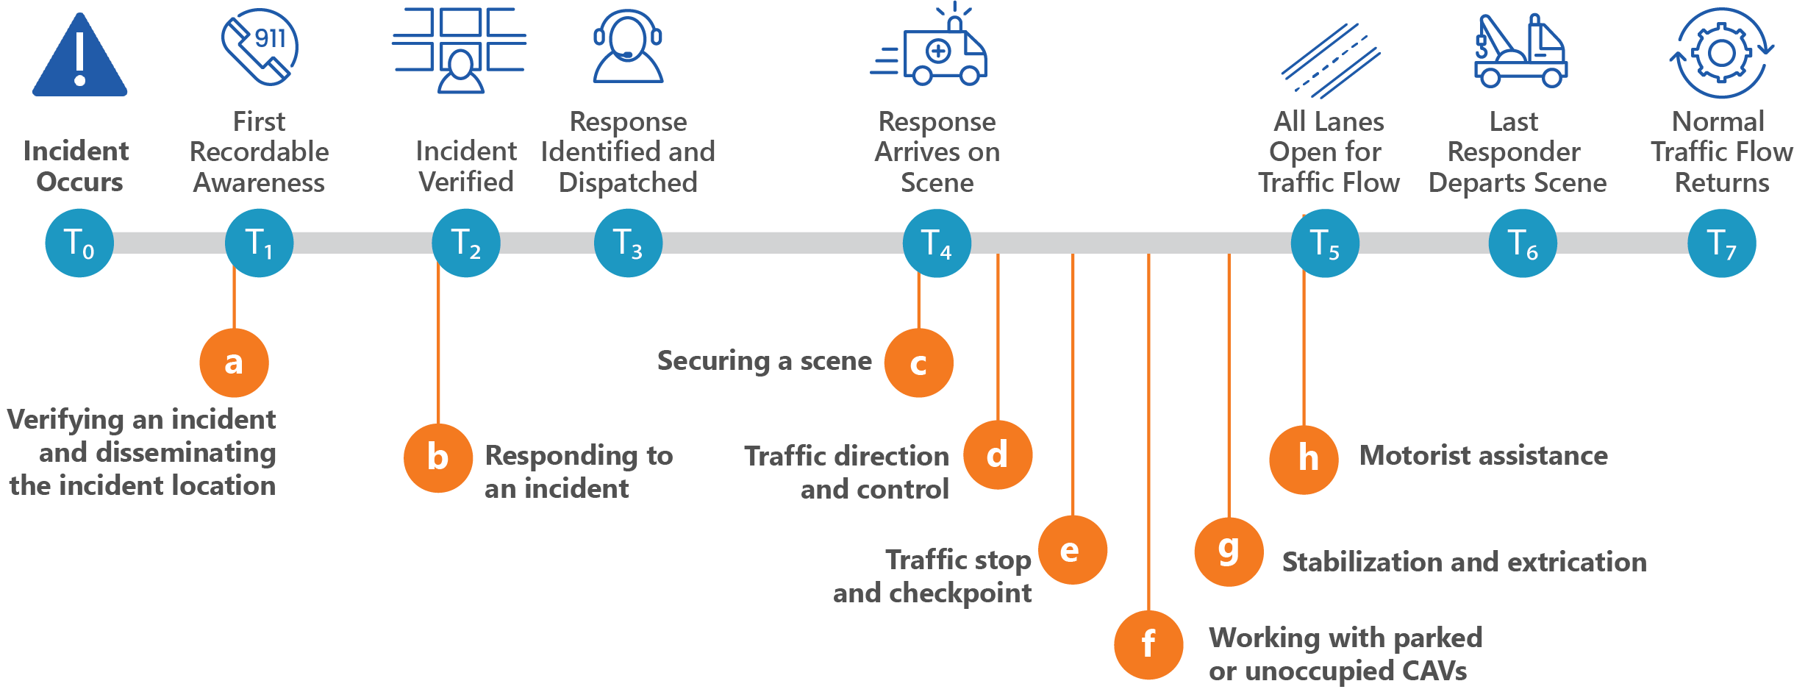
Impacts and Roles of CAV technology in TIM Scenarios
Eight Potential Interaction Scenarios

Slide 12
Traffic Incident Management Information Needs for Connected and Automated Vehicles
Information | AV Impact | CV Impact
Incident Location
Incident Location Specific location of unplanned event. | CAVs will have to adapt to incidents that were unplanned before communication devices could be deployed.
Precise Incident Location A more precise location of where the incident took place | CAVs could provide precise location of incident (i.e., orientation and location in the roadway) to emergency response personnel and directions.
AV/CV Involvement
AV/CV Involvement Whether or not a CV and or AV was involved (i.e., involved in an incident or pulled over) | Responders will have to be able to identify a CAV to report its involvement in an incident, as this information is essential for responder safety. Understanding technological abilities influences how law enforcement approaches and prepares for risks not common in standard vehicles, especially if the CAV is experiencing a software error.
Potential Hazards
Potential Hazards Details regarding active or potential hazards at the scene | CAVs may require emergency responder training to be adapted to account for other potential hazards that may arise that are exclusive to automated and connected vehicle technologies.

Slide 13
Traffic Incident Management Information Needs for Connected and Automated Vehicles
Information | AV Impact | CV Impact
Incident Information
Incident Information All incident details such as number of vehicles involved and condition, number of people and injuries, etc.. | As CAVs emerge, new problems and incidents may arise such as electrical fires, malfunctioning software, etc. | CV/CAVs could provide knowledge of optimal route (local SME, GPS navigation).
Vehicle Information Details of the vehicle(s) involved in the incident such as damage sustained, orientation, location, make, model, year, VIN, etc. | AVs may require specialized equipment to move out of the roadway to prevent more damage or other hazards based on specific vehicle protocols.
Occupant Information All information relating to occupants involved, including number of people, number and severity of injuries, condition of occupants, etc. | AV crash involvement may require responders to approach and secure the vehicle differently than a standard vehicle especially if it is experiencing a software error that causes unwarranted movement.
Driver/Occupant Information Information relating to the driver (i.e., vehicle registration, proof of insurance, license, etc.) and other vehicle information (model, year, operational status, etc.) | Determine if AV has a driver/occupant; all available contact information of occupants. | CVs may allow law enforcement to access driver information with more ease or detail (i.e., operational status, state of the driver, etc.)

Slide 14
Traffic Incident Management Information Needs for Connected and Automated Vehicles
Information | AV Impact | CV Impact
Knowledge of Resources Needed at the Incident/On-Scene
Knowledge of Resources Needed On-Scene What agencies and resources will provide the most effective response (i.e., if there are injuries EMS will be needed). | Communicate what assistance is needed and the complexity of the situation. Not only will these scenarios have to be identified but agencies must be trained and prepared to deploy the necessary resources to combat them. For example, with electric CAVs, responders will need to know details about the vehicle’s engine power (batteries or hybrid) as this will impact the firefighting resources and approach required.
Need for Extrication Whether or not occupant(s) will need to be extricated | Specific expertise may need to be deployed if an occupant is trapped inside a CAV. Manufacturers may need to provide guideline to disable the vehicle safely to avoid further injury to the occupant or response team.
Road and Optimal Route Conditions
Road and Route Conditions Current road and route conditions that may impact travel such as construction, weather, traffic, etc. | CAVs may impact travel of response vehicles and must be able to appropriately react and/or communicate to response vehicles passing. | CVs could enhance travel to an incident by providing emergency response vehicles with more detailed information regarding real-time road conditions and other vehicle movements.
Route Options Available route options to redirect traffic efficiently | CAVs may pose different requirements in choosing rerouting options to accommodate a mixed group of vehicles. This includes how routing interacts with a CAV’s ODD (e.g., can only operate in a geofenced area) and how any routing issues can be overridden through remote engagement or on-site driver engagement.
Resources and Tools to Reroute Vehicles Traffic control devices and other tools to redirect traffic | CAVs may require special equipment to communicate that rerouting and other changes in the roadway are detected and navigated safely.

Slide 15
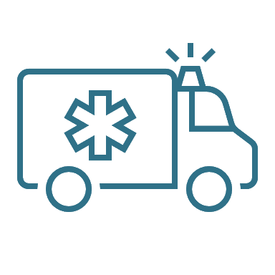
NETWORKS, ORGANIZATIONS, AND RELATIONSHIPS TO ENGAGE
Academia and
Research
Emergency Medical
Services
Towing and
Recovery
Emergency Communications
Fire and Rescue
Technology and
Telematics
Emergency
Management
Law Enforcement
Transportation
Operations

Slide 16
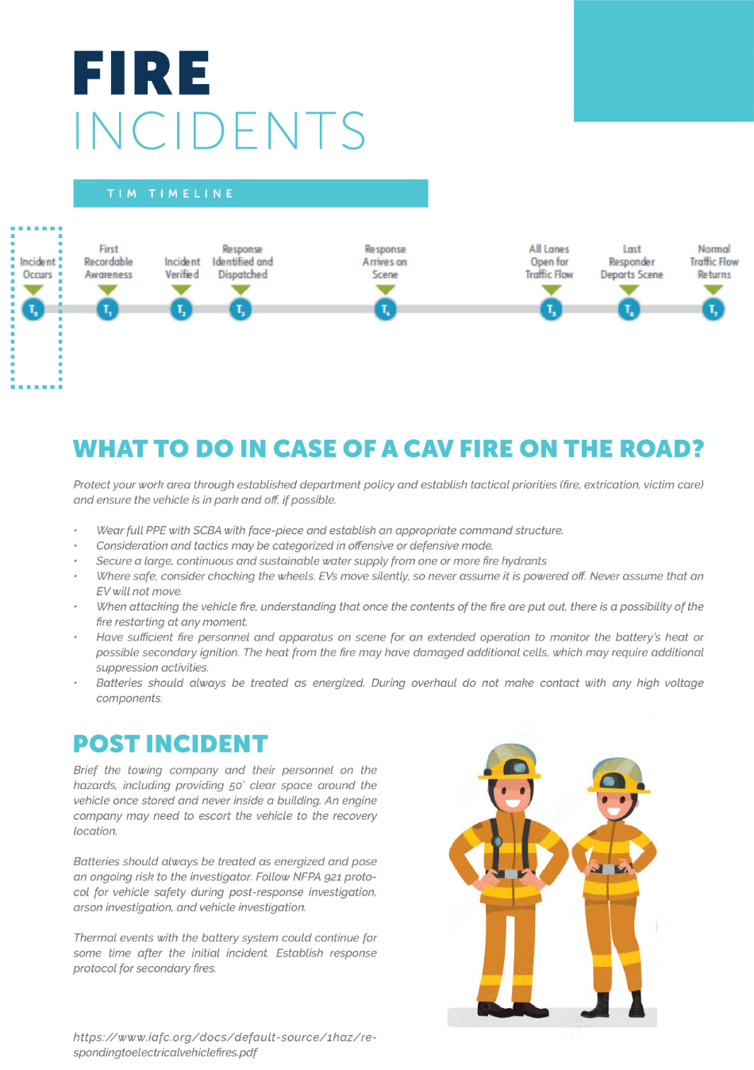
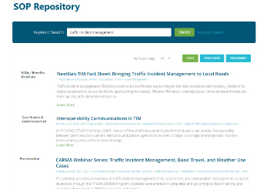
EFFECTIVE COMMUNICATION PRODUCTS TO BUILD AND DISSEMINATE
1. Single-page Flyer
2. Online SOP Repository
3. Input Form for Responders to Connect with OEMs

Slide 17
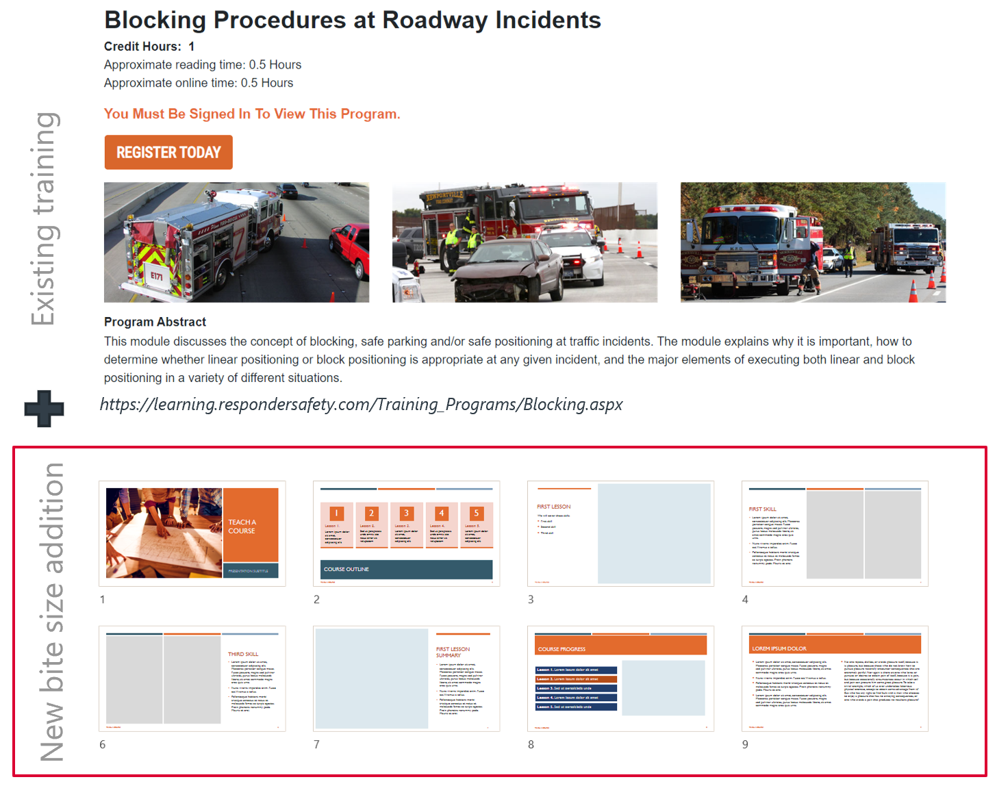
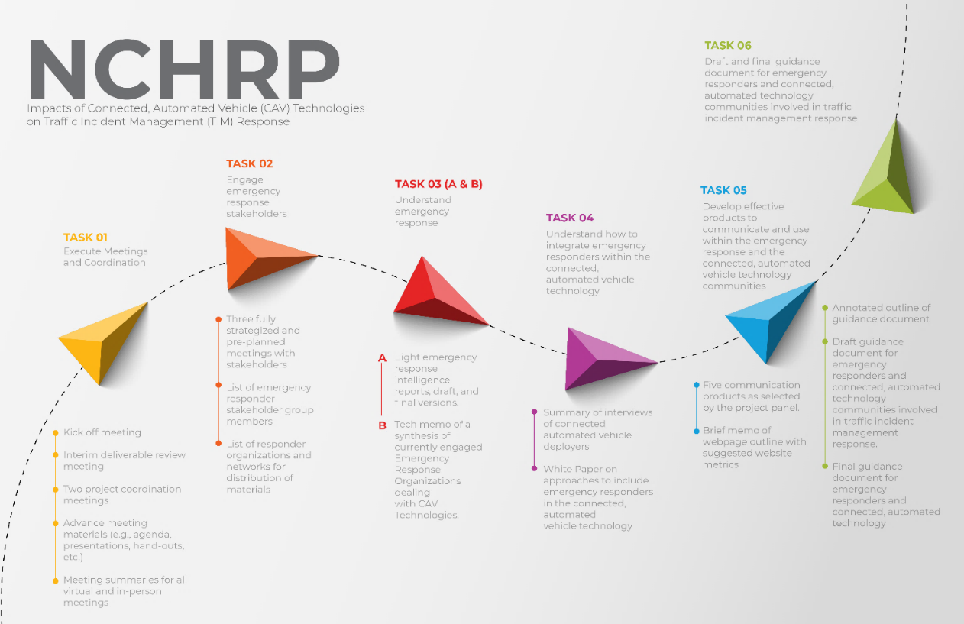
EFFECTIVE COMMUNICATION PRODUCTS TO BUILD AND DISSEMINATE
4. CAV-relevant Content for Responder Training
5. Project Overview Infographic

Slide 18
Implementation Actions
Plans in the report can be implemented through a few guiding principles such as being proactive, building meaningful coalitions, emphasizing standardization, supporting TIM-CAV relevant legislations ,expanding beyond local markets, aligning TIM-ER efforts with CAV manufacturer practices and streamlining communication flows.
The following actions will help realize the guiding principles and integrate TIM perspectives into CAV development
Standardize Processes
Standardize Data and Technology
Expand Training to Support TIM-ER Communities Identify CAVs
Update Reporting Processes
Engaging Responders for Pilot/Testing Deployments
“A Conversation Between Communities“

Slide 19
THANK YOU!

